Slide 1
Life insurance How to illustrate maximum income solve using WinFlex.
PRESENTER NAME
Subtitle
Notes:
Read directly from slide.

Slide 2
Choose among a variety of accumulation products to fit your clients’ needs.
Universal life
Indexed universal life
Variable universal life
Notes:
Read directly from slide.

Slide 3
STEP 1: Face amount
On the “Solve For” tab, select “Face Amount.”
Then select “Minimum MEC.”
Notes:
Read directly from slide.

Slide 4
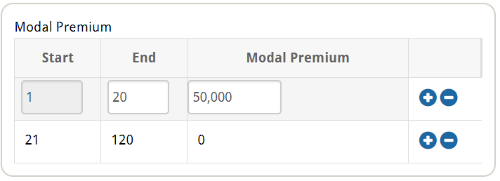
STEP 2: Premium
On the “Solve For” tab, enter the years to pay and the amount.
Notes:
Read directly from slide.

Slide 5
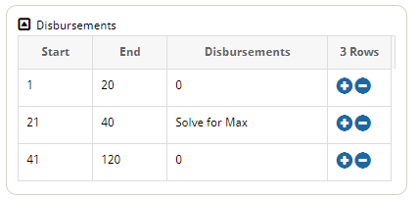
STEP 3: Disbursements
Schedule the income.
Enter the number of years for disbursements.
Use the Disbursement Option of “Switch at Basis.”
Select Life Paid Up Rider for over-loan protection.
Notes:
Read directly from slide.

Slide 6
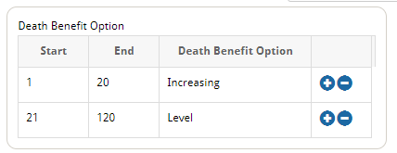
STEP 4: Death benefit option (DBO)
Select “Death Benefit Option” in “Policy Options” tab.
Select “Increasing” for the years prior to disbursements starting, and enter “Level” for the remaining time period.
Notes:
Read directly from slide.

Slide 7
Innovative automated income process Turns illustration assumptions into income reality
One-time request
Switch from DBO 2 to 1
Switch from surrenders to loans
Max. amount re-calculated
Over-loan protection triggers
Does the work for the client and you
Helps ensure maximum amount is received
Helps protect the client from tax liability
Notes:
Read directly from slide.

Slide 8
Have questions? Call the National Sales Desk at 800.654.4278
8
Notes:
Read directly from slide.

Slide 9
Principal National Life Insurance Company and Principal Life Insurance Company, Des Moines, Iowa 50392-0001 Insurance products issued by Principal National Life Insurance Company (except in NY), Principal Life Insurance Company®, and the companies available through the Preferred Product Network, Inc., Plan administrative services offered by Prinicpal Life. Referenced companies are members of the Principal Financial Group®, Des Moines, IA 50392.​ For financial professional use only. Not for use with the public. No part of this presentation may be reproduced or used in any form or by any means, electronic or mechanical, including photocopying or recording, or by any information storage and retrieval system, without prior written permission from the Principal Financial Group®. Principal®, Principal Financial Group®, and Principal and the logomark design are registered trademarks of Principal Financial Services, Inc., a Principal Financial Group company, in the United States and are trademarks and service marks of Principal Financial Services, Inc., in various countries around the world.
B12132-02 | 07/2022 | 2285689-072022 | © 2022 Principal Financial Services, Inc.
9

