Slide 1
The business life cycle and prioritizing planning
PRESENTER NAME, PRESENTER’S TITLE GOES HERE
For financial professional use only. Not for distribution to the public.
Notes:
Read from slide. Introductions.

Slide 2
Business owner research: Key findings
For financial professional use only. Not for distribution to the public.
Notes:
Read from slide.

Slide 3
Key findings: Owners and their businesses
Business protection is the number one priority for owners— and has been since 2010.
Succession planning makes the top three priority list for the first time since survey began in 2008.
Compared to last year, signficantly more owners are concerned about attracting and retaining employees.
Almost half of owners (48%) say retirement is 11 or more years away, compared to last year’s 37%.
Owner confidence grew by 10 percentage points for: “grow by adding employees” and “seek business investments.”
The number one thing preventing owners from planning for the financial health of their business is day-to-day responsibilities.
For financial professional use only. Not for distribution to the public.
Source: The 2022 Principal Business Owner Insights survey is based on 1,018 online interviews conducted in January 2022 by Dynata
Notes:
Continuing importance of business protection. Owners have ranked business protection as their highest priority since 2010.
Succession planning ranked #3—highest ever.
Compared to last year, signficantly more owners are concerned about both attracting and retaining employees. When rating concern for 16 items, availability of qualified job applicants is #2.
[optional insights to share: We've also seen a
Demographic shift: Compared to past years of this survey, there are now significantly more female owners, Millennial owners, and businesses that have been around for 10 or fewer years.
More "growing", less "established" businesses: Significantly more owners classify their business as growing, with fewer established and retrenching.] _ JJ NOTE – we should define "retrenching" for the user.

Slide 4
Key findings: Employees
Employee turnover at record levels. More than 25% of owners said employee turnover has increased over the past year, up from 20% one year ago and 15% two years ago.
When rating concern for 16 items, availability of qualified job applicants is #2. Compared to last year, significantly more owners are concerned about attracting and retaining employees.
Almost half of owners (49%) are concerned about employee mental health (67% among owners with 50+ employees).
Flexibility is critical—46% of owners are concerned about always having to be flexible/offer a remote option (64% among owners with 50+ employees).
For financial professional use only. Not for distribution to the public.
Source: The 2022 Principal Business Owner Insights survey is based on 1,018 online interviews conducted in January 2022 by Dynata
Notes:
Read from slide.

Slide 5
Key findings: Importance of employee benefits
Seven in 10 owners say the employee benefit package helps improve their ability to recruit qualified employees.
More than six in 10 owners want to offer more employee benefits.
More than seven in 10 owners say employee benefits improve retention.
Health & wellness and income protection offerings have increased since last year.
When asked how concerned are owners about various workforce issues, “affordability of employee benefits” is their #1 concern.
Two-thirds of owners say employee benefits improve productivity.
For financial professional use only. Not for distribution to the public.
Source: The 2022 Principal Business Owner Insights survey is based on 1,018 online interviews conducted in January 2022 by Dynata
Notes:
Read from slide.

Slide 6
Key findings: Key employees
40% of owners say they have 4 or more key employees—up from 35% last year.
55% want to offer more key employee benefits (66% among owners with 50+ employees).
Percentage of owners saying affordability of key employee benefits is the #1 goal has increased significantly, from 48% last year to 54%.
84% of owners say they offer key employee benefits— compared to 74% in 2017.
For financial professional use only. Not for distribution to the public.
Source: The 2022 Principal Business Owner Insights survey is based on 1,018 online interviews conducted in January 2022 by Dynata
Notes:
Read from slide.

Slide 7
Identifying priorities and solutions
For financial professional use only. Not for distribution to the public.
Notes:
Read from slide.

Slide 8
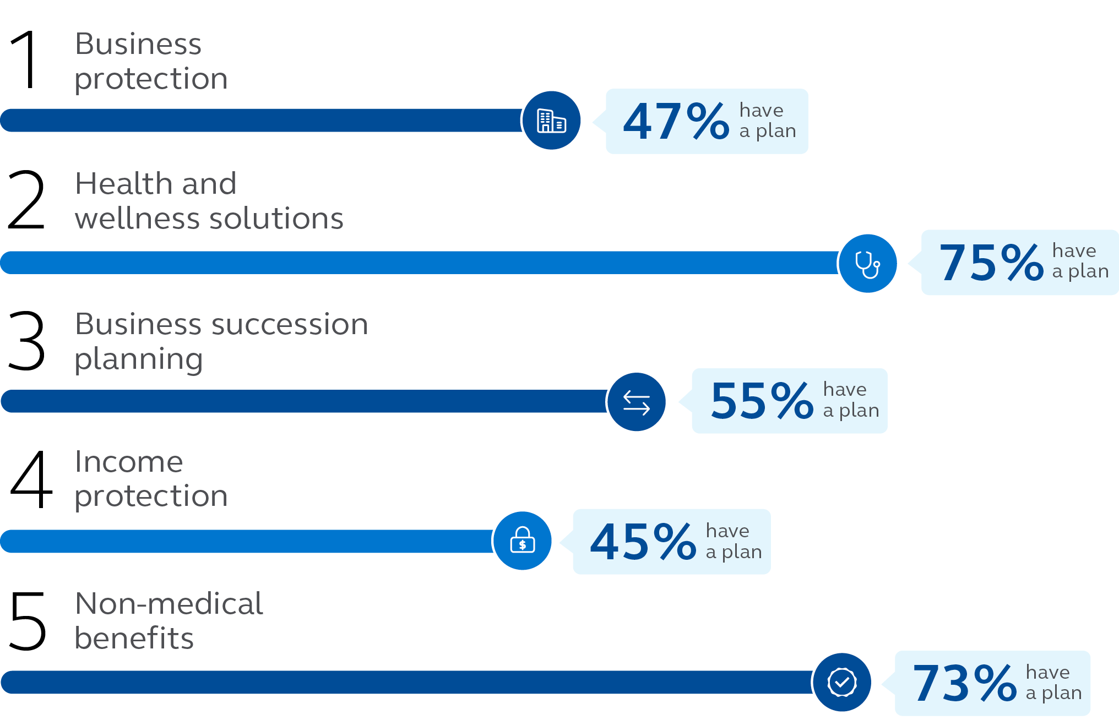
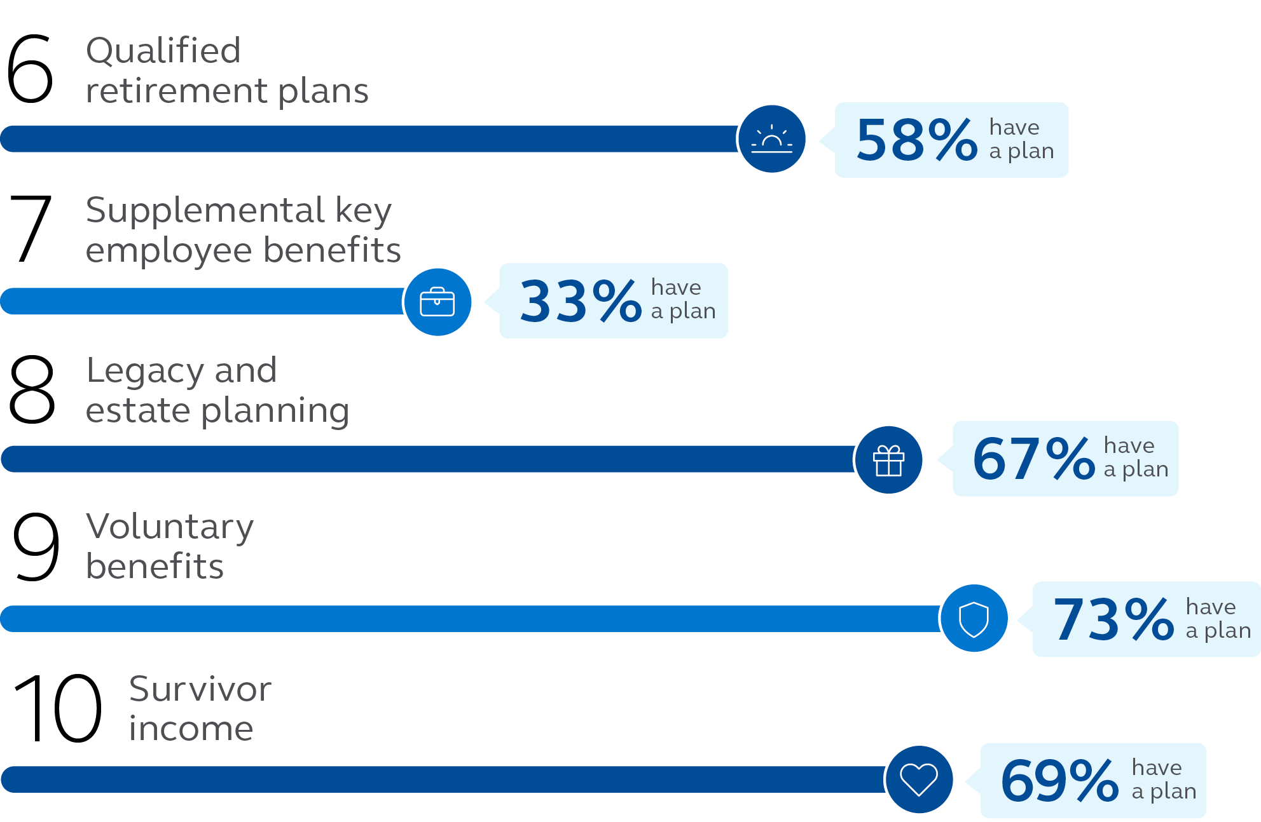
2022 snapshot of top priorities and realities
Source: The 2022 Principal Business Owner Insights survey is based on 1,018 online interviews conducted in January 2022 by Dynata
For financial professional use only. Not for distribution to the public.
Notes:
We asked business owners to rank their top priorities and whether they had a plan in place today. Even though owners rank these as important, many still need to take the next step to protect what matters most. For instance, business protection is ranked No. 1, yet less than half of owners have a plan in place.
Let’s take a closer look at each of them as they pertain to protecting your business, your employees, and your lifestyle.
Read from slide.

Slide 9
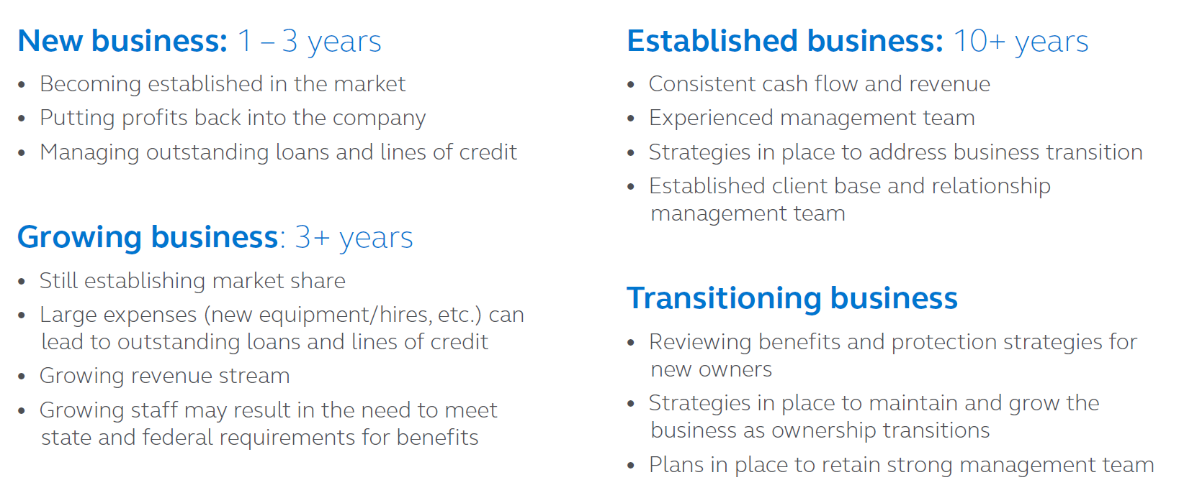
Where do you begin?
Help owners identify the stage of their business:
For financial professional use only. Not for distribution to the public.
Notes:
Read from slide.

Slide 10
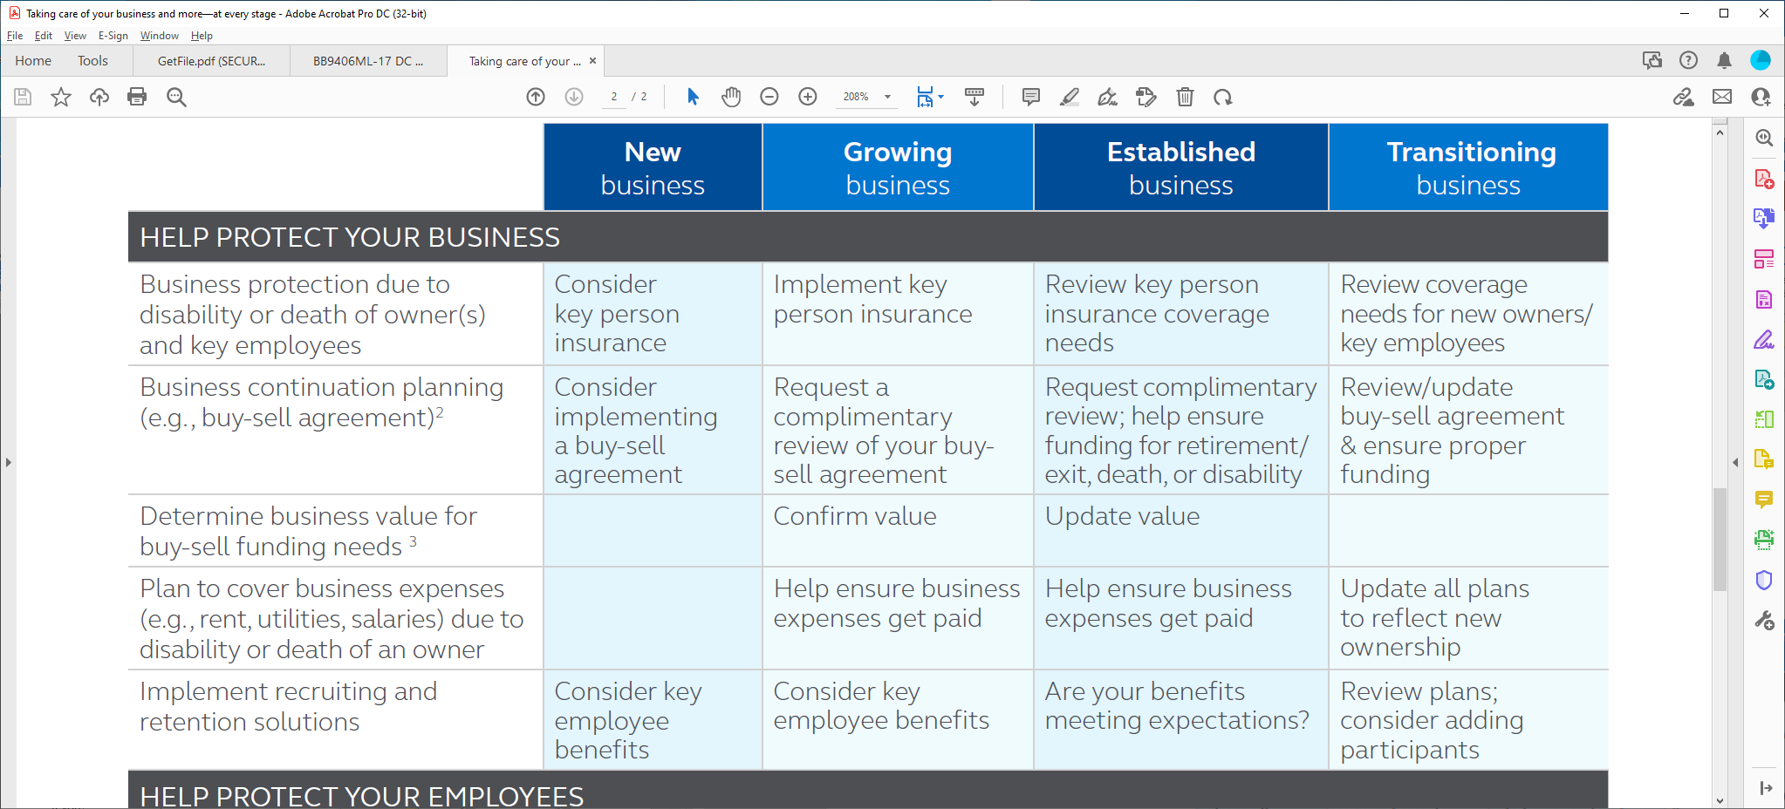
Pinpointing owners’ priorities and solutions
What are common solutions for each business stage?
A guide for addressing needs:
For financial professional use only. Not for distribution to the public.
Notes:
Read from slide.

Slide 11
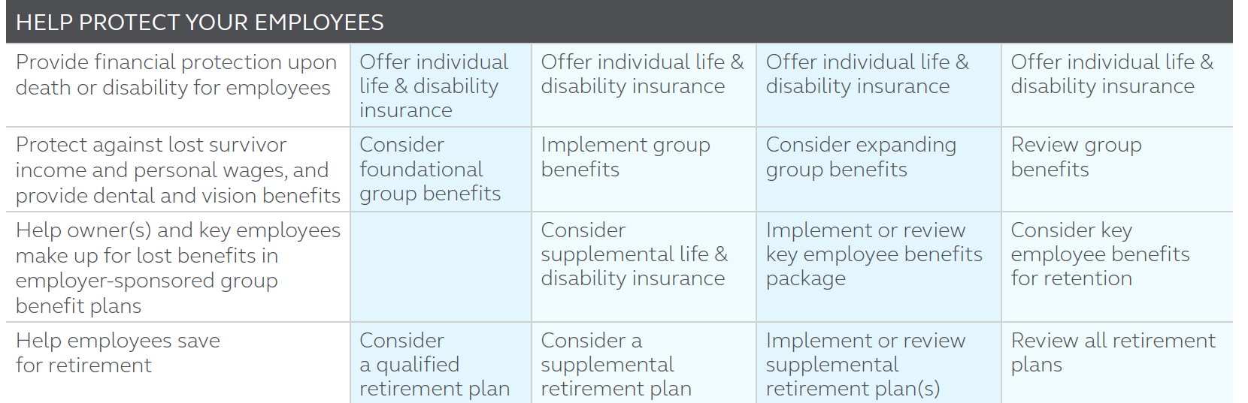
Pinpointing owners’ priorities and solutions
What are common solutions for each business stage?
A guide for addressing needs:
For financial professional use only. Not for distribution to the public.
Notes:
Read from slide.

Slide 12
Pinpointing owners’ priorities and solutions
What are common solutions for each businesses stage?
A guide for addressing needs:
For financial professional use only. Not for distribution to the public.
Notes:
Read from slide.

Slide 13
Open more doors with a few key questions
Help them protect their business
Question 1: Is your business protected with a current and well-funded buy-sell agreement?
Additional commentary: You, your family—and any other owners — need protection for both planned and unplanned events. And although succession planning was a #3 priority in our Business Owner Insights survey¹, almost half of the business owners surveyed don’t have a plan in place.
Where can you start? Offer a complimentary informal business valuation and buy-sell agreement review from Principal®.
Question 2: Do you have a strategy in place to protect your business form the loss of a key employee?
Additional commentary: Business owners have chosen business protection as their #1 priority in every Principal Business Owner Insights survey since 2010¹. Key person insurance can help protect you and your business should a key employee become disabled or die.
Where can you start? Use our Key Person Calculator to generate a proposal, complete with life and disability insurance quotes.
Notes:
Read from slide

Slide 14
Open more doors with a few key questions
Help them protect their employees
Question 1: Do your key employees value the benefits you offer? Should you review your benefits to ensure you’re keeping up with your competition?
Additional commentary: Implementing, or enhancing, your key employee benefits could be important, especially in light of the “Great Resignation” sentiment across the nation.
Where can you start? Offer a complimentary comparison with the Principal Benefit Design Tool!
Notes:
Read from slide

Slide 15
Open more doors with a few key questions
Help them protect themselves, and their lifestyle
Question 1: Is your group life and disability coverage enough to protect you and your key employees?
Additional commentary: Supplemental life and disability insurance can help you and your key employees prepare for the unexpected. Carve-out and bonus plans, funded with life and disability insurance, could help equalize the benefits for higher income earners.
Where can you start? Ask for a quote, today! We also offer Guaranteed Standard Issue (GSI) underwriting programs for those who qualify*.
*GSI DI: 5 lives or more. GSI Life: 10 lives or more. Guarantees are based upon the claims-paying ability of the issuing insurance company.
Notes:
Read from slide

Slide 16
Tools and resources to get started
For financial professional use only. Not for distribution to the public.
Notes:
Read from slide.

Slide 17
Starting the conversation
Benefit Design Tool
Show your clients how their benefits compare to businesses like theirs.
Benefit Design Tool
Planning tip: Especially during the time of the ‘Great resignation’, it’s important for your clients to know what their competition is doing.
For financial professional use only. Not for distribution to the public.
Notes:
Read from slide.

Slide 18
Starting the conversation
Key Person protection calculator
Show your clients how to protect their most valuable assets—their key employees!
Key Person Calculator
Planning tip: Determine how much they need—and the cost to provide — life and/or disability Key Person Replacement coverage for your clients.
For financial professional use only. Not for distribution to the public.
Notes:
Read from slide

Slide 19
Starting the conversation
Informal business valuation and buy-sell review services
What are these complimentary services?
An informal business valuation provides your business clients with a current value to consider for protection purposes.
A buy-sell review allows them to help ensure their buy-sell agreement is current and includes ‘best practices’.
If they don’t have a buy-sell agreement, we can provide a business continuation proposal and sample documents.
Planning tip: It’s easy to request these services! Just complete a simple fact-finder and gather three of the most recent years’ company tax returns!
For financial professional use only. Not for distribution to the public.
Notes:
Read from slide.

Slide 20
The process: approaching clients with business planning services
For financial professional use only. Not for distribution to the public.
Notes:
Read from slide.

Slide 21
Support throughout the process
Approaching your clients with business planning services
Step 1—Learn about the reports
Review the Sample Informal Business Valuation Report (PDF) (BB11286) and Sample Buy-Sell Review Summary Report (PDF) (BB9868) to get familiar with the components of these reports.
If you have questions, just call us! 833-803-8345
Step 2—Approach your clients
Do you know the value of your business? We have a team of CPAs, attorneys and financial consultants that have provided complimentary informal business valuations to more than 20,000 clients, nationally.
Top concerns for my business clients have been: growing their business, managing unexpected change, retaining employees, and eventually transitioning out of business—on their own terms.
For financial professional use only. Not for distribution to the public.
Notes:
Read from slide.

Slide 22
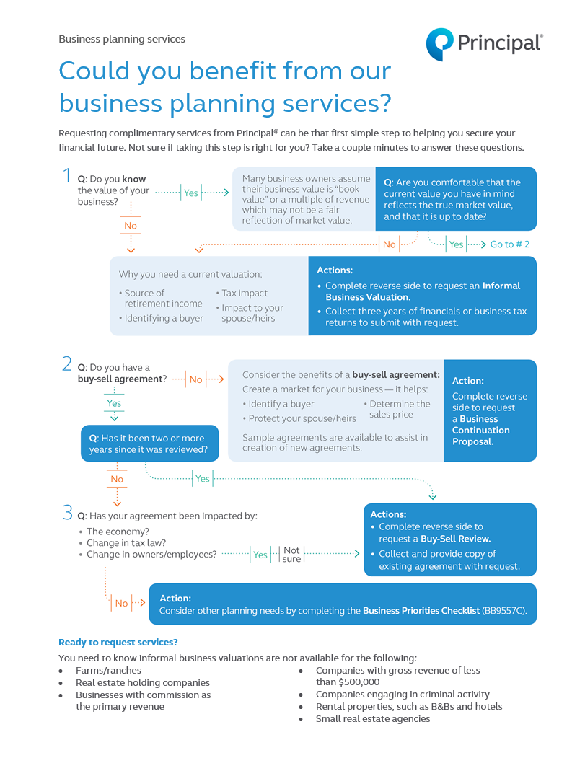
Support throughout the process
Approaching your clients with business planning services
Step 3—Factfinding and collecting documents
Complete the entire Business Valuation/Buy-Sell Review RFP/Fact Finder (DOC) (BB10847C).
Collect the most recent three full years of business tax returns.
Collect a copy of existing buy-sell agreement (if they have one) .
Ask about any existing insurance.
For financial professional use only. Not for distribution to the public.
Notes:
Read from slide.

Slide 23
Support throughout the process
Approaching your clients with business planning services
Step 4—Request the proposal/report
Send the completed Business Planning Services Fact Finder, three years of financials and/or the buy-sell agreement (if applicable) to Business and Advanced Solutions.
Send it via email to: NewRFPs@exchange.Principal.com
Five business-day turnaround on informal business valuations
Fifteen business-day turnaround on buy-sell reviews
When you receive the reports:
Review the results and schedule a call with the consultant who prepared the report.
Or call the Business Solutions hotline at 833-803-8345 for general questions.
For financial professional use only. Not for distribution to the public.
Notes:
Read from slide.

Slide 24
Support throughout the process
Approaching your clients with business planning services
Step 5—Present the proposal/report & discuss priorities
Your Business Solutions Consultant will partner with you to present the report to your client!
As your client asks questions, take note of their concerns and priorities.
When the call is done, you can discuss ‘next steps’ with your Business Solutions Consultant.
For financial professional use only. Not for distribution to the public.
Notes:
Read from slide.

Slide 25
Support throughout the process
Approaching your clients with business planning services
Step 6—Questions to ask your client
How do you replace revenue if one of your revenue generators doesn’t show up due to a death or disability? (Key person replacement – life and disability coverage)
What are you doing to differentiate your executive benefits program from your peers? (Offer a robust employee benefits package to include supplemental life and disability insurance to ‘fill any gaps’ in coverage for your owners/key employees)
Do you know how your benefits stack up against competitors? (Use the Benefit Design Tool)
How do you keep the lights on if the owner doesn’t show up because he’s too sick or injured to work? (Overhead expense coverage can help)
Are you prepared to transition out of business on your own terms? (A buy-sell agreement is key, funded with both life and disability insurance)
For financial professional use only. Not for distribution to the public.
Notes:
Read from slide.

Slide 26
Support resources Access support no matter what your client needs!
Disability insurance
Group & voluntary benefits
Life insurance
Business and Advanced Solutions
Notes:
Read from slide

Slide 27
Thank you
Insurance products issued by Principal National Life Insurance Company (except in NY), Principal Life Insurance Company®, and the companies available through the Preferred Product Network, Inc. Plan administrative services offered by Principal Life. Securities offered through Principal Securities, Inc., member SIPC, and/or independent broker/dealers. Referenced companies are members of the Principal Financial Group®, Des Moines, IA 50392.​
Disability insurance has limitations and exclusions. For cost and coverage details, contact your Principal representative.
No part of this presentation may be reproduced or used in any form or by any means, electronic or mechanical, including photocopying or recording, or by any information storage and retrieval system, without prior written permission from the Principal Financial Group®.
Not FDIC or NCUA insured. May lose value . Not a deposit. No bank or credit union guarantee. Not insured by any Federal government agency.
Principal®, Principal Financial Group®, and Principal and the logomark design are registered trademarks of Principal Financial Services, Inc., a Principal Financial Group company, in the United States and are trademarks and service marks of Principal Financial Services, Inc., in various countries around the world.
For financial professional use only. Not for distribution to the public.
BB12599 | 09/2022 | 2398812-092022 | © 2022 Principal Financial Services, Inc.
Notes:
Read from slide.

