Slide 1
Business solutions overview
Stand out in the business market
PRESENTER NAME (ALL CAPS)
Title
Notes:
Welcome and thanks for attending today’s business solutions overview.

Slide 2
Small businesses mean big business
There are more than 33.2 million small businesses¹
99.9% of U.S. firms have fewer than 500 employees¹
About 2/3 are family-owned businesses²
48% of owners of family businesses with a succession strategy plan to leave or sell the business to family²
¹ U.S. Small Business Administration Office of Advocacy, U.S. Small Business Profile, August 2022.
² 2023 Principal Business Owner Insights survey: online survey of business owners conducted by Dynata.
For financial professional use only. Not for distribution to the public.
Notes:
For more than 60 years, Principal® has focused on serving the needs, challenges, and opportunities faced by business owners—specifically small businesses. And, there are some interesting statistics I’d like to share with you around our target market.

Slide 3
Help provide the solutions they’re looking for
For their business
For their key employees
For their lifestyle
For financial professional use only. Not for distribution to the public.
Notes:
Whether you’re new to the business market, or you’ve been providing solutions for years, we offer support that can help you meet the needs of your business clients.

Slide 4
Solutions for their business Help them prepare for what lies ahead
Business protection
Key person life and disability protection
Overhead expense insurance
Business succession
Buy-sell and transfer strategies
Funding strategies with life and disability insurance solutions
Employee stock ownership plans (ESOPs)
ESOP repurchase
Key employee retention and retirement
Bonus plans
Deferred compensation plans
Split dollar plans
For financial professional use only. Not for distribution to the public.
Notes:
Business owners need to protect the integrity of their businesses in order to:
Help maintain business operations when your clients face the loss of a key employee
Key person life insurance, key person replacement disability insurance, and business overhead expense are key solutions to consider.
Preserve the value of their business when they choose to exit, by funding their succession strategies with life and disability insurance.
Provide strategies to help them better facilitate a transfer to family members, key employees, remaining owners, or third parties upon their exit.
Today the risk of losing key employees is top of mind to your business clients. Offer them solutions to recruit, reward, and retain those employees whose performance most affects the success of the company. The result will be more engaged and loyal employees.

Slide 5
Solutions for their key employees Offer employees benefits they’ve come to expect
Qualified retirement plans
401(k), traditional defined benefit or employee stock ownership plans (ESOP)
Group benefits
Dental, disability, life, vision, hospital indemnity, accident, and critical illness* insurance
Key employee benefits
Bonus plans
Deferred compensation plans
Split dollar plans
Supplemental life and disability insurance
Specified disease in NY.
For financial professional use only. Not for distribution to the public.
Notes:
Offer employees the benefits they’ve come to expect, from qualified retirement plans to key employee benefits.
Each employer will have unique needs, and at Principal, we strive to accommodate them all – Review slide.

Slide 6
Solutions for their lifestyle Help protect their way of life
Business owner strategies
Business owner retirement analysis
Family business planning
Agribusiness strategic planning
Life insurance to protect your client and their family
Disability insurance to protect their income
Legacy and estate planning
Gifting strategies
Private split dollar
Trust solutions
Charitable giving
For financial professional use only. Not for distribution to the public.
Notes:
Apart from needs directly related to their business, business owners and key employees want to maintain the lifestyle that they and their loved ones have come to know. Maybe they’re looking toward their retirement years or the legacy they want to leave. Or, maybe their goal is to protect their loved ones should they die or become disabled. We can help you get your clients' coverage to meet their needs.
Regardless of the industry, or whether your business client owns a family business, or an agricultural business, we can provide the support you need. We offer solutions to meet the lifestyle needs of all business owners, as they transition to and through retirement. We offer business owner strategies that include Business Owner Retirement Analysis, family business planning, and agribusiness strategic planning.
We also provide life and disability insurance products that can help provide protection for your clients and their families. Choose from a variety of life insurance to fit all needs and budgets. Many of our policies provide protection during their lifetime, as well as providing a survivor benefit. And we offer a variety of disability products to help protect their income.
For those with legacy and estate planning needs - we have diverse solutions as well! Whether their goal is to minimize the impact of estate taxes, or to gift business interests to their heirs, we can help.

Slide 7
Benefit from a comprehensive platform
Solutions, tools, and resources to help businesses, owners, their families, and their employees
Approaches that help open doors and uncover opportunities
Support to help you analyze, build, and close each case
For financial professional use only. Not for distribution to the public.
Notes:
Getting business cases doesn’t get easier than this. When you work with Principal, you benefit from our experienced team of sales professionals, attorneys, CPAs, and case design specialists. It’s your little secret to success in the local business insurance market.
We offer: Read slide.

Slide 8
We can help you succeed in the business market
Solutions
Experience
Service
For financial professional use only. Not for distribution to the public.
Notes:
It’s easier than ever to succeed in the business market when you have support every step of the way! We’ll help you ask the right questions and then tailor a solution to help meet the unique needs of each of your business clients. And we provide unique and flexible plan designs and implementation processes to keep things simple and streamlined.
And, as your clients’ needs evolve or tax laws change, we’re always available so you can continue to guide them throughout the life of their plans.
Once you’ve put a solution in place, our administrative plan services support you and your clients continuously, generating more sales opportunities for you and reducing hassles for both of you.
Refer to Stand out in the business market, BB11368, for a complete description of our solutions, experience, and service offerings.

Slide 9
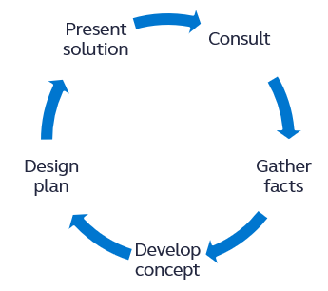
Access to business market professionals
Business & Advanced Solutions talent is comprised of JD*, CPA**, CLU, ChFC, CFP®***, AEP and MBA backgrounds
Deep experience in:
Key employee benefits
Business protection
Business succession
Legacy and estate planning
Financial modeling and product fit for financing the plan
* JD is an educational degree and holder does not provide legal services on behalf of the companies of the Principal Financial Group®.
** CPAs do not provide tax or accounting services on behalf of the companies of the Principal Financial Group.
*** Certified Financial Planner Board of Standards Inc. (CFP Board) owns the certification marks CFP®, CERTIFIED FINANCIAL PLANNERTM, CFP® (with plaque design), and CFP® (with flame design) in the U.S., which it authorizes use of by individuals who successfully complete CFP Board's initial and ongoing certification requirements.
For financial professional use only. Not for distribution to the public.
Notes:
Finding and maintaining a solution gets easier with access to business, legal, and tax consultation at every step. As clients’ needs evolve or tax laws change, help is always available to guide them throughout the life of the plan.
When you work with us, you get experienced sales support and personalized consulting every step of the way – from initial consulting and gathering facts to presenting the package to your clients.

Slide 10
Access Get personal consultation on your cases
Wholesaler relationships
Financial professional support line
Business & Advanced Solutions hotline
For financial professional use only. Not for distribution to the public.
Notes:
Current wholesaler relationships. Principal representative
Financial professional support line: 800-654-4278
Business & Advanced Solutions hotline: 833-803-8345

Slide 11
Business & Advanced Solutions hotline
Toll-free number: 833-803-8345
Menu options:
Informal business valuation or buy-sell review
Business succession (including ESOP repurchase)
Bonus, deferred comp, and other key employee benefit plans
Legacy and estate planning
Business approaches and marketing tools
A good resource for financial professionals who have business clients with needs that can be met with any of the many solutions offered by Principal.
Our hotline is staffed by consultants who focus on the business market, including CPAs, attorneys, and case design specialists. They offer pre-sale case consultation and ways to approach a business owner prospect with any of our business market solutions.
Notes:
Read the slide.

Slide 12
The right support at the right time Before the sale
Targeted approach tools to help uncover more opportunities
Business needs assessment
Complimentary informal business valuation and buy-sell review
Prioritizing business needs
Family business planning
Business owner retirement
Approaches for agribusiness, healthcare, and strategic alliances
Marketing tools and resources to help you build better cases
Access to consultants with business market focus
Support materials for each business concept
Sales ideas and approach materials
For financial professional use only. Not for distribution to the public.
Notes:
Identify and provide solutions for your clients by leveraging our sales support, approach strategies, tools, and resources.
Our digital Business Needs Assessment can be used to help your clients and prospects uncover planning needs to help protect the financial well-being of their business and prepare for the future. You can provide them a personalized assessment in three key areas: protecting their business, employees, and lifestyle.
Our complimentary Business Planning Services helps open doors and identify various business needs. And it comes with an easy to use digital RFP.
If clients need help prioritizing their needs, we’ve got you covered there, too. Our Prioritizing Business Needs includes an easy checklist to help clients determine a plan of action.
As part of the planning conversation, you can also illustrate and help clients prepare their business for every stage of its life by using our Business Life Cycle brochure.
Once you’ve identified needs and priorities, you can rely on a robust set of marketing materials to help you frame the proposed solutions.

Slide 13
The right support at the right time During the sale Get the support you need to deliver customized plans to your clients.
Customized plans using life and disability insurance
30+ innovative and popular plan designs
A range of financing options:
Life insurance: term, UL, IUL, VUL
Disability insurance: Disability Income, Disability Buy-Out, Key Person Replacement, Overhead Expense
Multiple underwriting programs: Guaranteed Issue/Guaranteed Standard Issue, Principal Accelerated Underwriting^{SM*}, Business Solutions Enhanced Underwriting
Point-of-sale assistance
Access to consultants with business market focus
Specialized business market and wholesalers
Customized proposal
For financial professional use only. Not for distribution to the public.
* Accelerated Underwriting is an expedited underwriting program offered by Principal Life Insurance Company. Applicants may qualify based on age, face amount, and personal history.
Notes:
We offer support throughout the sales process—from pre-sale consultation through plan design, product selection, and underwriting. We offer a full portfolio of products and multiple underwriting programs for all business solutions.
Your access to this differentiating service can set you apart from the competition and help you build—or enhance—strong, successful relationships with sophisticated clients.

Slide 14
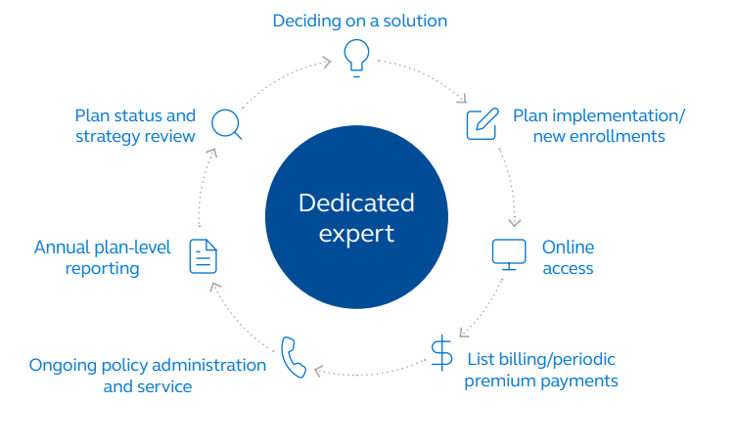
The right support at the right time After the sale Plan services keep clients coming back and keep you free to focus on building sales.
For financial professional use only. Not for distribution to the public.
Notes:
Make implementation and ongoing support easy for you and your clients with value-added assistance from our in-house plan services. See BB9441 for more details.
Read slide.

Slide 15
Leaders trust leaders
Over 24,400 plans and nearly 46,000 policies administered by BMA¹
Average BMA
premium¹= $5,763
¹ As of Sept. 30, 2023.
Notes:
Other companies may offer business solutions, but our experience and commitment set us apart.

Slide 16
Business market cases
Average premium/death benefit
Concept
Average Premium/Plan
Average Premium/Policy
Average Death Benefit/Plan
Average Death Benefit/Policy
Business market overall | $10,818 | $5,763 | $2,976,315 | $1,585,544
Key person insurance | $7,580 | $4,672 | $2,751,062 | $1,695,676
Key employee retention & retirement plans | $20,887 | $7,120 | $2,027,287 | $691,171
Buy-sell and exit planning solutions | $11,201 | $5,972 | $3,702,818 | $1,974,124
Notes:
Read the slide.

Slide 17
What are some top sales opportunities?
Address these needs with clients:
Key person protection
Buy-sell funding
Key employee benefits
For financial professional use only. Not for distribution to the public.
Notes:
Currently, our top three business market concepts are key person protection, buy-sell plan funding, and key employee benefits. If you have clients that want to safeguard their key employees, use our easy calculator to help determine how much life and disability insurance they need for each employee and a price quote.
If buy-sell funding is needed, easily generate sales with our complimentary informal valuation and buy-sell review or business continuation proposal. These tools can help clients identify and fund unmet financial needs.
Some business clients may also have key employees that need help filling their retirement gap.

Slide 18
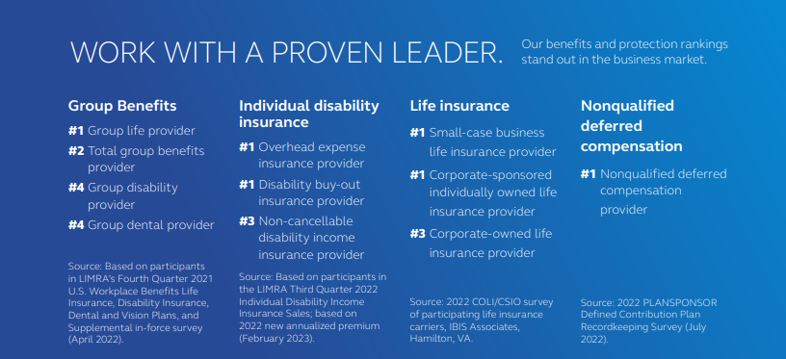
Why choose Principal?
For financial professional use only. Not for use with consumers or the public.
Notes:
Read slide.

Slide 19
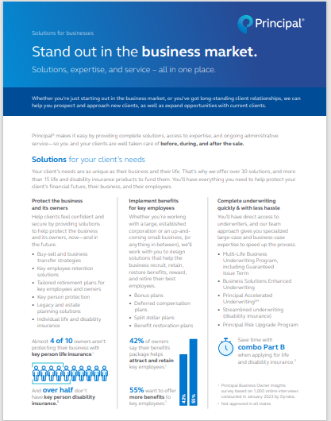
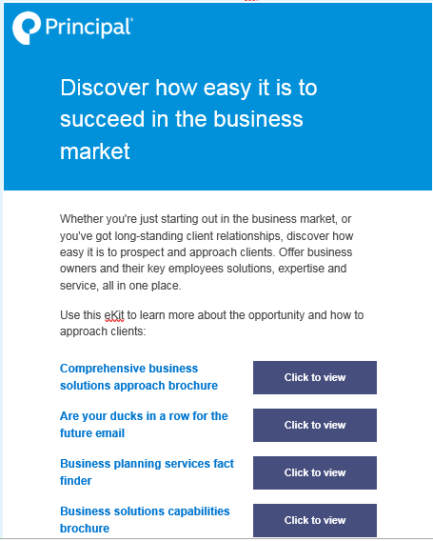
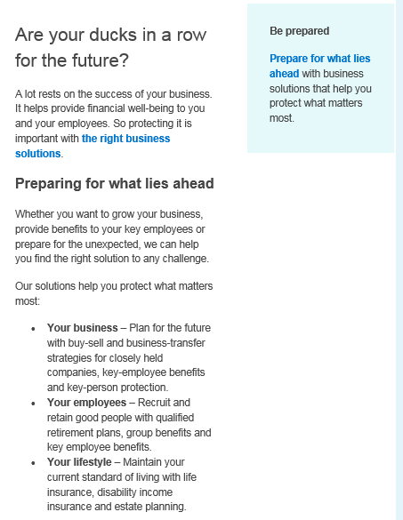
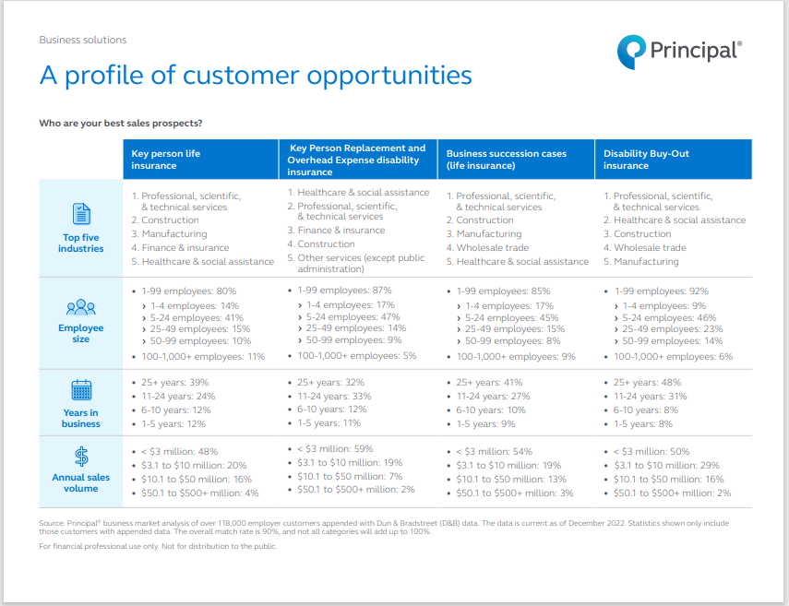
Resources to tell the story
For employers and key decision makers
For financial professionals
Brochure that demonstrates our broad business market solutions capabilities (BB11957)
Capabilities brochure (BB11368)
eKit
(LF827)
Email that approaches employers about finding solutions to challenges. (LF807)
Customer profiles flyer (BB11233)
For financial professional use only. Not for distribution to the public.
Notes:
Read the slide.

Slide 20
Let’s connect
Contact your wholesaler or the Business and Advanced Solutions hotline at 833-803-8345.
Visit us at advisors.principal.com.
For financial professional use only. Not for distribution to the public.
Notes:
Are there any questions I can address for you before we go?

Slide 21
Insurance products issued by Principal National Life Insurance Company (except in NY), Principal Life Insurance Company®, and the companies available through the Preferred Product Network, Inc. Plan administrative services provided through Principal Life Insurance Company®. Securities offered through Principal Securities, Inc., member SIPC, and/or independent broker/dealers. Referenced companies are members of the Principal Financial Group®, Des Moines, IA 50392.​
No part of this presentation may be reproduced or used in any form or by any means, electronic or mechanical, including photocopying or recording, or by any information storage and retrieval system, without prior written permission from the Principal Financial Group®.
Not FDIC or NCUA insured. May lose value . Not a deposit. No bank or credit union guarantee. Not insured by any Federal government agency.
Principal®, Principal Financial Group®, and Principal and the logomark design are registered trademarks of Principal Financial Services, Inc., a Principal Financial Group company, in the United States and are trademarks and service marks of Principal Financial Services, Inc., in various countries around the world.
For financial professional use only. Not for distribution to the public.
BB11336B-05 | 11/2023 | 3223422-112023 | © 2023 Principal Financial Services, Inc.
Notes:
[Leave on screen long enough for people to read.]

