Slide 1
Insights to help you plan for the future
2024 Principal® Business Owner Insights
PRESENTER NAME, PRESENTER’S TITLE GOES HERE
Notes:
Read slide. Introductions.

Slide 2
About the survey
Dynata conducted 1,020 online interviews January 8-18, 2024.
Respondents qualified to take the survey if they met the following criteria:
Own a business with between 2-499 employees
Own at least 5% of the business
Actively manage the business
Currently employed, either full time, part time, or self-employed
United States resident, age 21 or older
Non-profit organizations weren’t included
We’ve surveyed business owners since 2008
This year's survey was conducted by Dynata, January 8-18, 2024
Statistically significant differences compared to 2024 are highlighted throughout
Results are weighted based on the number of employees and annual sales. Potential respondents were selected from those who agreed to participate in Dynata surveys. Because the sample is based on those who agreed to be invited to participate, no estimates of theoretical sampling error can be calculated.
Notes:
Read slide.

Slide 3
Key findings
Notes:
Read slide.

Slide 4
Key findings: overall
Business protection is the number one priority for owners—and has been since 2010.
Voluntary benefits received highest ranking since inception of survey in 2008.
A record number of owners classify thir business as growing – more than doubling since 2015.
A record 72% have been in business 10 years or less.
Offering EAPs and emotional/mental wellness programs have reached record high levels.
More than 6 in 10 own a family business.
Notes:
Read slide.

Slide 5
Key findings: Employee benefits
​For the first time, employee feedback is #1 influence in employee benefit decisions.
Owners are offering benefits at record levels since 2008.
7 in 10 owners say benefits improve retention, recruiting and productivity.
6 in 10 owners say they’d like to offer additional employee benefits.
Notes:
Read slide.

Slide 6
Key findings: Owners, their business, and key employees
A record 7 in 10 have a succession plan to protect their business at the death of an owner.
Confidence in their succession plan is at its peak​.
The most popular succession strategy is to gift the business to family.
98% have key employees, and 46% want to offer more key employee benefits.
A record number of owners say retirement is 11 or more years away (62%).
A need for more capital, being too busy, and not sure where to start are what keeps owners from planning for the financial health of their business.
Notes:
Read slide.

Slide 7
Prioritization of benefits
Notes:
Read slide.

Slide 8
Business protection remains top priority since 2010
Owners rank the employee benefits and business owner solutions similar to last year, with voluntary benefits receiving their highest ranking since the survey started in 2008.
2008 | 2010 | 2012 | 2015 | 2017 | 2019 | 2021 | 2022 | 2023 | 2024
Group Medical Benefits | Business Protection | Business Protection | Business Protection | Business Protection | Business Protection | Business Protection | Business Protection | Business Protection | Business Protection
Business Protection | Group Health Benefits | Health & Wellness Solutions | Income Protection | Income Protection | Health & Wellness Solutions | Health & Wellness Solutions | Health & Wellness Solutions | Health & Wellness Solutions | Health & Wellness Solutions
Qualified Retirement Plans | Income Protection | Income Protection | Health & Wellness Solutions | Health & Wellness Solutions | Income Protection | Income Protection | Succession Planning | Income Protection | Income Protection
Group Life, Disability, Dental, Vision | Qualified Retirement Plans | Qualified Retirement Plans | Qualified Retirement Plans | Non-Medical Benefits | Qualified Retirement Plans | Succession Planning | Income Protection | Succession Planning | Succession Planning
Income Protection | Group Non-Medical Benefits | Non-Medical Benefits | Non-Medical Benefits | Qualified Retirement Plans | Non-Medical Benefits | Qualified Retirement Plans | Non-Medical Benefits | Non-Medical Benefits | Non-Medical Group Benefits
Supplemental Retirement Income | Supplemental Retirement Income | Supplemental Key Employee Benefits | Wealth Transfer | Supplemental Key Employee Benefits | Legacy & Estate Planning | Non-Medical Benefits | Qualified Retirement Plans | Qualified Retirement Plans | Voluntary Benefits
Vol. Supplementary Employee Benefits | Voluntary Benefits | Voluntary Benefits | Supplemental Key Employee Benefits | Exit Planning | Succession Planning | Supplemental Key Employee Benefits | Supplemental Key Employee Benefits | Supplemental Key Employee Benefits | Supplemental Key Employee Benefits
Survivor Income | Wealth Transfer | Wealth Transfer | Survivor Income | Survivor Income | Supplemental Key Employee Benefits | Legacy & Estate Planning | Legacy & Estate Planning | Voluntary Benefits | Qualified Retirement Plans
Wealth Transfer | Survivor Income | Survivor Income | Voluntary Benefits | Wealth Transfer | Survivor Income | Voluntary Benefits | Voluntary Benefits | Legacy & Estate Planning | Survivor Income
Exit Planning | Exit Planning | Exit Planning | Exit Planning | Voluntary Benefits | Voluntary Benefits | Survivor Income | Survivor Income | Survivor Income | Legacy & Estate Planning
2024 Answering: 1,020 SMB owners
Q930 Please rank the following employee benefits and business owner solutions in order of importance from 1 to 10, based on your priorities as a business owner.
Notes:
Read slide. Highlight how ranking changes (or doesn’t for some) over the 10 waves of this survey.

Slide 9
Priorities and realities
Notes:
Read slide.

Slide 10
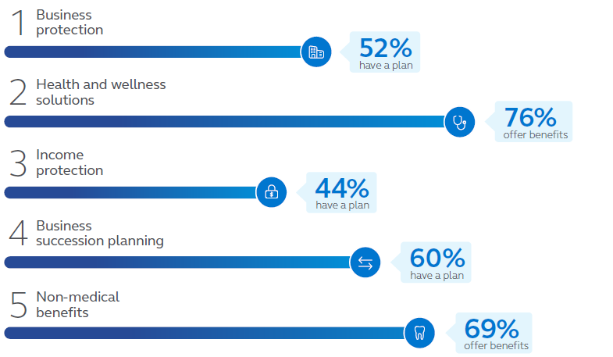
2024 Snapshot of top priorities and realities
Notes:
We asked business owners to rank their top priorities and whether they had a plan in place today. Even though owners rank these as important, many still need to take the next step to protect what matters most. For instance, business protection is ranked No. 1, just over half of owners have a plan in place.

Slide 11
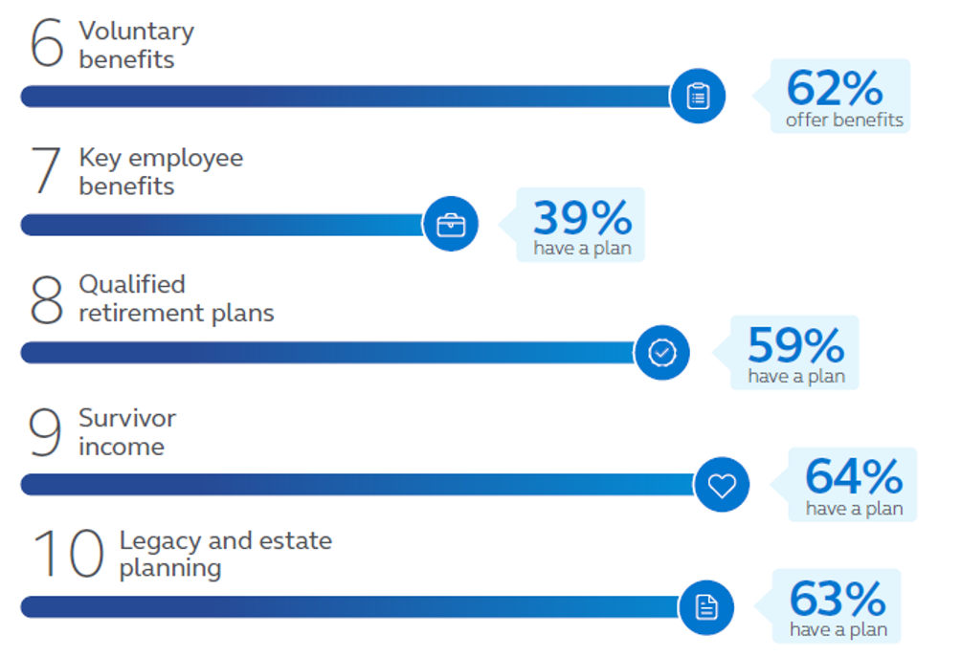
2024 Snapshot of top priorities and realities
Notes:
Read slide.
Let’s take a closer look at each of them as they pertain to protecting your business, your employees, and your lifestyle.

Slide 12
Potential solutions for your employees Stay competitive by offering benefits.
Notes:
Read slide.

Slide 13
Solutions for your employees
Health and wellness (#2 priority)
Employer-sponsored programs that provide health-related benefits and organized activities to help employees maintain or improve their health.
What the survey said:
Comprehensive health insurance remains the most common - 60% offer it.
Employee assistance programs (EAP) and emotional/mental wellness programs showed growth and are offered at record high levels.
Planning tip: These solutions can work together to keep employees healthy and working and can be a valuable part of the benefits you offer to attract and retain employees.
Notes:
Read slide.

Slide 14
Solutions for your employees
Qualified retirement plans (#8 priority)
Retirement solutions, including 401(k) plans and traditional defined benefit plans, that are available to all eligible employees.
What the survey said:
The 401(k) plan continues to be the most popular (53%).
Employee Stock Ownership Plans (ESOP) are at a record high with 22% of owners saying they have one.
Planning tip: Principal offers expertise in the major plan types, as well as service – to make it easier on you to maintain the plan. Your financial professional can help you choose retirement benefits that work for your employees and your business.
Notes:
Read slide.

Slide 15
Solutions for your employees
Non-medical (#5 priority) and voluntary benefits (#6 priority)
Offered at the worksite, they can be employer-paid or employee-paid (voluntary) and typically include benefit options like dental, disability, life, vision, critical illness*, and accident insurance.
What the survey said:
Business owners are offering many employee benefits at record levels.
7 out of 10 say benefits improve employee retention, recruiting, and productivity.
Dental insurance is the most common - 60% offer it.
Planning tip: These benefits can be designed to fit your needs and budget. Principal® Benefit Design Tool can help benchmark your benefits with similarly sized companies in your region and industry.
*Specified disease in New York
Notes:
Read slide.

Slide 16
Solutions for your employees
Key employee benefits (#7 priority)
Typically targeted to select (key) employees who are critical to the success of the business.
What the survey said:
Life insurance is the most common (46%), followed by disability income insurance (43%), retirement protection disability coverage (30%), and deferred comp (28%).
When looking at what benefits to offer these employees, affordability and ability to attract/retain are key considerations.
Planning tip: Principal can help find a plan to fit your business type and overall goals with funding options tailored to your needs.
Notes:
Read slide.

Slide 17
Potential solutions for your business Help protect the future of your business.
Notes:
Read slide.

Slide 18
Solutions for your business
Business protection (#1 priority)
Helps safeguard the integrity, cash flow, and value of the business if there’s an unexpected event like death or disability of a key employee or business owner.
What the survey said:
Among owners with a plan in place, key person life and disability insurance are the most popular.
A record number have disability overhead expense insurance.
Planning tip: Principal can help calculate the value of a key employee and then offer insurance solutions to help protect the business in the event of a death or disability.
Notes:
Read slide.

Slide 19
Solutions for your business
Business succession planning (#4 priority)
Formal agreements help ensure everyone involved is on same page when it comes time to transition the business.
What the survey said:
More than 6 in 10 own a family business.
The most popular succession strategy is to sell and/or gift the business to family members (48%).
Planning tip:
Consider funding vehicles – like savings and/or insurance – to help exercise the plan.
Identify sources for retirement income if your strategy is to gift the business to family. Principal can provide a personalized Business Owner Retirement Analysis to help.
Notes:
Read slide.

Slide 20
Potential solutions to help protect your lifestyle Help protect yourself and your family.
Notes:
Read slide.

Slide 21
Solutions for your lifestyle
Income protection (#3 priority)
Helps replace a portion of income and provides continuous cash flow if you’re too sick or hurt to work.
What the survey said:
A record number have individual disability income insurance (47%).
Planning tip: Individual disability income insurance can provide you with monthly payments when you’re too sick or hurt to work. Find out what you need to protect your income and how much it might cost using this simple calculator: principal.com/dicalc
Notes:
Read slide.

Slide 22
Solutions for your lifestyle
Legacy and estate planning (#10 priority)
When properly funded, these plans and/or agreements can help ensure there are assets – both personal and business – to help meet your lifetime objectives.
What the survey said
Wills remain the most common strategy (54%).
Family trusts, family limited partnerships, and irrevocable life insurance trusts (ILIT) are at record high for the 10 times this survey has been done starting in 2008.
Planning tip: Be sure to review your will and other plans annually to make sure they still accurately reflect how you want your assets distributed. Provisions of the Tax Cuts & Jobs Act of 2017, sunset 12/31/25.
Notes:
Read slide.

Slide 23
Solutions for your lifestyle
Survivor income (#9 priority)
Life insurance provides for your family in the event of death and can also be used to achieve certain financial objectives.
What the survey said
Almost two-thirds of business owners have individual life insurance in place to help protect their family.
A record high 41% use business assets to help pay for it.
Planning tip: Be sure to consider the type of life insurance you buy – both term and permanent insurance can help meet your objectives. Find out how much life insurance you need and how much it might cost with this simple calculator: principal.com/lifecalc.
Notes:
Read slide.

Slide 24
Business planning
Notes:
Read slide.

Slide 25
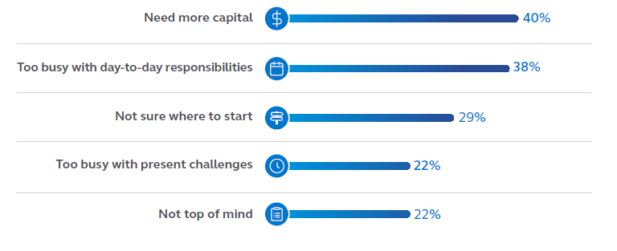
What stops business owners from planning?
When it comes to planning for the financial health of their business, owners say they need capital, they’re too busy, or they don’t know where to start. Lack of a financial professional as a barrier is now at a record high (20%).
Top 5 responses:
Principal® Business Needs Assessment is an online tool to help you assess where you stand today.
Notes:
We learned that business owners, like you, are tight for time, and business and financial planning isn’t likely at the top of their daily to do list --- but it should be. Can you relate to this? [read slide]
Taking the first step can feel intimidating or maybe overwhelming. The Principal® Business Needs Assessment is an online resource that can help you get started.
Financial professional version of Principal Business Needs Assessment: https://life.employers.principal.com/needs/assessment/advisor?utm_source=advisor&utm_medium=banner&utm_campaign=businessneedsassessment_advisor_2021

Slide 26
Do you have the right team helping you?
Notes:
Read slide.
Adding a financial professional whose expertise is in insurance and investments can provide a more robust team working for you.

Slide 27
A more detailed look at some key findings
Notes:
Read slide.

Slide 28
Survey history
Online survey of business owners conducted by Dynata from January 8-18, 2024.
Qualifications:
Own at least 5% of the business and actively involved in making business decisions
U.S. resident aged 21 or older
Non-profits excluded
Sample size by year:
# of employees | 2008 | 2010 | 2012 | 2015 | 2017 | 2019 | 2021 | 2022 | 2023 | 2024
2 to 9 | 130 | 104 | 101 | 100 | 205 | 206 | 201 | 201 | 200 | 200
10 to 49 | 126 | 102 | 103 | 106 | 200 | 205 | 203 | 204 | 200 | 201
50 to 99 | 90 | 103 | 100 | 101 | 200 | 202 | 202 | 201 | 200 | 211
100 to 199 | ^ combined | 101 | 100 | 99 | 200 | 205 | 202 | 206 | 200 | 208
200 to 499 | 77 | 101 | 100 | 101 | 200 | 202 | 203 | 206 | 200 | 200
Total | 423 | 511 | 505 | 507 | 1,005 | 1,020 | 1,011 | 1,018 | 1,000 | 1,020
Notes:
Read slide

Slide 29
Owners offering each benefit/solution
Record high
Compared to last year, supplemental key employee benefits show a directional increase, with usage now at a record high. Significantly fewer owners have legacy & estate plans.
Non-Med/Voluntary
Health & Wellness
Survivor Income
Legacy & Estate Planning
Succession Planning
Qualified Retirement
Business Protection
Income Protection
Key Employee Benefits
Significant increase since 2023
Significant decrease since 2023
2024 Answering: 1,020 SMB owners
Notes:
Read slide – highlight trends over time. Record high for Business Protection and Key Employee Benefits.

Slide 30
The number who say benefits improve employee retention has decreased (although still high).
2024 Answering: 1,020 SMB owners
Q9080 Do you think your employee benefits package helps improve the productivity of your workforce?
Q9081 Do you think your employee benefits package helps improve the retention of your workforce?
Q9082: Do you think your employee benefits package helps improve your ability to recruit qualified employees?
Significant increase since 2023
Significant decrease since 2023
Notes:
Read slide.

Slide 31
Owners & their business
Notes:
Read slide.

Slide 32
#1
#2
#3
Four in ten owners say needing more capital keeps them from planning for the financial health of their business
Record high
Lack of a financial professional as a barrier is now at a record high. This is significantly more common among Hispanics (36%), the construction industry (32%), women (27%), those in business 5-10 years (26%), and owners with 2-9 employees (23%).
Planning distractions | 2015 | 2017 | 2019 | 2021 | 2022 | 2023 | 2024
Need more capital | 37 | 29 | 32 | 26 | 36 | 44 | 40
Too busy with day-to-day responsibilities | - | - | - | - | 38 | 36 | 38
Not sure where to start | 21 | 22 | 23 | 22 | 26 | 31 | 29
Too busy with present challenges | 40 | 30 | 29 | 29 | 29 | 29 | 22
Not top of mind | 34 | 25 | 26 | 23 | 25 | 23 | 22
No financial professional | 12 | 16 | 12 | 17 | 14 | 12 | 20
Not sure which financial professional to turn to | - | 13 | 15 | 12 | 15 | 16 | 17
Not sure which carrier to turn to | 15 | 12 | 14 | 14 | 15 | 18 | 16
Financial professional not knowledgeable | 8 | 14 | 12 | 16 | 15 | 13 | 14
Financial professional hasn’t contacted me | 6 | 13 | 13 | 16 | 16 | 9 | 14
There’s nothing preventing me from planning | 52 | 45 | 43 | 41 | 36 | 31 | 30
Being unsure keeps owners from planning
2024 Answering: 732 SMB owners (those answering “nothing prevents me” were removed from the analysis)
Q9045_2 What, if anything, prevents you from taking the time to plan for the financial health of your business? Please select all that apply
Significant increase since 2023
Significant decrease since 2023
Notes:
Read slide.

Slide 33
#1
#2
#3
Confidence in business goals remains high
Several items show record high confidence, and two items - growth by adding employees and seeking business investments - show significant increases.
Record high
Total somewhat + very confident | 2015 | 2017 | 2019 | 2021 | 2022 | 2023 | 2024
Achieve business stability | 82 | 91 | 92 | 87 | 86 | 88 | 89
Maximize profits | 77 | 83 | 85 | 78 | 81 | 86 | 87
Reach revenue milestone | 62 | 70 | 78 | 68 | 73 | 84 | 83
Change business model to adjust to shifting demands | - | - | - | 72 | 73 | 83 | 77
Grow by adding employees | 40 | 54 | 54 | 50 | 60 | 65 | 70
Grow by expanding into new markets | 44 | 54 | 60 | 54 | 63 | 68 | 67
Grow by adding contractors | 29 | 45 | 48 | 46 | 53 | 58 | 61
Seek business investments | 27 | 34 | 42 | 42 | 52 | 55 | 60
Start new business | 21 | 28 | 29 | 30 | 39 | 40 | 42
Grow by adding partners | 16 | 28 | 31 | 32 | 37 | 35 | 33
Sell business | 21 | 29 | 28 | 31 | 31 | 24 | 24
2024 Answering: 1,020 SMB owners
Q9030 How confident are you in achieving each of these business goals in the next five years?
Significant increase since 2023
Significant decrease since 2023
Notes:
Read slide.

Slide 34
Record high
A record 72% of business owners have been in business 10 years or less
<10 years
11+ years
72
67
57
34
39
37
28
28
33
43
66
61
63
72
Significant increase since 2023
2024 Answering: 1,020 SMB owners
Q9015 Which of the following best describes how long your current business has been open?
Significant decrease since 2023
Notes:
Read slide.

Slide 35
A record number of owners classify their business as “growing”
Record high
Business owners who classify their business as growing have more than doubled since 2015.
2024 Answering: 1,007 SMB owners (those answering “not sure” were excluded from the analysis)
Q9075_1 What business life cycle do you think your business is in?
Significant increase since 2023
Significant decrease since 2023
Notes:
Read slide.

Slide 36
A record 62% of owners say retirement is 11+ years away
Record high
This makes sense as Baby Boomers retire (the second largest generation) and Millennials take over as owners (the largest generation).
2024 Answering: 957 SMB owners (those answering “not sure” were excluded from the analysis)
Q1145_2 When do you plan to retire?
No significant differences
Notes:
Read slide.

Slide 37
More than six in ten own a family business
2024 Answering: 608 SMB owners with more than one owner in Q900
Q9005 Do you consider your business to be family owned?
No significant differences
Notes:
Read slide.

Slide 38
Virtually all owners have key employees
Almost 4 in 10 have 4+ key employees (on par with last year).
Total with key employees
Total with 4+
Key employees
98
98
99
97
96
97
99
99
97
96
37
39
40
35
34
35
36
29
23
21
2024 Answering: 1,020 SMB owners
Q905 How many key employees do you have in your company? Please include yourself as the business owner as well as any other
employees you consider key.
No significant differences
Notes:
Read slide.

Slide 39
Potential solutions for the business, the employees, and the owner
Notes:
Read slide.

Slide 40
Solutions for the
business
Notes:
Read slide.

Slide 41
Business Protection
#1
#2
#3
Key person life insurance remains the most common business protection solution
Record high
Usage of key person disability has increased, and disability overhead expense is at record level.
Types of protection solutions | 2010 | 2012 | 2015 | 2017 | 2019 | 2021 | 2022 | 2023 | 2024
Key person life insurance | 78 | 57 | 63 | 57 | 71 | 60 | 57 | 61 | 58
Key person disability insurance | 31 | 35 | 42 | 47 | 57 | 44 | 51 | 43 | 53
Disability overhead expense | 15 | 19 | 20 | 30 | 37 | 36 | 41 | 43 | 45
Significant increase since 2023
Significant decrease since 2023
2024 Answering: 722 SMB owners (those answering “none” and “not sure” were removed from the analysis )
Q1100_2 Which of the following types of plans does your company have in place to help protect your business due to death, disability or termination of an owner or key employees? Please select all that apply.
Notes:
Read slide.

Slide 42
Business Protection
#1
#2
#3
Increasingly more owners are protecting their business debt with disability insurance
Record high
 | 2015 | 2017 | 2019 | 2021 | 2023 | 2024
YES (TOTAL) | 56 | 65 | 70 | 74 | 72 | 71
Yes, I have life insurance | 53 | 58 | 63 | 69 | 65 | 64
Yes, I have disability insurance | 22 | 30 | 38 | 26 | 31 | 34
NO (TOTAL) | 44 | 35 | 30 | 28 | 29 | 30
No, but I’m planning to purchase life insurance | 7 | 6 | 9 | 8 | 13 | 12
No, not interested in protecting the debt with insurance | 34 | 25 | 18 | 15 | 13 | 11
No, but I’m planning to purchase disability insurance | 4 | 5 | 5 | 6 | 6 | 10
Significant increase since 2023
Significant decrease since 2023
2024 Answering: 882 SMB owners (those answering “no business debt” were removed from the analysis )
Q9085_2 Have you protected your business debt with insurance? Please select all that apply..
Notes:
Read slide.

Slide 43
Business Succession Plans
#1
#2
#3
A record seven in ten owners have plans in place to continue their business in case of their death
Record high
Planning distractions | 2015 | 2017 | 2019 | 2021 | 2022 | 2023 | 2024
Death | 65 | 66 | 64 | 63 | 50 | 64 | 70
Disability | 42 | 54 | 58 | 49 | 56 | 61 | 57
Retirement | 45 | 46 | 52 | 37 | 52 | 52 | 50
Involuntary termination | 23 | 23 | 27 | 19 | 25 | 31 | 30
Voluntary termination | 25 | 15 | 25 | 18 | 26 | 28 | 26
Other | 3 | 4 | 6 | 6 | 4 | 3 | 5
2024 Answering: 783 SMB owners (those answering “none” and “not sure” were removed from the analysis)
Q1120_2 Does your company have plans in place to help continue the business if any of the following events happens to an owner or key person? Please select all that apply.
Significant increase since 2023
Significant decrease since 2023
Notes:
Read slide.

Slide 44
Business Succession Plans
Most owners with a succession plan fund the plan with business cash flow
#1
#2
#3
Record high
Planning distractions | 2015 | 2017 | 2019 | 2021 | 2022 | 2023 | 2024
Business cash flow | 50 | 51 | 59 | 62 | - | 69 | 68
Life insurance | 56 | 46 | 44 | 44 | - | 40 | 43
Disability buy-out insurance | 19 | 18 | 17 | 14 | - | 17 | 17
Accumulation sinking fund | 9 | 17 | 14 | 16 | - | 14 | 16
Other | 8 | 4 | 7 | 7 | - | 7 | 5
2024 Answering: 771 SMB owners with a succession plan in Q1120 and “none removed”
Q9090_2 How is the plan funded? Please select all that apply.
No significant differences
Notes:
Read slide.

Slide 45
Business Succession Plans
Most owners with a succession plan have reviewed it within the past two years
Compared to last year, significantly more say their plan hasn’t been reviewed in the past two years.
Significant increase since 2023
2024 Answering: 761 SMB owners who have a plan for exit (those answering “not sure” were removed from the analysis)
Q9095_2 When was the plan last reviewed?
Significant decrease since 2023
Notes:
Read slide.

Slide 46
Business Succession Plans
Record high
Gifting the business to family members remains the most popular succession strategy
NEW
NEW
46
Significant increase since 2023
2024 Answering: 770 SMB owners (those answering “not sure” and “I’m not planning to leave” were removed from the analysis)
Q1150 What is your business succession strategy for your business when/if you leave?
Significant decrease since 2023
Notes:
Read slide.

Slide 47
Business Succession Plans
Of those who plan to gift or sell the business to family, more than eight in ten say the family is prepared
47
2024 Answering: 360 SMB owners who would gift or sell business to family
Q1150_1 How well prepared is your family member(s) to succeed you in managing the business if needed today?
Notes:
Read slide.

Slide 48
Business Succession Plans
Record high
Of the close to half who’ve had their business valued, most of those were done in the past two years
LAST ASKED IN 2021, PUT BACK IN FOR 2024
2024 Answering: 1,020 SMB owners
Q9100 Have you had your business valued?
LAST ASKED IN 2021, PUT BACK IN FOR 2024
2024 Answering: 278 SMB owners (those answering “not sure” were removed from the analysis)
Q9110 When was the valuation conducted?
48
Notes:
Read slide.

Slide 49
Business Succession Plans
While confidence in succession plans remains very high, it’s lower compared to last year
Total confident
90
95
88
93
88
90
88
Reasons for being
very confident in their plan:
49
2024 Answering: 697 SMB owners who have an exit strategy (those answering “not sure” were removed from the analysis)
Q9115 How confident are you in your business succession strategy?
2024 Answering: 378 SMB owners who are very confident in their exit strategy
Q9116 Why are you [INSERT ANSWER FROM Q9115] about your business succession strategy? [TEXT BOX]
Significant increase since 2023
Significant decrease since 2023
Notes:
Read slide.

Slide 50
Solutions for the employees
Notes:
Read slide.

Slide 51
Health and Wellness Solutions
#1
#2
#3
Usage of EAPs and emotional/mental wellness programs have reached record highs
Record high
Top benefits | 2015 | 2017 | 2019 | 2021 | 2022 | 2023 | 2024
Comprehensive health insurance | 74 | 72 | 78 | 60 | 54 | 62 | 60
Non-traditional perks (additional time off, flexible hours, etc.) | - | - | - | - | 40 | 35 | 38
Health Savings Accounts | 35 | 43 | 50 | 46 | 34 | 44 | 40
Wellness solutions | 27 | 37 | 44 | 37 | 34 | 38 | 38
Employee Assistance Programs (EAP) | - | - | - | 33 | 30 | 37 | 38
Emotional and mental wellness programs | - | - | - | 7 | 30 | 39 | 40
Other | 16 | 9 | 11 | 12 | 6 | 4 | 4
2024 Answering: 912 SMB owners (those answering “none” and “not sure” were removed from the analysis)
Q945_2 Which of the following health and wellness solutions does your company current offer? Please select all that apply.
No significant differences
Notes:
Read slide.

Slide 52
Non-Medical and Voluntary Benefits
#1
#2
#3
Owners are offering many employee benefits at record levels
Record high
Top benefits | 2010 | 2012 | 2015 | 2017 | 2019 | 2021 | 2022 | 2023 | 2024
Dental insurance | 26 | 38 | 36 | 45 | 47 | 48 | 51 | 59 | 60
Paid Family & Medical Leave | - | - | - | - | - | 46 | 50 | 56 | 56
Vision insurance | 20 | 36 | 31 | 40 | 40 | 46 | 46 | 55 | 56
Maternity leave | - | - | - | - | - | 45 | 48 | 57 | 55
Wellness benefits | - | - | - | 33 | 32 | 43 | 46 | 52 | 54
Short-term disability insurance | 23 | 36 | 33 | 38 | 41 | 41 | 42 | 48 | 51
Health Savings Accounts | - | - | - | - | - | 43 | 41 | 50 | 51
Accident insurance | 14 | 29 | 30 | 41 | 44 | 41 | 44 | 53 | 52
Life insurance | 26 | 38 | 36 | 43 | 42 | 46 | 46 | 52 | 49
Financial wellness benefits | - | - | - | - | - | - | - | 47 | 49
Critical illness insurance* | 7 | 24 | 23 | 34 | 34 | 39 | 40 | 47 | 49
Paternity leave | - | - | - | - | - | 37 | 40 | 50 | 48
Long-term disability insurance | 19 | 32 | 32 | 36 | 37 | 38 | 40 | 47 | 46
52
2024 Answering 1,020 SMB owners
Q1005 Does your company currently offer [INSERT] as an employee benefit?
*Specified disease in New York
No significant differences
Notes:
Read slide.

Slide 53
Qualified Retirement Plans
#1
#2
#3
401(k) plans remain #1
Record high
Plans offered | 2008 | 2010 | 2012 | 2015 | 2017 | 2019 | 2021 | 2022 | 2023 | 2024
401(k) plan | 56 | 60 | 68 | 66 | 71 | 68 | 57 | 54 | 64 | 53
401(k) employer contributions | - | - | - | - | - | - | 41 | 37 | 37 | 47
ESOP | 2 | 5 | 5 | 6 | 9 | 7 | 17 | 21 | 21 | 22
Cash balance plan (new) | - | - | - | - | - | - | - | - | - | 19
Profit sharing | 28 | 20 | 22 | 30 | 24 | 27 | 24 | 25 | 23 | 17
Simple IRA | 20 | 16 | 12 | 8 | 19 | 20 | 16 | 11 | 19 | 17
Defined benefit | 6 | 6 | 7 | 9 | 12 | 17 | 15 | 14 | 13 | 16
Money purchase plan | 3 | 3 | 6 | 4 | 9 | 13 | 12 | 14 | 12 | 14
Simplified Employee Pension (SEP) | 16 | 9 | 12 | 11 | 11 | 16 | 12 | 14 | 15 | 12
53
Significant increase since 2023
2024 Answering: 824 SMB owners (those answering “none of these” and “not sure” were removed from the analysis)
Q1060_2 Which of the following qualified retirement plans does your company currently offer? Please select all that apply.
Significant decrease since 2023
Notes:
Read slide.

Slide 54
Key Employee Benefit Plans
#1
#2
#3
Life insurance is the most offered key employee benefit, and usage of several other key employee benefits has increased.
Record high
Plans offered | 2008 | 2010 | 2010 | 2015 | 2017 | 2019 | 2021 | 2022 | 2023 | 2024
Life insurance for key employees | - | - | - | - | - | - | - | - | - | 46
Disability income ins. for key employees | - | - | 33 | 42 | 33 | 50 | 35 | 44 | 35 | 43
Retirement protection disability coverage | - | 25 | 29 | 22 | 21 | 30 | 17 | 21 | 23 | 30
Deferred comp – acct balance | 33 | 26 | 23 | 16 | 25 | 18 | 22 | 22 | 21 | 28
Deferred comp – future benefit | 11 | 35 | 21 | 18 | 30 | 26 | 27 | 29 | 27 | 27
Executive bonus plan | 33 | 33 | 30 | 30 | 30 | 27 | 26 | 24 | 22 | 23
Split dollar | 18 | 6 | 18 | 7 | 9 | 9 | 6 | 7 | 9 | 12
54
Significant increase since 2023
2024 Answering: 751 SMB owners (those answering “none of these” and “not sure” were removed from the analysis)
Q1080_2 Which of the following key employees benefit plans does your company currently offer? Please select all that apply.
Significant decrease since 2023
Notes:
Read slide.

Slide 55
Key Employee Benefit Plans
#1
#2
#3
More than half say affordability is the number one goal of offering benefits to their key employees.
Record high
Top answers | 2017 | 2019 | 2021 | 2022 | 2023 | 2024
Affordability | 50 | 50 | 48 | 54 | 54 | 51
Ability to attract/retain KEY employees | 48 | 44 | 45 | 43 | 42 | 39
Taking care of my KEY employees | 39 | 42 | 36 | 41 | 41 | 38
Increasing productivity of workforce | 26 | 28 | 26 | 26 | 32 | 31
Helping KEY employees maximize benefits to achieve financial security | 30 | 31 | 27 | 28 | 28 | 29
Offering benefits KEY employees ask for | 20 | 22 | 22 | 28 | 29 | 23
KEY Employee knowledge of benefits | 23 | 24 | 24 | 29 | 30 | 22
Offering a variety of solutions | 14 | 17 | 19 | 21 | 23 | 21
Bring benefit levels up to a more equivalent % of salary (new) | - | - | - | - | - | 21
Remaining competitive | 22 | 23 | 26 | 25 | 26 | 20
Percent who offer key employee benefits | No influences
2017 | 74%
2019 | 77%
2021 | 81%
2022 | 84%
2023 | 87%
2024 | 87%
55
2024 Answering: 930 SMB owners (those answering “company doesn’t provide ee benefits” and “NA” were removed from the analysis)
Q1081_2 What goals are you trying to achieve with your company’s key employee benefit package? Please select all that apply.
Significant increase since 2023
Significant decrease since 2023
Notes:
Read slide.

Slide 56
Key Employee Benefit Plans
Most owners would like to offer more benefits to their key employees
2021
2022
2023
2024
5 5
55
55
46
Want to offer
more benefits
to key employees:
401(k) plan/a better match
Vacation/PTO/sick leave
Health/better health insurance
Top benefits owners
want to offer
key employees:
2024 Answering: 1,011 SMB owners with key employees
Q1082 Would your company like to offer more benefits to your key employees than you currently do?
56
2024 Answering: 458 SMB owners answering yes in Q1082 and giving an answer
Q1084 Which additional benefits would you like to offer your company’s key employees? [TEXT BOX]
Significant increase since 2023
Significant decrease since 2023
Notes:
Read slide.

Slide 57
Potential solutions for the
owner
Notes:
Read slide.

Slide 58
Income Protection
Record high
A record number of owners have individual disability income insurance
2024 Answering: 977 SMB owners (those answering “not sure” were removed from the analysis)
Q1195_2 Do you have individual disability income insurance in place to protect you in the event of a prolonged illness or injury?
No significant differences
Notes:
Read slide.

Slide 59
Survivor Income
Record high
Almost two-thirds have individual life insurance in place to protect their family in case of their death
Of those with individual life insurance, more than four in ten use business assets to finance their life insurance needs.
Have individual life insurance
Use business assets to finance this need
2024 Answering: 997 SMB owners (those answering “not sure” were removed from the analysis)
Q1175_2 Do you have individual life insurance in place to protect your family in the event of your death?
2024 Answering: 769 SMB owners (those answering “not sure” were removed from the analysis)
Q9125_2 Are you currently using business assets to finance your individual life insurance needs?
59
No significant differences
Notes:
Read slide.

Slide 60
Legacy and Estate Planning
#1
#2
#3
Wills remain the most common estate planning technique, although usage has decreased
Record high
 | Top answers | 2008 | 2010 | 2010 | 2015 | 2017 | 2019 | 2021 | 2022 | 2023 | 2024
Single answer | Will only | 60 | 50 | 49 | 47 | 37 | 41 | 35 | 37 | 42 | 39
Multiple answers | Will | 85 | 72 | 73 | 77 | 57 | 69 | 57 | 53 | 59 | 54
 | Family trust | 12 | 23 | 20 | 19 | 20 | 23 | 25 | 31 | 28 | 31
 | Family limited partnership | 7 | 5 | 10 | 12 | 17 | 18 | 20 | 24 | 23 | 25
 | Revocable trust | 18 | 19 | 26 | 25 | 25 | 25 | 24 | 22 | 15 | 16
 | Irrevocable Life Insurance Trust (ILIT) | 6 | 13 | 10 | 13 | 13 | 15 | 15 | 15 | 17 | 20
Significant increase since 2023
Significant decrease since 2023
60
2024 Answering: 799 SMB owners (those answering “none” and “not sure” were removed from the analysis)
Q1155 _2 Which legacy and estate plans do you have in place to distribute your personal and business assets (on your own terms) in the event of your death? Please select all that apply
Notes:
Read slide.

Slide 61
Thank you
Insurance products issued by Principal National Insurance Co. (except in NY), Principal Life Insurance Company®, and the companies available through the Preferred Product Network, Inc. Plan administrative services offered by Principal Life. Referenced companies are members of the Principal Financial Group®, Des Moines, IA 50392.
All insurance products have limitations and exclusions. For cost and coverage details, contact your Principal Life representative.
No part of this presentation may be reproduced or used in any form or by any means, electronic or mechanical, including photocopying or recording, or by any information storage and retrieval system, without prior written permission from Principal®.
Source: The 2024 Principal Business Owner Insights survey is based on 1,020 online interviews conducted in January 2024 by Dynata.
Principal®, Principal Financial Group® and the Principal logo design are registered trademarks of Principal Financial Services, Inc., a Principal
Financial Group company, in the United States and are trademarks and service marks of Principal Financial Services, Inc., in various countries
around the world.
DI9430-06 | 3406241-022024 | 02/2024
Notes:
Read slide.

