Slide 1
Estate Planning with Irrevocable Trusts
Building flexibility with a SLAT
PRESENTER NAME (ALL CAPS)
Title
Notes:
Welcome and introductions.

Slide 2
Estate planning solutions for each need:
For the
business: Buy-sell planning
For personal planning:
Will, revocable trust, financial and health care POAs
For estate tax liquidity: Irrevocable life insurance trust; potentially other trusts
For financial professional use only. Not for distribution to the public.
Notes:
At Principal, we have all the solutions they’re looking for. Whether you’re new to the business market, or you’ve been providing solutions for years, we provide the support you need to become the go-to authority for business owners in your community.

Slide 3
Potential objectives of trusts
Estate and trust planning
Providing for spouse, children, and other loved ones
Addressing special needs planning
Equalizing inheritances
Navigating second marriages and blended families
Providing for non-citizen spouse
Providing for education and healthcare expenses (e.g., chronic illness)
Providing for multiple generations
Funding business succession
Protection for beneficiaries who may need help handling money
For financial professional use only. Not for distribution to the public.
Notes:
Read directly from the slide

Slide 4
Potential objectives of an irrevocable trust
Estate and trust planning
Any of the preceding objectives, in an estate where estate taxes are a likely concern;
Providing liquidity for Federal estate and generation skipping taxes;
Providing liquidity for state estate and inheritance taxes
Why: to avoid inflating the estate (and increasing the estate tax liability) with life insurance purchased to meet an estate liquidity need.
For financial professional use only. Not for distribution to the public.
Notes:
Read directly from the slide

Slide 5
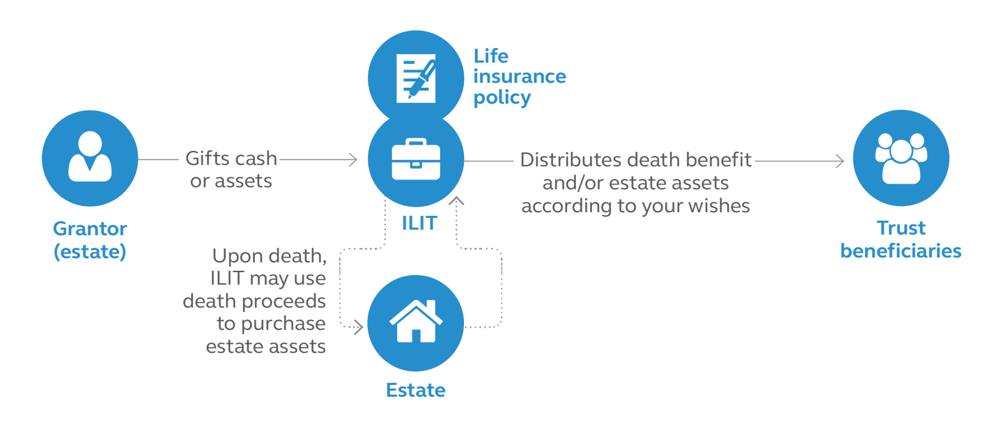
Estate and trust planning How an irrevocable life insurance trust works
For financial professional use only. Not for distribution to the public.
Notes:
Graphic of the points made

Slide 6
Estate and trust planning Irrevocable life insurance trust funding
An irrevocable life insurance trust (ILIT) helps keep insurance proceeds out of the taxable estate, but transfers to pay premiums need to be considered
Annual exclusion gifts using Crummey Powers are often used to fund an ILIT
Additional planning may be necessary to overcome annual exclusion gifting limits
For financial professional use only. Not for distribution to the public.
Notes:
Discussion of the points made

Slide 7
Federal Estate Tax
Year | Exemption | Top rate |  | Year | Exemption | Top rate
1916 | $50,000 | 10% |  | 2010 | $0 or $5 million | 0% or 35%
1986 | $500,000 | 55% |  | 2011 | $5 million | 35%
2002 | $1 million | 50% |  | 2016 | $5,450,000 | 39.6%
2006 | $2 million | 46% |  | 2022 | $12,060,000 | 40%
2009 | $3.5 million | 45% |  | 2026* | Est. $6 million | 40%*
* 2026 amounts reflect scheduled sunsetting of changes made by TCJA 2017, beginning January 1, 2026.
For financial professional use only. Not for distribution to the public.
Notes:
Read directly from the slide

Slide 8
Estate tax Planning Goal: Pat and Shelby are in their late 30s. They have a net worth of $10M, including a business valued at $8 million. Based on today’s exemption, they would not have an estate tax. But the business is growing. If the exemption is $6 million each in 2026, their estate could easily surpass it at the second death.
E.g., $2M
Estate liquidity need at 2nd death
Business value: $8 million
and growing
$1M life insurance for survivor needs
For financial professional use only. Not for distribution to the public.
Notes:
Read directly from the slide

Slide 9
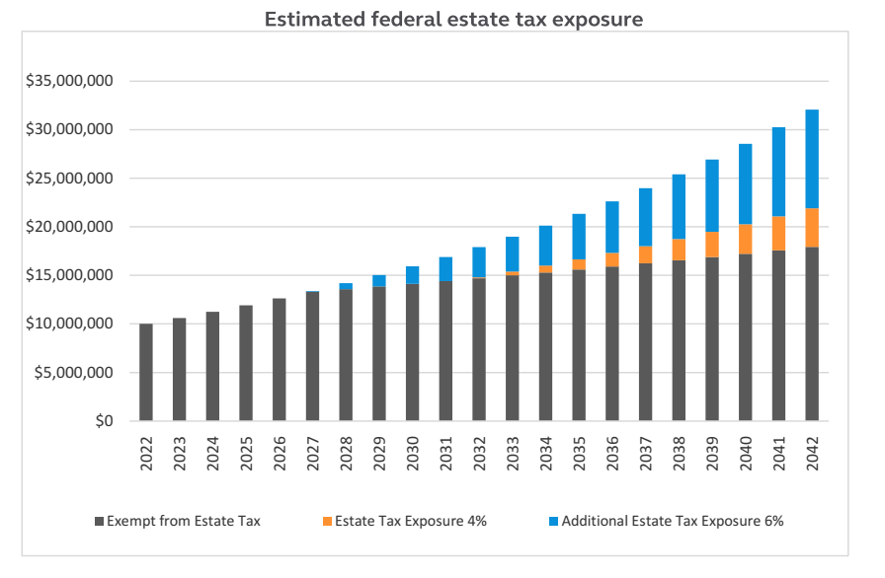
Estate tax exposure report The chart shows estate projections for a married couple with a net worth of $10,000,000 today. Assumes estate growth rates of 4% and 6%.
Here's how we calculated the results
Current planning results in zero estate tax liability at first death through effective use of the estate tax exemption and marital deduction, as needed.
Estate tax exemption indexed at 2% based on Chained Consumer Price Index (C-CPI).
Estate tax rate is 40%.
For financial professional use only. Not for distribution to the public.
Notes:
Here’s an analysis of their estate tax scenario. As you can see, even if a client doesn’t appear to have an estate tax concern currently, they may have one in the future depending on their age.
If they have insufficient funds to cover their federal estate tax liability, it may be necessary for them to liquidate business assets.
So, they may want to consider techniques to minimize potential estate and inheritance taxes.
Permanent life insurance can be used to provide liquidity to help pay any federal estate taxes.

Slide 10
Irrevocable trust with flexibility
Irrevocable trust planning
Define children to include children not yet born, stepchildren and adopted children
Provide for a former spouse to be treated as having predeceased the grantor in the event of a divorce
Define “spouse” as the person to whom the grantor is married at the time a distribution is made.
Include a decanting provision, which can permit certain nondispositive changes under applicable state law
For financial professional use only. Not for distribution to the public.
Notes:
Read directly from the slide

Slide 11
Irrevocable trust with SLAT feature
Irrevocable trust planning
SLAT = spousal lifetime access trust
Within limits, the spouse of the grantor can be named as a beneficiary without creating estate inclusion for either spouse
A SLAT feature can allow the grantor’s spouse to receive distributions from the trust
If a single-life insurance policy on the grantor includes a chronic illness (“CIDBAR”) rider, the trust may be able to make the CIDBAR benefit available to the grantor’s spouse through a SLAT feature.
Gifts to an ILIT with a SLAT feature should be made from the separate assets of the grantor
For financial professional use only. Not for distribution to the public.
Notes:
Read directly from the slide

Slide 12
Irrevocable trust: 2022 Pat and Shelby purchase the life insurance they intend for their estate tax liquidity in an ILIT, so that the death benefit is not included in their taxable estate.
$2M
Estate liquidity need
Business value: $8 million
In 2022 and growing
ILIT with SLAT feature
$1M survivor needs at death of Pat
For financial professional use only. Not for distribution to the public.
Notes:
Read directly from the slide

Slide 13
Irrevocable Trust with SLAT Feature
Why does Pat have a personally owned life insurance policy that is not in the ILIT?
The purpose of the life insurance policy held personally is to accumulate cash and provide a supplemental retirement benefit.
The ILIT is designed to keep all the assets it holds out of the estate of both spouses and use them only for those benefiting from the trust, not for the needs of the grantor.
Personally owned assets allow the spouses to make changes, address needs as they occur in the future, and use funds for their own needs.
Frequently asked questions
For financial professional use only. Not for distribution to the public.
Notes:
Read directly from the silde

Slide 14
Irrevocable trust: changing needs It is 10 years later, and Pat and Shelby have divorced. Pat and Shelby’s child is now a teenager.
$2M
Estate liquidity need
Business value: $10 million In 2032
ILIT with SLAT feature
$1M survivor needs at death of Pat
Pat & Shelby’s child
Pat
For financial professional use only. Not for distribution to the public.
Notes:
Read directly from the slide

Slide 15
Irrevocable trusts It is now 20 years since the ILIT was established, and Pat has married Mason. They are in their late 50s. The business growth has leveled and faces much stiffer competition. Their net worth is well below the Federal estate tax exemption amount.
Independent,
third party trustee
$500K cash value; no
estate liquidity need
Business value: Stable at $5 million by 2040
SLAT
Feature
$
$
$
ILIT with SLAT feature
$1M survivor needs at death of Pat
Mason
Pat & Shelby’s child
Pat
For financial professional use only. Not for distribution to the public.
Notes:
Read directly from the slide

Slide 16
Irrevocable Trust with SLAT Feature
Can the spouse who is beneficiary also be the trustee?
Only under very limited circumstances, and not if the life insurance in the ILIT is a survivorship (second to die) policy.
How did Mason acquire rights under a trust that was created before Pat and Mason married?
The trust specifies that a former spouse would be treated as having predeceased Pat, and defines “spouse” as the grantor’s spouse at the time a distribution is made.
If Pat becomes chronically ill, can a CIDBAR rider be used to get funds for Pat’s care?
In a single life policy, a CIDBAR rider could be used to accelerate a portion of the death benefit and make distributions under a SLAT feature.
Frequently asked questions
For financial professional use only. Not for distribution to the public.
Notes:
Read directly from the slide

Slide 17
Irrevocable Trust with SLAT Feature
When is it important to make gifts only from the separate property of the grantor spouse?
Making a gift to the trust from joint or community property can cause the other spouse to become a grantor. If that spouse is also a beneficiary or a trustee, becoming a grantor can result in estate inclusion.
Can “Crummey” gift tax annual exclusion gifts be made to a SLAT?
For all beneficiaries other than the spouse, yes. It is common to limit spousal gifts to a “5 or 5” gift, meaning no more than $5,000 or 5% of the trust assets.
Frequently asked questions
For financial professional use only. Not for distribution to the public.
Notes:
Read directly from the slide

Slide 18
Estate and trust planning Why review estate plans now?
High gift and estate tax exemptions
Changes in family members (births, marriages, divorces)
Changes in business
Changes in asset values
Entity discounting is still available
Insurability is not a given
For financial professional use only. Not for distribution to the public.
Notes:
Much of the decision-making generally takes place after the client has answered a number of key questions. Generally, these tools will help you choose the best design. based on your client’s goals and objectives.

Slide 19
Estate and trust planning How to get started
Use the Irrevocable life insurance and gifting strategies brochure (BB12101) and Legacy and estate planning fact finder (BB6794)
Take advantage of the solution-specific request for proposal (RFP)
Submit the completed RFP to the Business and Advanced Solutions team (NewRFPs@exchange.principal.com) for a customized proposal for your client
For financial professional use only. Not for distribution to the public.
Notes:
Much of the decision-making generally takes place after the client has answered a number of key questions. Generally, these tools will help you choose the best design. based on your client’s goals and objectives.

Slide 20
Business & Advanced Solutions hotline
Toll-free number:
833-803-8345
Menu options:
Informal business valuation or buy-sell review
Business succession (including ESOP repurchase)
Bonus, deferred comp, and other key employee benefit plans
Legacy and estate planning
Business approaches and marketing tools
A great resource for financial professionals who have business clients with needs that can be met with any of the many solutions offered by Principal.
Our hotline is staffed by consultants who focus on the business market. Our team includes CPAs, attorneys, and case design specialists – all ready to help you with pre-sale case consultation, or how to approach a business owner prospect with any of our business market solutions.
Notes:
Read directly from the slide.

Slide 21
Questions?
For financial professional use only. Not for distribution to the public.
Notes:
[Optional: If time allows, you can offer Q&A at the end of the session.]
Are there any questions I can address for you before we go?

Slide 22
Let’s connect
Contact your wholesaler or call the National Sales Desk at 800-654-4278.
Visit us at advisors.principal.com.
For financial professional use only. Not for distribution to the public.
Notes:
Read directly from the slide.

Slide 23
Principal National Life Insurance Company and Principal Life Insurance Company, Des Moines, Iowa 50392-0001
Insurance products issued by Principal National Life Insurance Co. (except in NY) and Principal Life Insurance Company®. Plan administrative services offered by Principal Life. Principal Funds, Inc. is distributed by Principal Funds Distributor, Inc. Securities offered through Principal Securities, Inc., Member SIPC, and/or independent broker/dealers. Referenced companies are members of the Principal Financial Group®, Des Moines, IA 50392.
No part of this presentation may be reproduced or used in any form or by any means, electronic or mechanical, including photocopying or recording, or by any information storage and retrieval system, without prior written permission from the Principal Financial Group®.
Not FDIC or NCUA insured. May lose value . Not a deposit. No bank or credit union guarantee. Not insured by any Federal government agency.
Principal®, Principal Financial Group® and the Principal logo design are registered trademarks of Principal Financial Services, Inc., a Principal Financial Group company, in the United States and are trademarks and service marks of Principal Financial Services, Inc., in various countries around the world.
For financial professional use only. Not for distribution to the public.
BB12605 | 09/2022 | 2415122 | © 2022 Principal Financial Services, Inc.
Notes:
[Leave on screen long enough for people to read.]

