Slide 1
Business market approaches
Find options to help you connect with your clients
PRESENTER NAME (ALL CAPS)
Title
Notes:
Welcome and thanks for attending today’s business solutions overview.

Slide 2
Business market approaches
Tailor the conversation to clients’ needs
Informal business valuation and/or buy-sell review/business continuation
Business needs analysis
Business needs assessment
Family-owned business
Agribusiness
Business owner retirement
Strategic alliances
Approaches guide (BB12262)
Notes:
It's simple, easy, and profitable to work in the business market with our platform of solutions that serve the financial planning needs of business owners and their key employees.
Approach clients based on your focus to meet their various needs, deepen relationships, and uncover new sales opportunities.
Choose from a variety of options to start a conversation. Highlights of these approaches can be found in the Approaches Guide (BB12262).
Informal business valuation/buy-sell review
Business needs analysis
Family-owned business
Agribusiness (farms/ranches)
Business owner retirement
Strategic alliances

Slide 3
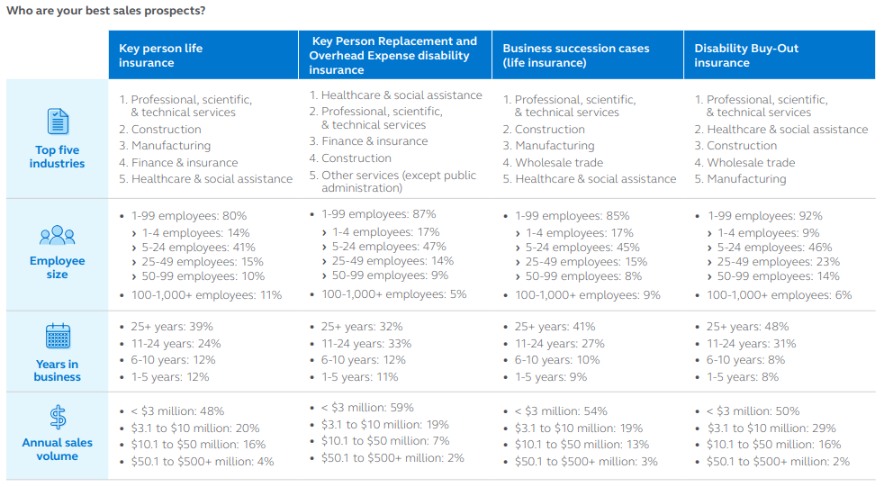
First, identify a good prospect
Source: Principal® business market analysis of over 118,000 employer customers appended with Dunn & Bradstreet (D&B) data. The data is current as of December 2022. Statistics shown only include those plans with appended data. The overall match rate is 90%, and not all categories will add up to 100%.
For financial professional use only. Not for distribution to the public.
Notes:
Handout: BB11233
Knowing who to talk to doesn’t have to be a mystery. In reviewing the business cases we have at Principal®, it helps to identify potential prospects for the business solutions we offer.
[Review the Business Solutions profiles flyer (BB11233).]

Slide 4
Informal Business Valuation, Buy-Sell review, and Business Continuation
Notes:
Uncovering business owner needs and starting the planning conversation is easy when you use our complimentary business planning services – informal business valuation, buy-sell review, and business continuation. The reports serve as a great door-opener that can lead to life and disability insurance sales and help business owners:
Determine a current value for their business they can use for planning purposes.
Make decisions about retirement income planning, business succession planning, business protection, and estate planning.

Slide 5
Business Valuation/Buy Sell-Review/Business Continuation Why does this approach work?
The business is the owner’s most valuable asset
Confirms knowledge of the value, and/or sets expectations
Helps ensure the buy-sell agreement is current and funding is adequate
Can kick-start the planning process
Opens multiple sales opportunities for you
For financial professional use only. Not for distribution to the public.
Notes:
The business is generally a business owner’s largest asset. However, many business owners don’t know the value. Principal offers complimentary informal business valuations. These informal valuations aren’t intended to determine “fair market value” but rather provide a valuation range that gives the business owner an idea of the value they need to protect, as well as help start the planning process and open multiple sales opportunities for you.
As I mentioned, our informal business valuation service is not intended to provide the fair market value for purposes of selling a business. Long before a sale occurs, it’s important for business owners to know the value of their business for risk protection purposes. This means understanding and protecting the value at risk—for both planned and unplanned events.
Our complimentary Buy-Sell Review is not intended to replace a business owner’s valued legal counsel either. This service provides a timely review of key provisions in the buy-sell document(s) in order to provide best practices feedback and ensure everything is current and in line with the business owner’s expectations. Our goal is to provide suggestions that will help facilitate a discussion between the business owner and their legal counsel.

Slide 6
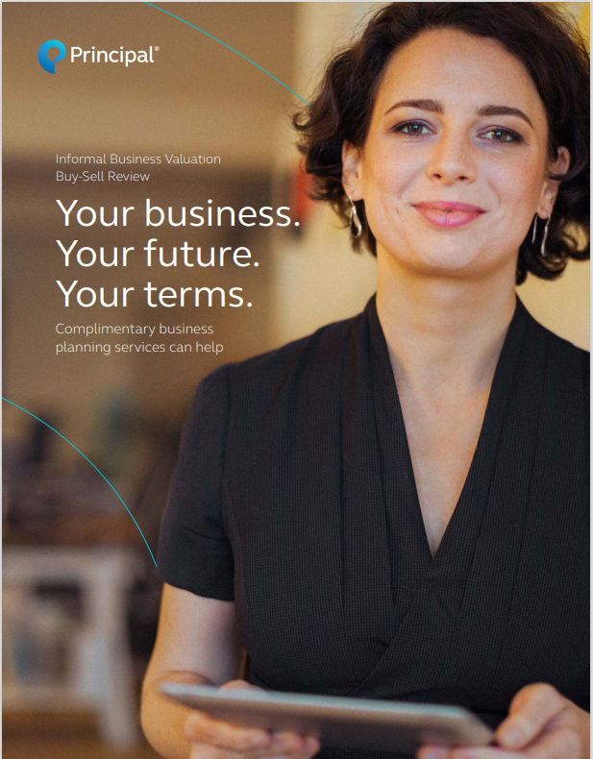
Business Valuation/Buy-Sell Review/Business Continuation
Complimentary services
Available services:
Informal business valuation
Business continuation proposal
Buy-sell review report
Approach brochure (BB98522)
Notes:
Depending on what your client has in place, you can request and receive an informal business valuation, business continuation proposal, and/or a buy-sell review. These services can help facilitate planning discussions and can lead to multiple business insurance opportunities that include:
Key employee retention & retirement plans
Business succession planning and buy-sell agreement funding
Key person life and disability insurance
Estate & legacy planning
Disability insurance solutions

Slide 7
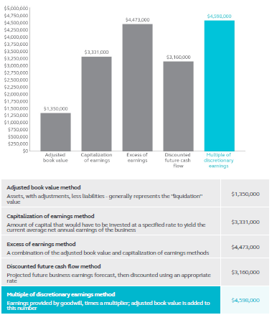
Business valuation proposal 5 common valuation methods
Sample Informal Business Valuation Proposal (BB11286)
For financial professional use only. Not for distribution to the public.
Notes:
Here’s an example of what we provide to you when we complete an informal business valuation. There are also some things to take into consideration as you review it.
Sample discussions the valuation can bring up with your client:
What value will my heirs be taxed on?
What does my buy-sell agreement say the value is?
Will the value hold if a key employee leaves?
Is there a buyer who will pay the value I’m planning on?

Slide 8
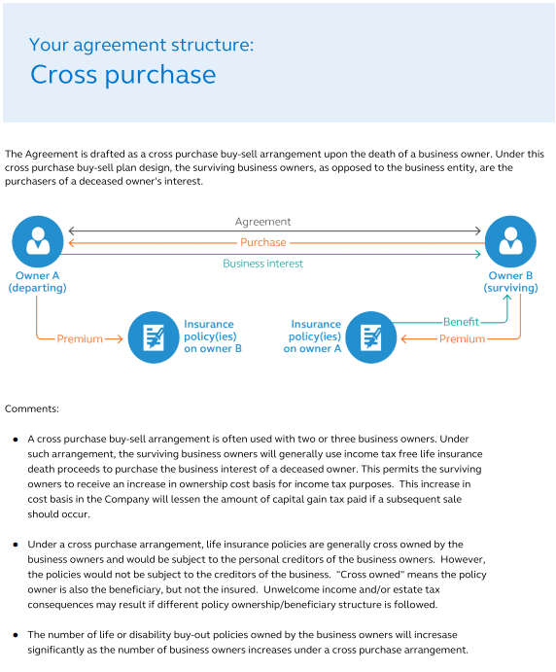
Business Valuation/Buy-Sell Review/Business Continuation What is a buy-sell review?
Sample Buy-Sell Review Summary Report (BB9868)
For financial professional use only. Not for distribution to the public.
Notes:
What is a Buy-Sell Review? - It’s another way to open a case with a business owner. You’re talking with business owners about a key issue for many of them.
We generate a customized report based on the information provided to us. Sample Buy-Sell Review Summary Report (BB9868)
The report includes:
Highlights of the existing buy-sell agreement.
Recommendations based on business needs.
A summary of the current funding and options to help meet business needs.

Slide 9
Business Valuation/Buy Sell-Review/Business Continuation Primary focus of the buy-sell review
Structure of the agreement
The buy-sell triggers (mandatory and optional)
How the parties determine the sale price
The terms of the purchase transaction
How the funding is structured
For financial professional use only. Not for distribution to the public.
Notes:
In reviewing a buy-sell agreement, there are five key areas that we focus on. [Read through the items on slide.]

Slide 10
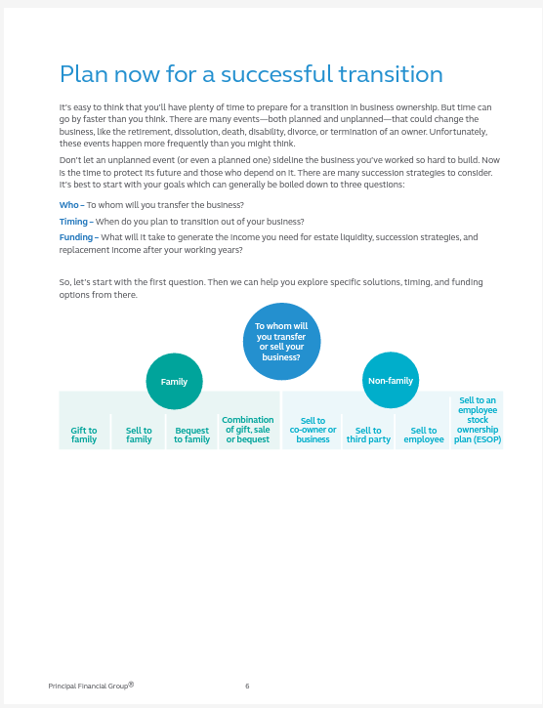
Business continuation proposal Proposing a buy-sell agreement
Sample Business Continuation Proposal (BB10880)
For financial professional use only. Not for distribution to the public.
Notes:
We also offer a business continuation proposal for those situations where an IBV and/or a buy-sell review may not be a good fit. This proposal is designed to focus on business succession. As with our informal business valuation and buy-sell review proposals, we capture information about the company – as well as what they’re hoping to accomplish with a request for proposal, then customize this proposal specific to their needs.

Slide 11
Business Valuation/Buy Sell-Review/Business Continuation Uncover more opportunities
Match up agreement, valuation, and funding
Identify unmet financial needs—for lifetime, death, and disability triggers
Align life insurance ownership with the ownership outlined in the buy-sell agreement
Align definition of “disability” in the buy-sell agreement with definition in the disability product
For financial professional use only. Not for distribution to the public.
Notes:
Now that we’ve discussed the buy-sell review and business valuation services offered by Principal, I want to identify where the sales opportunities are.
Let’s categorize the opportunities based on the client’s situation and what they currently have in place.
If they have a buy-sell agreement in place, what are the opportunities for you to add value? Read slide.

Slide 12
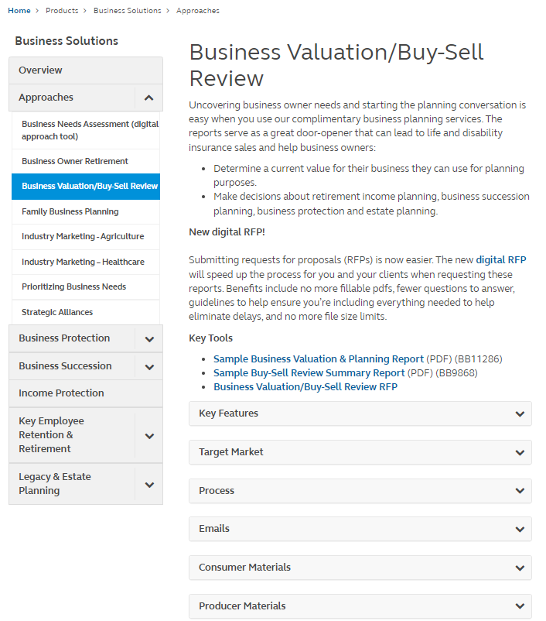
Business valuation/buy-Sell review/business continuation Resources for you Find everything you need to start the conversation with clients at: principal.com/business planning.
For financial professional use only. Not for distribution to the public.
Notes:
We’ve seen financial professionals have a lot of success with this approach. Everything you need is housed on our financial professional site – principal.com/business planning.

Slide 13
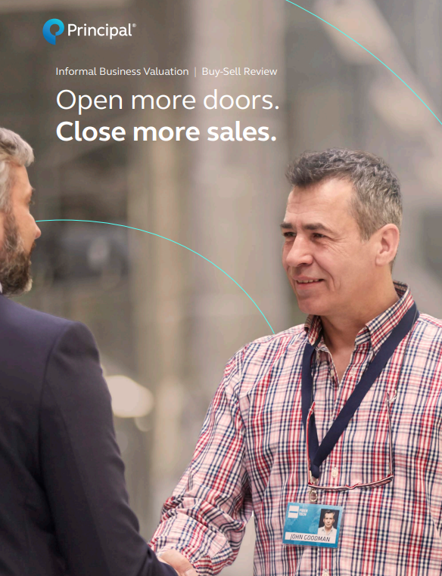
Business Valuation/Buy-Sell Review/Business Continuation
The sales opportunity
The key with this approach—as with all approaches—is to know who’s a good prospect and who may not be.
Sales opportunity brochure (BB10350)
Notes:
Review the sales opportunity guide (BB10350) to see how these complimentary services can help you generate sales with the right types of clients.

Slide 14
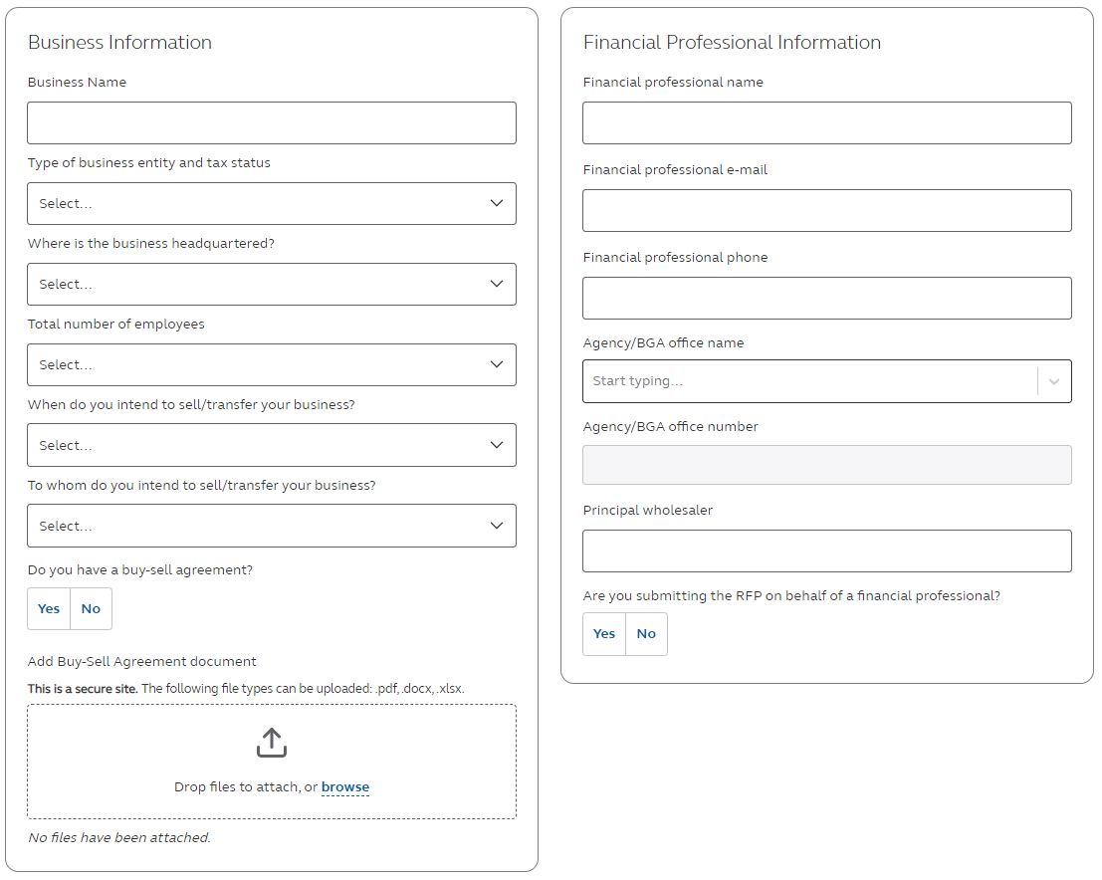
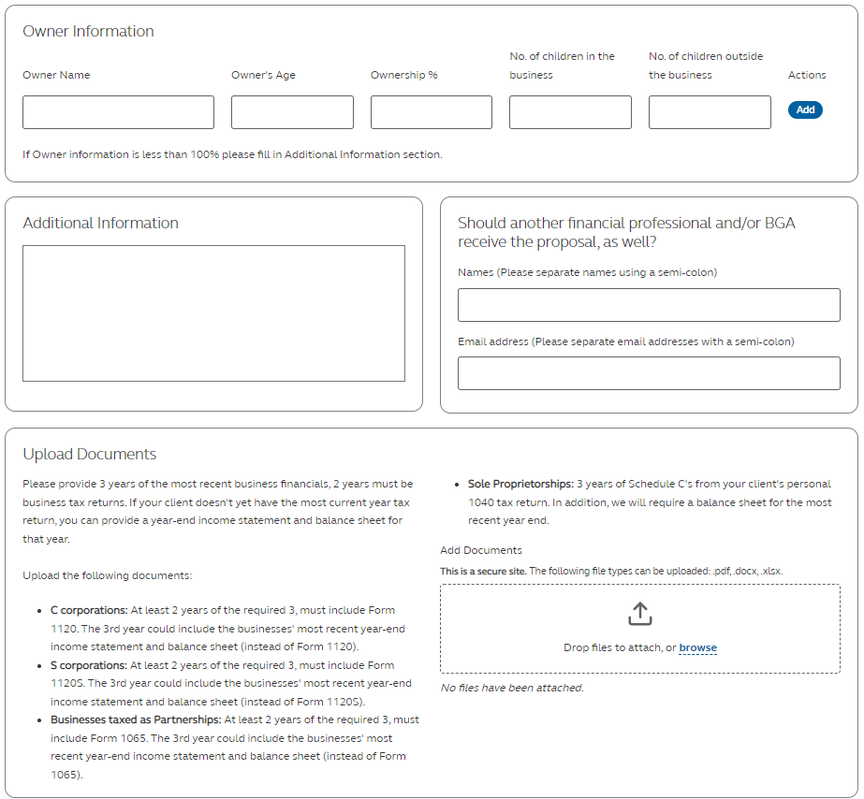
Informal Business Valuation/ Buy-Sell Review RFP
principal.com/ibv-bsr-rfp
For financial professional use only. Not for use with consumers or the public.
Notes:
Submitting requests for proposals (RFPs) is now easier. The new digital RFP will speed up the process for you and your clients when requesting these reports. Benefits include no more fillable pdfs, fewer questions to answer, guidelines to help ensure you’re including everything needed to help eliminate delays, and no more file size limits. You can find the RFP on our financial professional website by navigating to Products > Business Solutions > Approaches > Business Valuation/Buy-Sell Review or by typing the URL: principal.com/ibv-bsr-rfp.

Slide 15
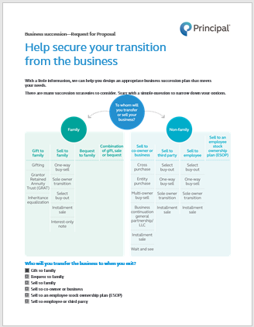
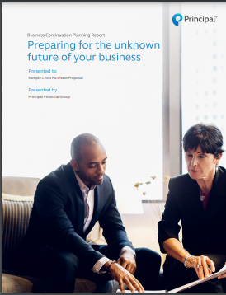
Business Continuation Proposal and RFP (BB8720)
If you’re not sure which type of agreement is most appropriate, we can provide options. Request a Business Continuation proposal.
For financial professional use only. Not for use with consumers or the public.
Notes:
Read directly from slide.

Slide 16
Business Valuation/Buy-Sell Review/Business Continuation What’s needed to get a proposal?
Informal Business Valuation
Completed RFP
Three most recent years’ financials (income statements and balance sheets or business tax returns
Expect 5 business day turnaround
Buy-Sell Review
Completed RFP
Current buy-sell agreement and any amendments
Information on any insurance in place to fund the agreement
Expect 15 business day turnaround
Business Continuation
Completed RFP
Information on any insurance in place to fund the agreement
Expect 3 business day turnaround
For financial professional use only. Not for distribution to the public.
Notes:
Read directly from slide.

Slide 17
Business Needs Assessment
Notes:
Using this innovative digital tool, you can help your clients uncover planning needs to help protect the financial well-being of their business and prepare for the future. You can provide them a personalized assessment in three key areas: protecting their business, protecting their employees, and protecting their lifestyle.

Slide 18
Business Needs Assessment Why does this approach work?
Proper planning can help business owners take control of their business and their future
This approach offers 3 assessments:
Protecting their business
Protecting their employees
Protecting their lifestyle
You can choose from two different approaches to use this digital tool with your clients and prospects
For financial professional use only. Not for distribution to the public.
Notes:
Read directly from slide.

Slide 19
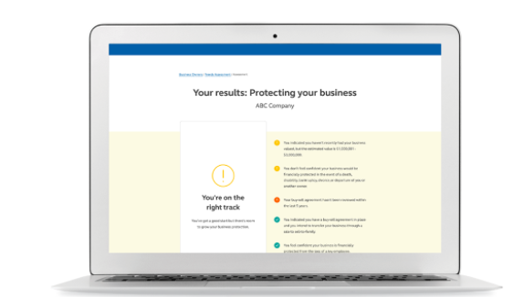
Business Needs Assessment
Who can benefit?
Who’s it for?
Privately held and publicly traded businesses
For-profit and nonprofit organizations
Businesses with any number of employees
All industries
What do they get?
A personalized report with an analysis of how they’re doing
Next steps in planning process
Information on topics relevant to helping protect their business, their employees, and their lifestyle
For financial professional use only. Not for distribution to the public.
Notes:
Read directly from slide.

Slide 20
Business Needs Assessment A holistic view of business planning needs
Protect their business
Buy-sell and business transfer strategies
Key employee retention benefits
Key person protection
Protect their employees
Qualified retirement plans
Group benefits
Key employee retirement benefits
Protect their lifestyle
Business owner strategies
Life and disability insurance
Legacy and estate planning
For financial professional use only. Not for distribution to the public.
Notes:
Read directly from slide.

Slide 21
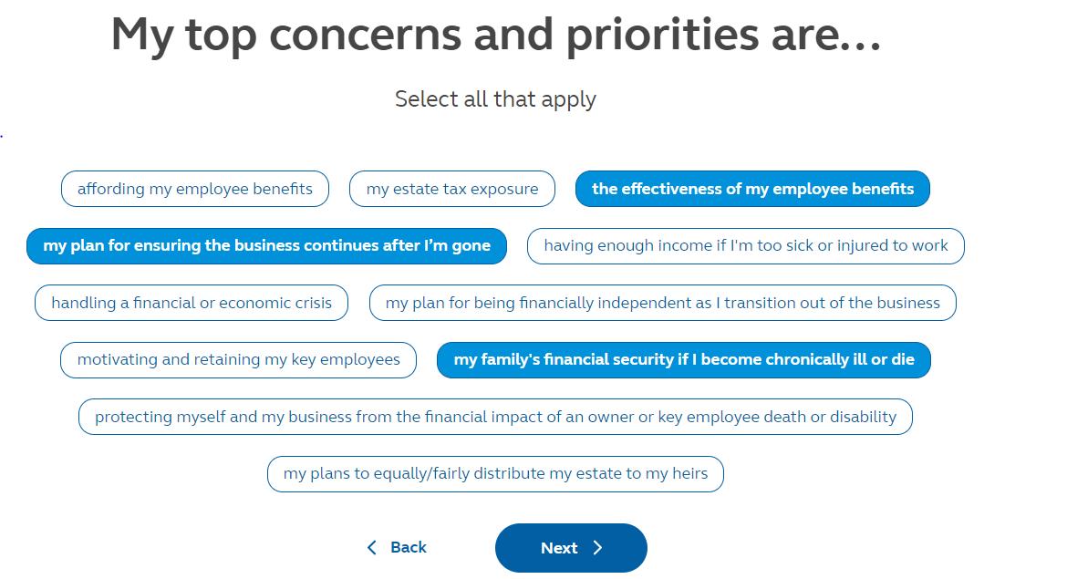
The business owner indicates what’s important to them
Business Needs Assessment
For financial professional use only. Not for distribution to the public.
Notes:
Read directly from slide.

Slide 22
Then, decides which of the assessments they want to complete
Business Needs Assessment
For financial professional use only. Not for distribution to the public.
Notes:
The client can choose to do one, two, or three assessments – right away, or they can come back later and complete them.

Slide 23
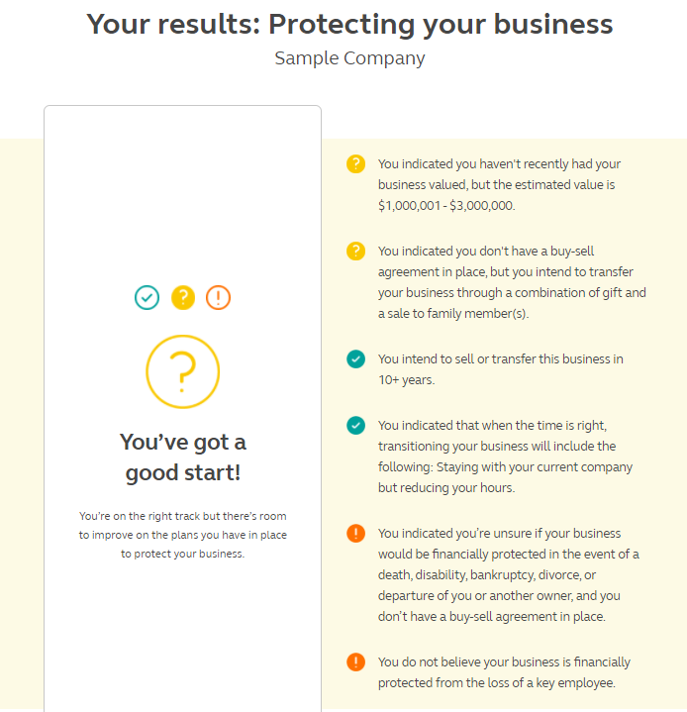
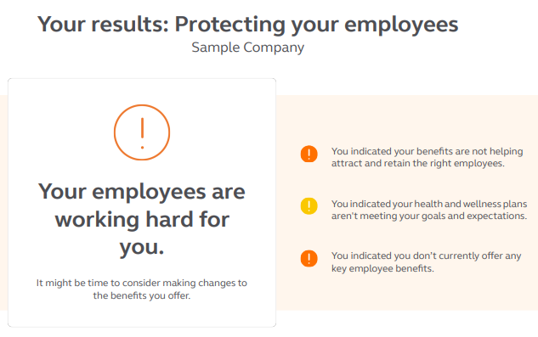
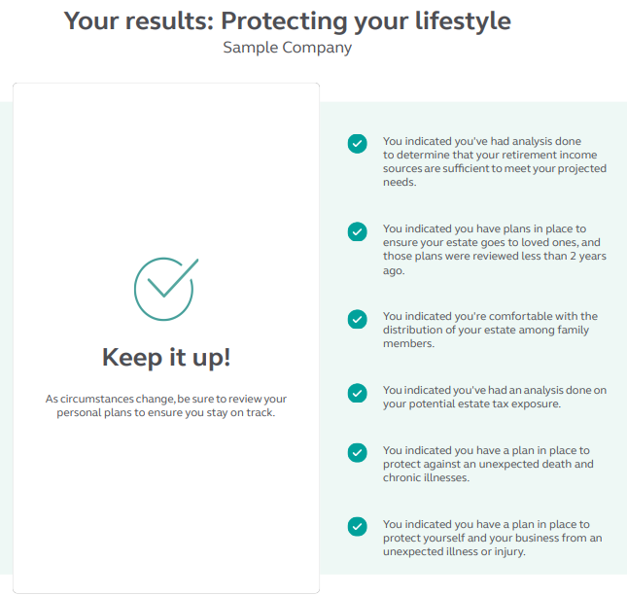
Personalized assessments are provided
Business Needs Assessment
For financial professional use only. Not for distribution to the public.
Notes:
The client gets personalized analysis showing where they’re doing well and where they need additional help.

Slide 24
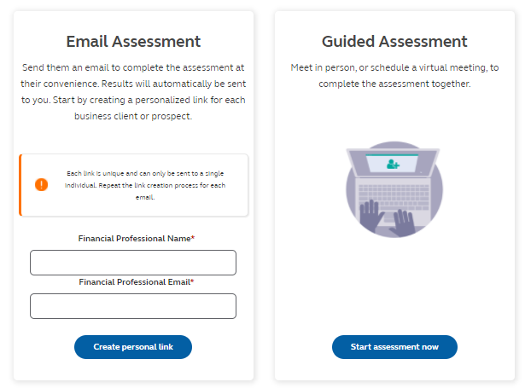
Two options to use to approach your clients/ prospects
Business Needs Assessment
Copy and paste assessment link into an email before finishing session
For financial professional use only. Not for distribution to the public.
Notes:
We’ve completed a seamless process to help you approach your clients and prospects.
Choose from one of two paths – email assessment or guided assessment.
Email assessment:
Send an email to each client/prospect inviting them to complete the assessment.
The email contains a link that uniquely identifies the recipient. This allows their assessment results to automatically be emailed back to you when complete.
Because each email link is unique, it’s important that you send a separate email to each client/prospect you’re reaching out to.
Guided assessment:
Use a direct link to go through the assessments with your clients – either in person or virtually.
Be sure before you end the session that you copy/paste the link into an email and email it to both you and your client/prospect... This does NOT automatically send completed assessments to the client nor you!
With either method, you have access to a completed assessment or assessments for you to take the next steps in the planning process with your clients.

Slide 25
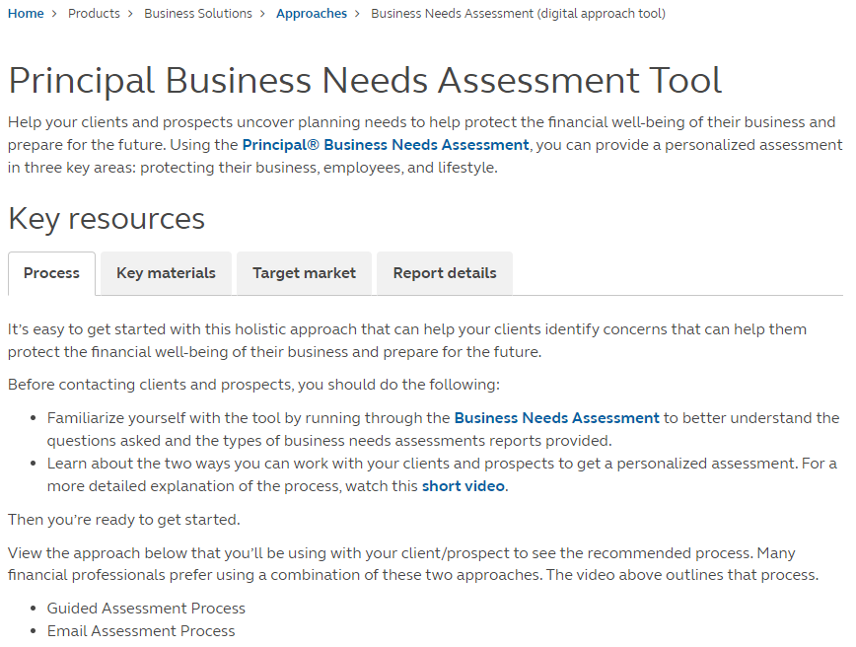
Get the resources you need at principal.com/ businessneeds assessment tools
Business Needs Assessment
For financial professional use only. Not for distribution to the public.
Notes:
We have a dedicated web page on our website for financial professionals.
You can get directly there by entering principal.com/businessneedsassessmenttools.
It will provide useful materials, tips on who good prospects are, and walk you through both assessment processes.

Slide 26
Prioritizing Business Needs
Notes:
Business owners often have numerous planning needs – some known and others unknown. So how do you determine which solutions are most important to them? Using a couple of basic needs analysis tools, you can walk them through it.
And it doesn’t matter whether it’s a nonprofit organization, a sole proprietorship, or a farm. These tools can be used with any business.

Slide 27
Prioritizing Business Needs Why does this approach work?
Business owners have numerous planning needs
Some known and some unknown
Many times, their needs coincide with where they are in their business life cycle
You can help business owners identify and prioritize a variety of needs for the business, for their employees, and for their lifestyle
For financial professional use only. Not for distribution to the public.
Notes:
Read directly from slide.

Slide 28
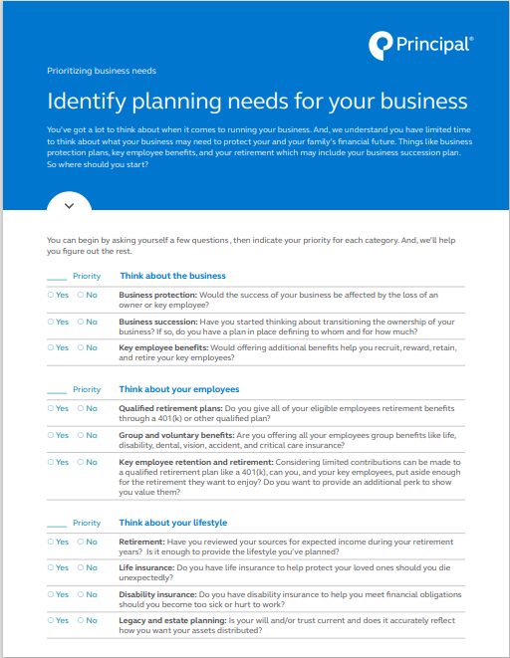
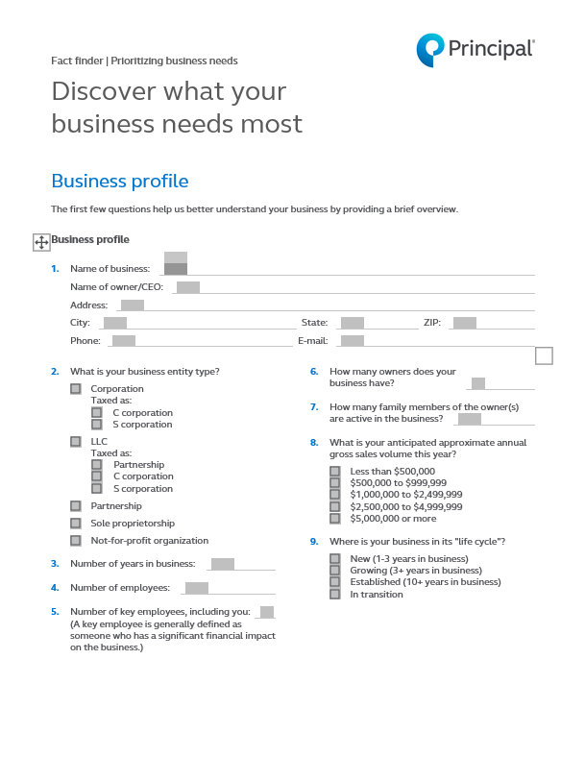
Prioritizing Business Needs Getting started
Priorities checklist (BB9557)
Comprehensive fact finder (BB8718C)
For financial professional use only. Not for distribution to the public.
Notes:
Use a short priorities checklist (BB9557) to ask some basic questions that will help your clients prioritize their top planning needs.
Or, if you prefer something more in-depth, a comprehensive fact finder (BB8718C) can also be used to identify areas of need.
You can customize either of these pieces to print your contact information at the end.
These and other tools will help you identify solutions to protect: The business, its employees , and the personal lifestyle of the owner(s).

Slide 29
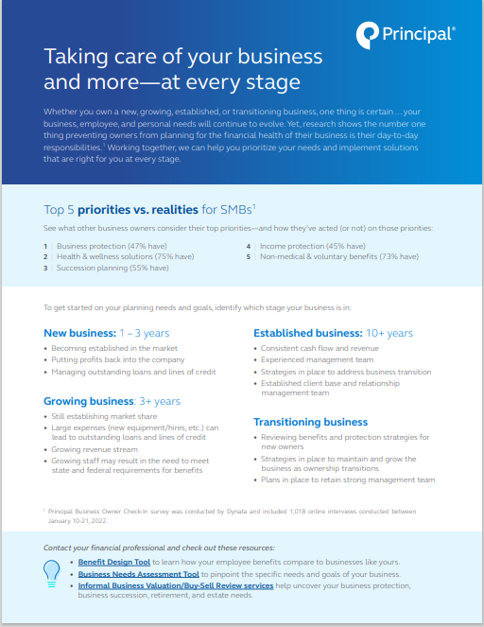
Prioritizing Business Needs
Business life cycle & planning needs
Solutions based on where the business is in its life cycle
Brochure (BB11226)
For financial professional use only. Not for distribution to the public.
Notes:
Every stage has different needs. We offer solutions for all of them.
Business solutions from Principal help support the needs of your business clients through every phase. It’s just a matter of determining what’s a planning priority for them today. We’ll work with you to help your client figure out their most pressing needs. Then we’ll give you options that prepare your client and their business for the future. Along the way we provide complete support to you and your client from planning and implementation to administrative experience and more.
Use this brochure (BB11226C) in tandem with either the checklist or fact finder in conversations with your client. It helps to point out planning considerations based on where the business is in its life cycle.

Slide 30
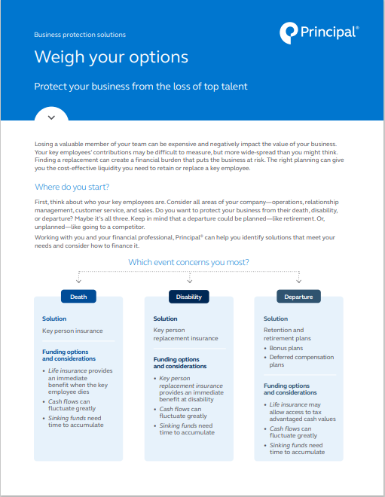
Prioritizing Business Needs
Not sure which business concept to offer? Tools like these could help.
Key Person calculator
Determine how much life insurance your clients may need on their most valued employees to help protect the business. The proposal includes a 10-, 15-, 20- ,and 30-year term insurance quote. www.principal.com/keyperson
Business protection grid (BB11280)
For financial professional use only. Not for distribution to the public.
Notes:
Read directly from slide.

Slide 31
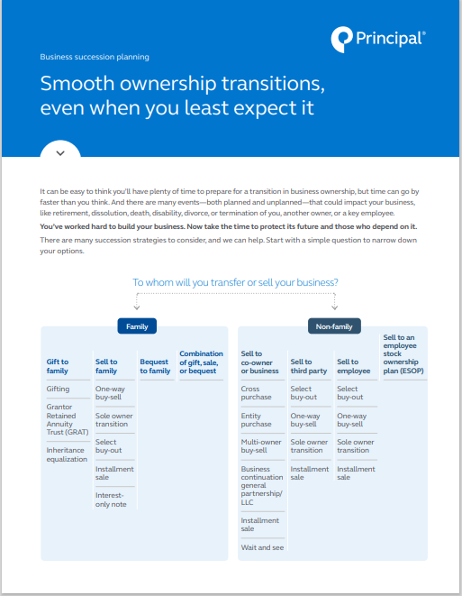
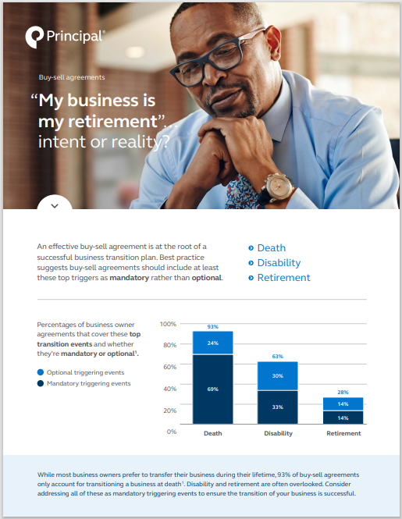
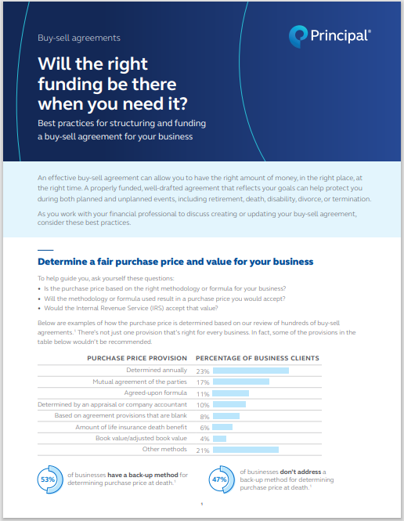
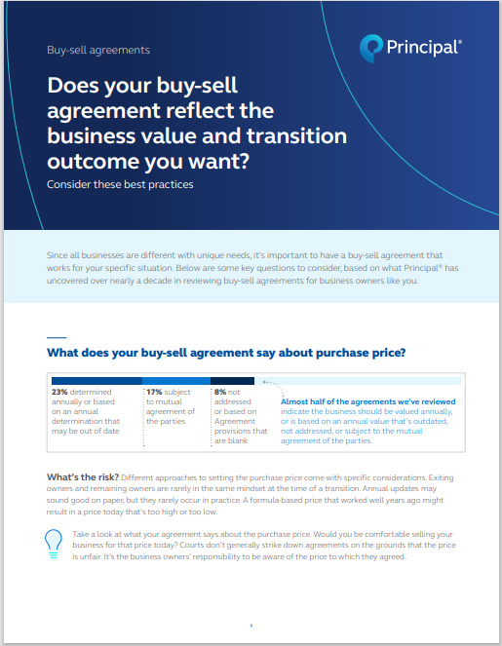
Prioritizing business needs
Not sure which business concept to offer? Tools like these could help.
Business succession grid (BB10262)
Business succession infographics: BB11378, BB11420, BB11581
For financial professional use only. Not for distribution to the public.
Notes:
BB10262 Business succession decision grid
BB11378 Buy-sell agreement & retirement infographic
BB11420 Buy-sell agreement funding infographic
BB11581 Buy-sell agreement & business valuation infographic

Slide 32
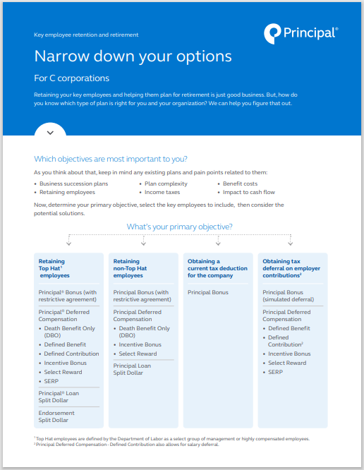
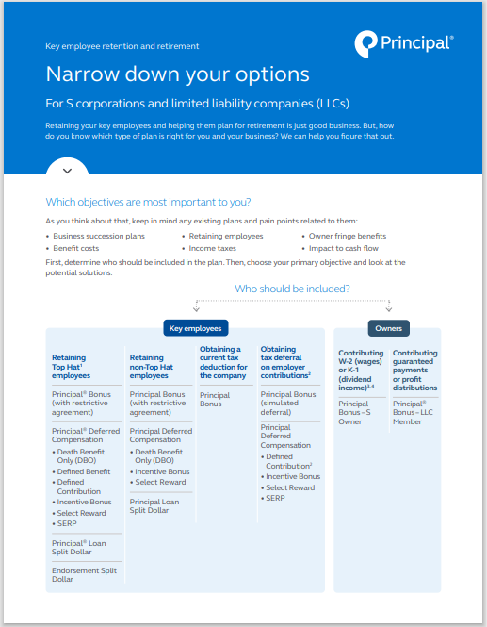
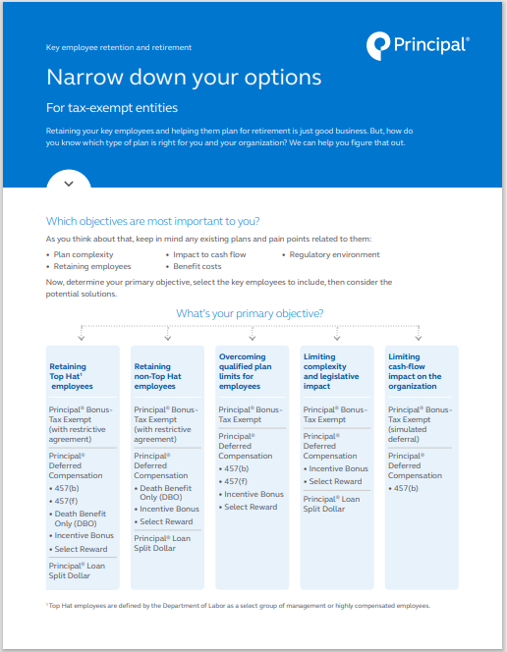
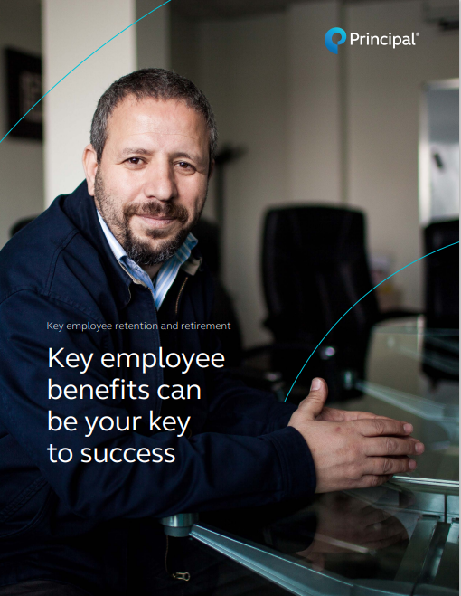
Prioritizing business needs
Solutions to help recruit, reward, retain, and retire key employees
Not sure which concept to offer? Tools like these could help.
Decision grids for: S Corporations & LLCs (BB11383),
C Corporations (BB11384), and Tax-Exempt Entities (BB11385)
Key employee benefits capabilities brochure (BB12064)
For financial professional use only. Not for distribution to the public.
Notes:
BB12064 Key employee benefits capabilities brochure
Key employee retention/retirement decision grids:
BB11383 for S corporations/LLCs
BB11384 for C corporations
BB11385 for tax-exempt entities

Slide 33
Prioritizing Business Needs
Requesting a proposal
After narrowing down the options, request a proposal for the concept that meets your client’s need.
Bonus plans
Bonus
Bonus - LLC
Bonus - S Owner
Deferred compensation plans
Death Benefit Only (DBO)
Defined Contribution
Defined Benefit
Incentive Bonus
SERP
Select Reward
Split Dollar
Endorsement Split Dollar
Loan Split Dollar
Business succession
All buy-sell and transfer strategies
Legacy & estate planning
Estate Tax Analysis
Estate Tax Exposure
Inheritance equalization
Business protection
Key person insurance (life and disability)
Additional proposals
Agribusiness solutions planning report
Business owner retirement analysis
Family business planning proposal
For financial professional use only. Not for distribution to the public.
Notes:
Read directly from slide

Slide 34
Prioritizing Business Needs
Solutions to help protect the owner’s lifestyle
Not sure which concept to offer? Tools like these could help.
Business owner retirement analysis (BB11876)
Family business planning proposal (BB12043)
Agribusiness solutions proposal (BB11824)
Estate tax calculator (BB10045)
Life insurance calculator: principal.com/lifecalc
Disability insurance calculator: principal.com/dicalc
For financial professional use only. Not for distribution to the public.
Notes:
Depending on the type of business you’re working with, these comprehensive proposals can help you dive into specific business owner needs – based on where they are in their business and lifecycle, and/or the type of business they have.
Business owner retirement analysis (BB11876) & Request for Proposal (BB11879)
Family business planning proposal (BB12043)
Agribusiness solutions proposal (BB11824)
Estate tax calculator (BB10045)
Life insurance calculator: www.principal.com/lifecalc
Disability insurance calculator: www.principal.com/dicalc

Slide 35
Family Business Planning approach
Notes:
Now let’s touch base on some specific approaches based on who you are targeting.

Slide 36
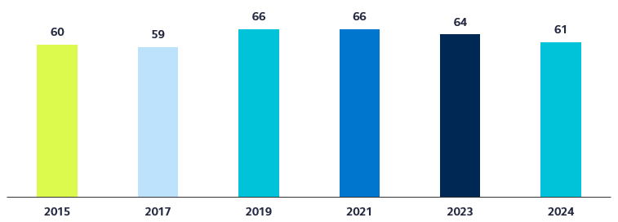
Family Business Planning approach Take advantage of the market opportunity
More than six in ten business owners own a family business*
* From Principal Business Owner Insights Study: online survey of business owners conducted by Dynata in January 2024. Harris Poll also conducted the 2015, 2017, 2019, and 2021 surveys for Principal Financial Group.
For financial professional use only. Not for distribution to the public.
Notes:
Family-owned businesses account for a significant portion of small- to medium-sized businesses in the U.S.
In our 2024 Principal Business Owner Research study, 6 in 10 of the business owners surveyed indicated their business is family-owned.
This represented a noticeable increase over the previous two surveys.
And many of these businesses need planning help.

Slide 37
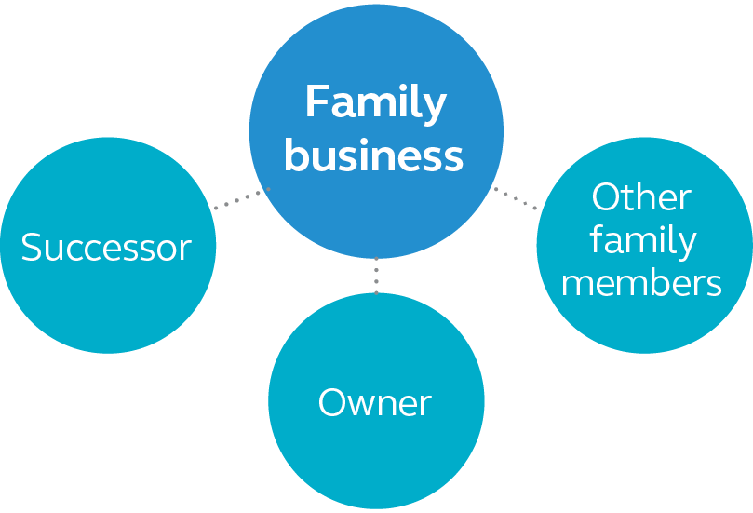
Family Business Planning approach Owner often must balance competing needs.
Leave healthy business to support itself and successor
Provide sufficient retirement income for exiting owner
Assure other family members of equitable inheritance
32% of business owners plan to give the business to family members.
Source: Principal Business Owner Insights Study: online survey of business owners conducted by Dynata in January 2024.
For financial professional use only. Not for distribution to the public.
Notes:
The most challenging part of an owner exiting his or her family business is balancing the needs of all parties, including how to:
provide sufficient retirement income for exiting owner,
leave a healthy business to support itself and your successor, and
assure other family members of an equitable inheritance.
You can help your business owner clients plan for these events to help ensure a smooth transition out of the business.

Slide 38
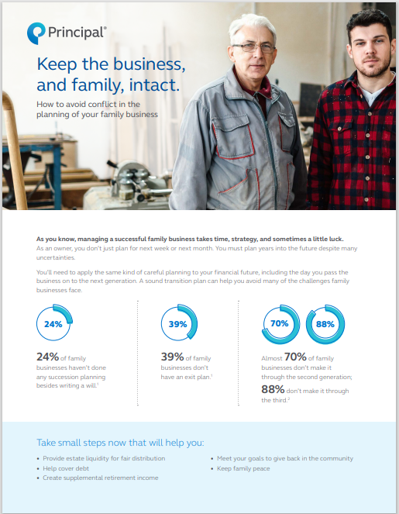
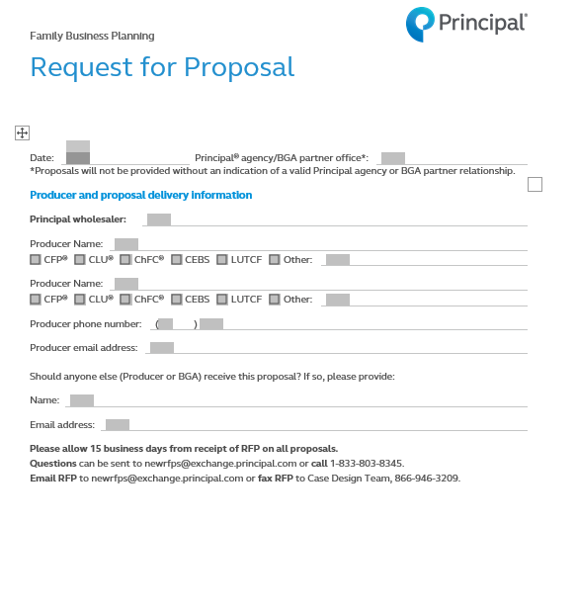
Family Business Planning
We offer tools to help guide the conversation.
Approach brochure (BB12032)
Conflict flyer (BB12639)
Request for Proposal (BB12033C)
For financial professional use only. Not for distribution to the public.
Notes:
We offer an approach package for use with family business owner clients and prospects. It includes an approach brochure and materials you can use with the client to start a planning conversation.
BB12032 Approach brochure
BB12639 Conflict flyer
BB12033C RFP

Slide 39
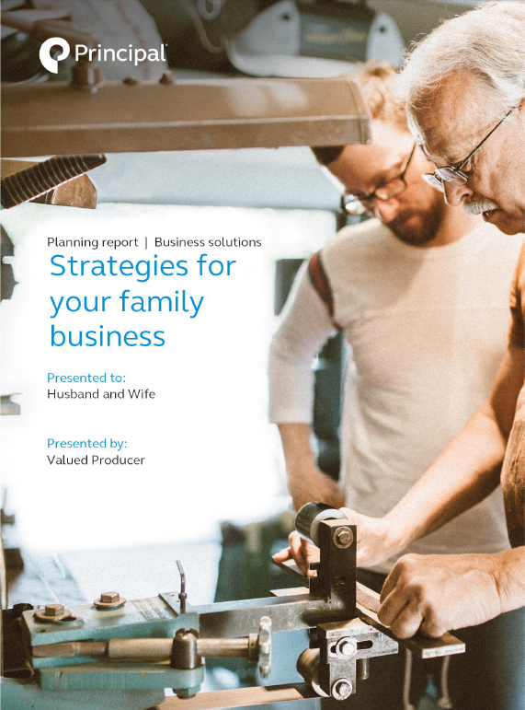
Family Business Planning approach
Common business planning strategies
Buy-sell and succession strategies
Buy-sell plan and funding
Succession plan and funding
Key person protection
Key person retention
Retirement income
Retirement analysis
Supplemental income
Chronic illness protection
Estate planning
Wills & trusts
Inheritance equalization
Estate taxes
Gifting techniques
Sample proposal (BB12043)
Notes:
When working with family businesses there are several strategies that will likely be discussed. Here are some of the most common.
Review slide.

Slide 40
Agribusiness approach
Notes:
Now let’s touch base on some specific approaches based on who you are targeting.

Slide 41
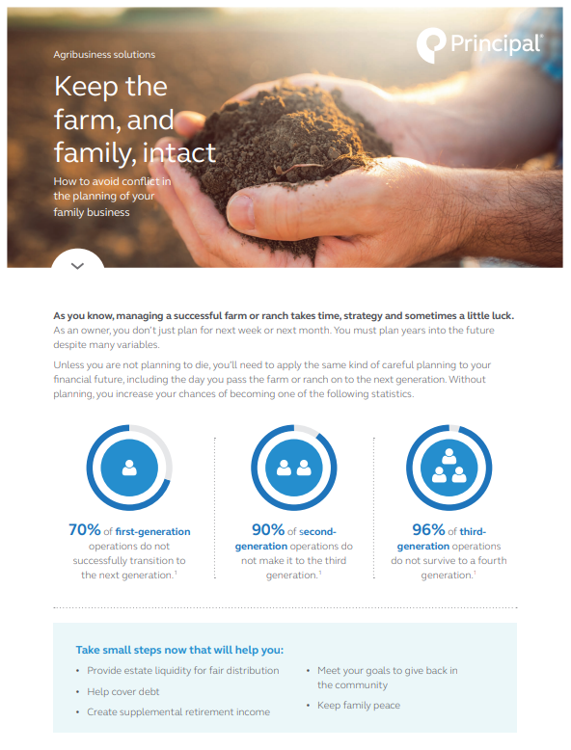
Agribusiness approach
We offer tools to help guide the conversation.
Marketing guide (BB11775)
Approach brochure (BB11777)
Conflict flyer (BB11573)
For financial professional use only. Not for distribution to the public.
Notes:
We offer an approach package for use with agribusiness clients and prospects. It includes a marketing guide and materials you can use with the client to start a planning conversation.
BB11775 Agribusiness marketing guide
BB11777 Agribusiness approach brochure
BB11573 Conflict flyer

Slide 42
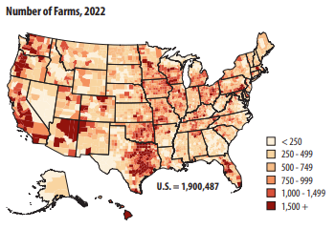
Agribusiness approach
Opportunities are vast
2022 Census of Agriculture
https://www.ers.usda.gov/topics/farm-economy/land-use-land-value-tenure/
https://www.agcensus.usda.gov/Publications/2017/Full_Report/Volume_1,_Chapter_1_US/
For financial professional use only. Not for distribution to the public.
Notes:
The opportunity in the Ag market is significant:
According to the USDA National Agricultural Statistics Service, the U.S. had just over 1.9 million farms, accounting for 880.1 million acres of farmland (or about 2 out of ever 5 acres of land in the U.S.) in 2022.¹
¹ 2022 Census of Agriculture Highlights, USDA NASS, 2022 Census of Agriculture

Slide 43
Agribusiness approach Getting started
Break the big questions into smaller, manageable ones.
Where are you now?
Where are you going?
How will you get there? there?
For financial professional use only. Not for distribution to the public.
Notes:
Often times, the big question owners have may seem be too big, too complex or have too many moving parts. But they have resolved to do something about it, despite these doubts and fears. Once they’ve made up their mind, the question changes to, “Where do I start?” As with any problem happening on their farm/ranch, start by breaking the big questions into smaller, more manageable ones. It’s like breaking down an engine into its “nuts and bolts.”

Slide 44
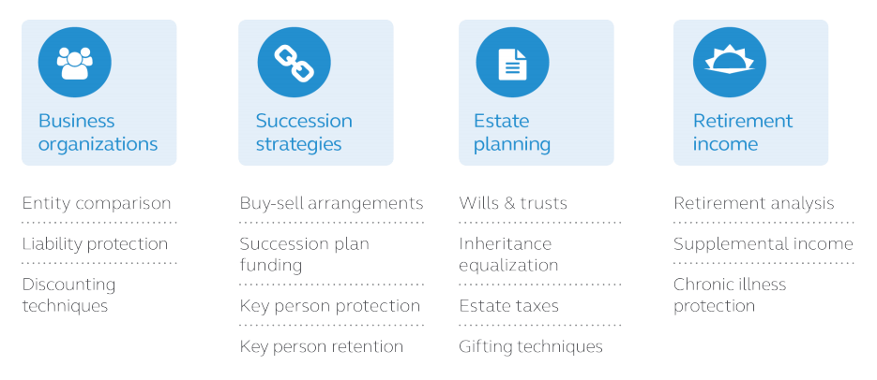
Agribusiness approach
Help them determine where to start
For financial professional use only. Not for distribution to the public.
Notes:
Farmers, ranchers, and other agricultural professionals have worked to build financial security through their operations. But without proper planning, their hopes for transitioning their land and their legacy could be derailed. We offer tools and solutions to provide your farm and ranch clients with the help they need for a seamless, successful transition.
At Principal, we start by breaking the big questions down into four key areas: business organizations, succession strategies, legacy and estate planning, and retirement income.
From there, we approach each key area as a building block for the next – one piece at a time.
Within each building block of the Ag Planning Report, the information and solutions are customized to focus in on specific conditions and goals. By tackling them “one piece at a time,” clients can make steady, tangible and coordinated progress.
Whether they farm row crops, raise livestock, run a dairy, own an orchard or another form of agribusiness, the questions remain the same:
How will the agribusiness owners protect their legacy while providing for their family?
What does their agribusiness operation look like now, and what will it look like when they are gone?
How will the agribusiness owners protect their assets while alive, reward their successor’s efforts, yet still be fair to their other heirs?
How will the owners pass the agribusiness to the next generation while minimizing taxes?

Slide 45
Agribusiness approach What’s next?
Complete the agriculture planning questionnaire
Receive and review the agribusiness planning report there?
For financial professional use only. Not for distribution to the public.
Notes:
Once you’ve determined where they want to focus, you can complete the agriculture planning questionnaire, submit it to Business and Advanced Solutions, and then review the report with your prospects/clients.

Slide 46
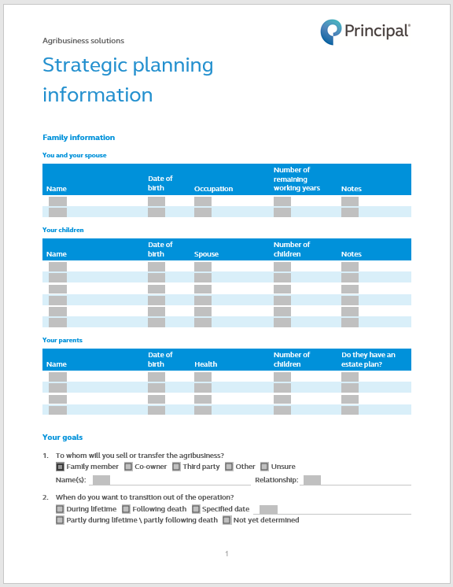
Agribusiness approach
Complete a planning questionnaire
Condensed for quicker and easier completion
Complete and send to the Business and Advanced Solutions team
Fact finder (BB11776C)
For financial professional use only. Not for distribution to the public.
Notes:
BB11776C Agribusiness Solutions Fact Finder

Slide 47
Agribusiness approach
Review the customized report
Complimentary agribusiness solutions planning report
Customized to your client’s specific needs
Prioritize and target your client’s agribusiness planning needs
Work with your client’s team of advisors to implement and maintain a succession plan
Attorney
CPA
Financial professional
Sample proposal (BB11824)
For financial professional use only. Not for distribution to the public.
Notes:
Read directly from the slide.

Slide 48
Agribusiness approach
Present a client workshop
Workshop presentation (BB10368)
For financial professional use only. Not for distribution to the public.
Notes:
For those who would prefer to hold financial workshops to prospect in this market, we also offer a client presentation specific to the needs of these clients (BB10368).

Slide 49
Business Owner Retirement Analysis
Notes:
Sometimes, it may make sense to approach a business owner about retirement since it’s often a topic people want to talk about.

Slide 50
Business Owner Retirement Analysis Why does this approach work?
Many business owners believe their business will fund their retirement needs.
To maintain their current standard of living, business owners may need at least 80% of their pre-retirement earnings.
There may be lack of understanding about the potential impact to the on-going business if exiting business owners don’t have other means of income to help meet their retirement goals.
They likely also need information about other income sources that could help them meet their goal.
For financial professional use only. Not for distribution to the public.
Notes:
Read directly from slide.

Slide 51
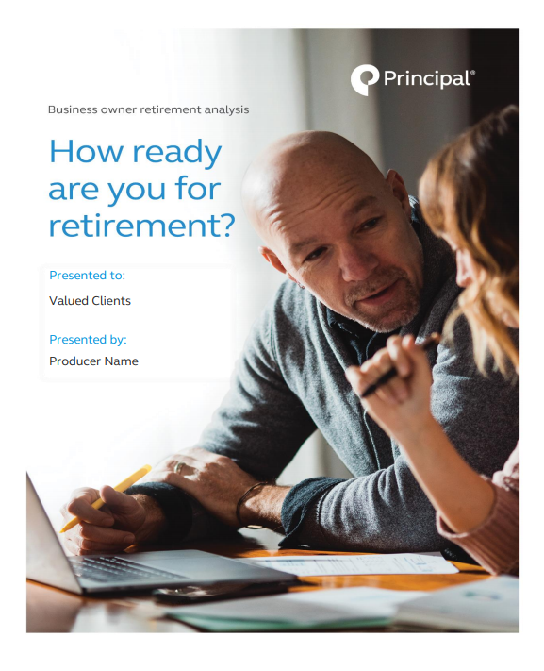
Business Owner Retirement Analysis
Analysis report
Factors impacting the reality of the business funding their retirement:
Value of their business
Business transition plans
Current savings/investments
Identifying any gaps
Providing potential solutions
Business Owner Retirement Analysis (BB11876)
Notes:
Core to this approach is a free, personalized Business Owner Retirement Analysis (BB11876).
This proposal takes into consideration the factors affecting your client’s ability to retire when and how they want, including:
The value of their business
Their business transition plans
Their current personal savings and investments
Any gaps or problems identified
As well as recommended solutions
This puts you in a good position to bring value to your clients and drive your sales.

Slide 52
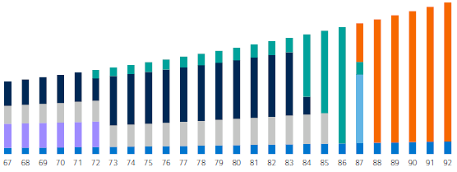
Identifying the gap
Business Owner Retirement Analysis
Hypothetical example for illustrative purposes only.
Notes:
Let’s look at the retirement income potential with proceeds from the sale of our sample business along with the business owner’s other assets. Based on the information the prospect provides, we put together the following analysis.
ASSUMPTIONS:
Desired annual income is $300,000 AFTER-TAX, inflating at 3% over time.
REVIEW THE ASSETS, AND CORRESPONDING COLORS:
-Sale of Business (PURPLE)
-Social Security (BLUE)
-Rental Income (LIGHT GREY)
-Investment Income (DARK BLUE)
-Qualified Plans & IRAs (TEAL)
-Gap (ORANGE)
This calculation OF THE GAP is based on distributing the available assets in the most tax-efficient manner possible. Now, let’s look at the Appendix for a year-by-year analysis of those distributions, by asset type.

Slide 53
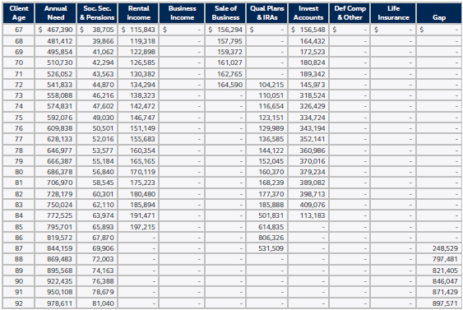
Appendix
Business Owner Retirement Analysis
Hypothetical example for illustrative purposes only.
Notes:
The client’s CURRENT retirement income sources on a year-by-year AND by asset type (DOES NOT INCLUDE LIFE INSURANCE POLICY YET – Notice the retirement income GAP identified in the last column. All income sources are assumed to be ‘after-tax’.
On the prior slide, the “Gap” (of $1,118,745) represents how much extra you will need at retirement age to meet your retirement goals through your retirement years. These numbers in the “Gap” column is the present value of the future estimated retirement deficits, each year.
In this example, the sum of the Gap column at ages 86+ exceeds $5MM. On a present value basis, this is approximately $1,118,745 when the client retires at age 67.
Remember, this calculation is based on distributing their available assets in the most tax-efficient manner possible.

Slide 54
Options to address the gap
Business Owner Retirement Analysis
Work longer
Increase the market value of your business
Save more
Bridge the gap with a supplemental retirement plan
Notes:
So, what are the options you can employ to address the GAP that was identified? Well, there are always multiple options to consider:
Work longer:
This isn’t an ideal option, but one many at least consider, nonetheless.
Increase the market value of the business:
Consider activities that can help make the business worth more to cover the gap amount (net of capital gains), such as reducing discretionary expenditures, and/or increasing revenues.
Save more:
Implementing a nonqualified supplemental retirement plan may be a tax-efficient way to create additional retirement income. Contributing to an additional retirement plan may help the business owner meet their goals.
Bridge the gap:
Now that we have identified that there is a gap between what the business owner has in place for retirement, and what they will likely need, let’s take a closer look at this possible solution.

Slide 55
Overcoming the gap
Business Owner Retirement Analysis
How it works
The business owner selects an amount to contribute on an after-tax basis.
Contributions are used to fund a personally-owned asset that finances the plan (i.e., company cash flow).
At retirement, the business owner can access accumulated values in the plan to supplement their income.
Supplementing retirement income with a nonqualified retirement plan.
Notes:
Read directly from slide

Slide 56
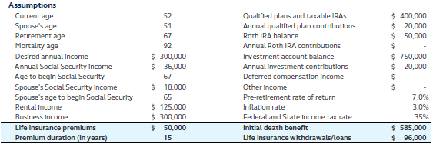
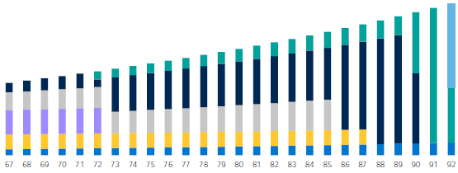
Overcoming the gap
Business Owner Retirement Analysis
Hypothetical example for illustrative purposes only.
Notes:
Now, let’s look at their retirement income potential with the proceeds from the sale of the same client’s business, supplemented with a nonqualified retirement plan to address their retirement gap. Based on the information they provided, we've put together the following analysis.
- Note that none of the assumptions changed, other than we added a new supplemental retirement plan funded with a life insurance policy.
- The annual desired income is still $300,000 AFTER-TAX, inflating at 3% over time.
So, now let’s look at what is different:
The nonqualified supplemental retirement plan details:
- In this example, the client will begin paying life insurance premiums at current age (52) and continue paying premiums for 15 years to age (67) for a total of 15 annual premium payments of $50,000.
- There will also be an initial death benefit of $585,000 which can be payable to the client’s personal beneficiaries.
- Once distributions start at retirement age (age 67) for this sample client, they may be able to withdrawal an annual amount of $96,000, to help satisfy their estimated retirement income gap.
AGAIN, REMEMBER TO EXPLAIN COLORS
-Sale of Business (PURPLE)
-Social Security (BLUE)
-Rental Income (LIGHT GREY)
-Investment Income (DARK BLUE)
-Qualified Plans & IRAs (TEAL)
- HIGHLIGHTING THE NEW SUPPLEMENTAL RETIRMENT PLAN DISTRIBUTIONS (YELLOW)

Slide 57
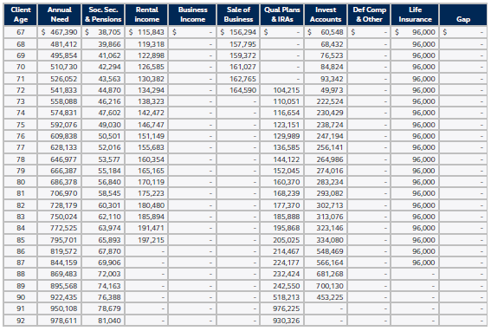
Appendix
Business Owner Retirement Analysis
Hypothetical example for illustrative purposes only.
Notes:
This time, we’re showing the client’s retirement income sources, on a year-by-year analysis by asset type - with the distributions from the new supplemental retirement plan distributions, highlighted on this slide.
As you can see, the GAP is now $0, because of this additional income source.
Remember that all income sources are after-tax, and that this calculation is based on distributing the client’s available assets in the most tax-efficient manner possible.

Slide 58
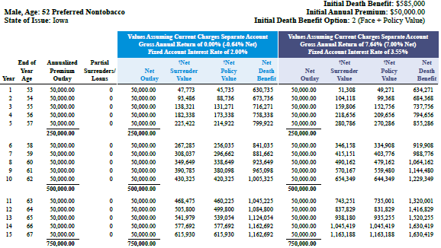
Sample illustration
Business Owner Retirement Analysis
Accumulation period
Assumptions: Principal Executive VUL III, male, age 52, Preferred Nontobacco, $585,000 initial death benefit, $50,000 annual premiums for 15 years, distributions starting at age 67 for 20 years
Hypothetical example for illustrative purposes only.
Notes:
This sample illustration shows the client (age 52) purchasing a Principal Executive Variable Universal Life III policy with a face amount of $585,000 to use for death benefit protection and supplement retirement income. In this example, the client pays an annual premium of $50,000 to retirement (age 67).

Slide 59
Sample illustration
Business Owner Retirement Analysis
Distribution period
Assumptions: Principal Executive VUL III, male, age 52, Preferred Nontobacco, $585,000 initial death benefit, $50,000 annual premiums for 15 years, distributions starting at age 67 for 20 years
Hypothetical example for illustrative purposes only.
Notes:
This part of the illustration shows annual distributions of $96,000 from the policy to supplement other retirement income sources. With Principal, your clients benefit from our innovative automated income platform that automatically switches the death benefit option from increasing to level when distributions begin, takes distributions as withdrawals until cost basis has been removed and then automatically switches to policy loans, and converts the policy to a reduced paid-up status when distributions have completed to prevent the policy from lapsing and creating a taxable event.

Slide 60
Business Owner Retirement Analysis Target market
Owners of for-profit businesses of varying entity types, including C corporations, S corporations, partnerships, and LLCs
Owners who want to use their business as a source of retirement income—from either a sale or other transition method
Owners of businesses with good financial integrity
For financial professional use only. Not for distribution to the public.
Notes:
So, now that we’ve shared the concept and proposal with you, let’s talk about who might be a good prospect to approach with this solution. Review slide.

Slide 61
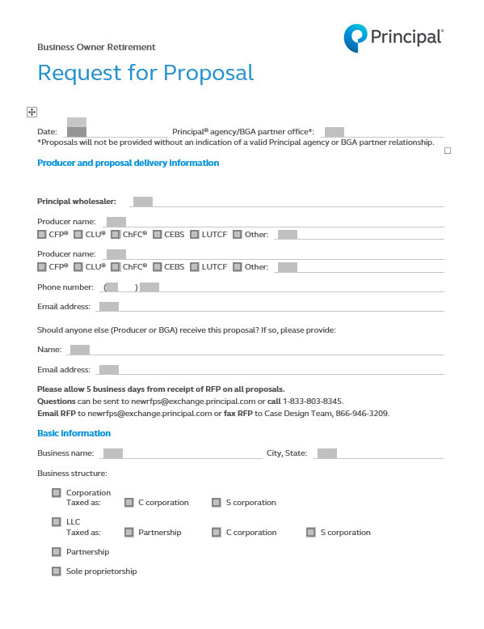
Business Owner Retirement Analysis Start the conversation.
Approach brochure (BB11848)
Request for proposal (BB11879)
For financial professional use only. Not for distribution to the public.
Notes:
When approaching these business owners, you can use the approach brochure to outline factors for business owners to consider when planning for retirement. It promotes personalized planning tools such as the Business Owner Retirement Analysis, the Informal Business Valuation and Planning Report and Buy-Sell Review.
Then download the Request for Proposal, complete and submit to Business and Advanced Solutions by sending it to: newRFPs@principal.com to receive this comprehensive Business Owner Retirement Analysis report, customized for your client.

Slide 62
Typical sales process for business market solutions
Business Owner Retirement Analysis
Offering potential solutions
Approach with tools & resources
Discuss potential needs
Present sample solution
Meet with client & identify needs
Submit RFP and present to client
For financial professional use only. Not for distribution to the public.
Notes:
Once you identify a prospective client – a common question we receive is how does the typical case flow. Every case is different, but this will give you an idea of the steps we normally see.
Approach, Informal Business Valuation, or other approach package – Many times, the initial discussion leads to an informal business valuation or buy-sell review, which helps show the business owner where to start.
Principal provides the complimentary valuation when you send in a request for proposal and 3 years of financial statements (income statements and balance sheets).
Discuss potential needs and sales opportunities with BGA/Principal resources – The resources at Principal are glad to work with us to help identify some areas of planning from the informal business valuation. They can provide some key questions that might get the business owner to recognize the need and move through the process.
Discuss with client to uncover most important needs – You would meet with the client to present the informal business valuation and find out what their No. 1 need is and where they want to start.
Develop solution with BGA/Principal resources – By working with the resources at Principal, we can put together a customized proposal for the solutions that meets their needs. Their proposals objectively show multiple financing options.
Present solution – The solution is presented to the business by you on your own (with tips from Principal) or with Principal resources (on phone or in person).
Make sales!

Slide 63
Business Owner Retirement Analysis When business owner clients turn to you, you can turn to us. Find everything you need in one place.
Prospecting and approach tools
Technical expertise of Business & Advanced Solutions team
Customized proposals with potential solutions
Business-focused product portfolio and underwriting programs
Local sales support
Plan administrative services
For financial professional use only. Not for distribution to the public.
Notes:
We can provide a platform of tools, solutions and resources that are designed to enable you to meet your clients’ needs through Principal. You can rest assured the solution we help you deliver will be well thought out and fully supported by Principal.
Everything you need is in one place to help you identify needs, implement solutions and manage results for your business owner clients.

Slide 64
Strategic Alliances approach
Notes:
Up next is a quick overview of our property and casualty approach.

Slide 65
Strategic Alliances approach Why does this approach work?
Adds value as a natural extension to an existing trusted relationship with Property & Casualty (P&C) agencies, certified public accountants (CPAs), etc.
Helps enhance firms’:
Persistency of core business
Image in the marketplace
Profitability
Firm valuation
Aids staff retention and recruiting
Creates an additional profit center and diversification of revenue
For financial professional use only. Not for distribution to the public.
Notes:
The strategic alliance brand provides a good opportunity for you to help them extend their risk protection offering. By offering additional product lines, you can help the strategic alliance enhance the persistency of their core business and increase their image in the marketplace. You can also help increase their profitability, and as a result, the value of their firm. Offering additional product lines can also help them with retaining clients as well as staff retention and recruiting goals. Bottom line, it creates an additional profit center for them and helps diversify their revenue to create more stability.

Slide 66
Strategic Alliances approach What’s the opportunity?
Get commitment – from the top, down!
Business plan (overcome fear of “cherry picking” clients)
Define the potential – P&C Revenue Opportunity calculator
Education – to open opportunities, not to sell additional products
Use technology to streamline the new business process
Make it easy!
Process
Tools
Resources
For financial professional use only. Not for distribution to the public.
Notes:
Get commitment – from the top, down! Getting commitment from the principals of the firm is the best strategy. They will help ‘enforce’ the process.
Business plan (overcome fear of “cherry picking”) This helps the principals and financial professionals to have a clear picture of the value you will bring to the relationship. That you’ve put a plan and process around your relationship – that you’re not just there to ‘cherry pick’ a few good and/or high-end cases!
Define the potential – for P&C agencies, use the revenue opportunity calculator
Education – to open opportunities, not to sell additional products
Use technology when available – accelerated underwriting, online applications, etc.
Make it easy!
Process
Tools
Resources

Slide 67
Strategic Alliances approach The Principal difference Lean on us when you need help!
Offer more than just product:
Provide tools/resources that can help them easily uncover opportunities
Offer value-add: Business Planning Services
Leverage time-saving underwriting programs, online applications, etc.
Help them strengthen their client relationships – additional product sales can lead to better retention
Guide their support teams through the process of easily adding life insurance to their business
For financial professional use only. Not for distribution to the public.
Notes:
We’ve been in this market for several years, and over time, we’ve engaged in research, focus groups and working with financial professionals who’ve had success in this marketplace. As a result, we continue to develop new tools and tweak existing tools and resources to help financial professionals have success in this market.
Our intention is to offer financial professionals the “Principal difference” as we do with our other approach platforms. We offer those of you who work with or want to work with P&C firms and other strategic alliances, value-added solutions, service and support throughout the sales process – not just product!
Our hope is that together, we can help your trusted relationships:
Identify and uncover the opportunities
Offer value-added Business Planning Services and personal risk protection solutions
The opportunity to leverage our time-saving underwriting and new business tools
Help them strengthen their client relationships leading to increased retention and value for the firm
Guide their support teams through the process of easily integrating life insurance to their business
And should you decide to implement this strategy for your business, the good news is you can lean on us whenever you need help throughout the entire process!

Slide 68
Strategic Alliances approach What’s the process?
Identify and research
Initiate contact and build trust at decision maker level
Expose potential – revenue opportunity calculator
Develop a plan
Establish goals
Commit and implement
Analyze metrics to define success
For financial professional use only. Not for distribution to the public.
Notes:
We’ve identified seven key steps to having success in this market. We’re making tools available on our platform that help you through these steps to building and implementing a successful relationship.
The seven key steps include the following:
Identify and research which P&C firms you’ll approach – In our new producer opportunity guide, you’ll find suggestions on the types of firms to approach and ideas on how to identify and research those in your area.
Initiate contact and build trust at decision maker level – In the opportunity guide, we provide suggestions on defining your value proposition and approach to the firms. Learn from ideas other producers have used and found beneficial.
Expose the potential with the revenue opportunity calculator – We’re updating the data behind our revenue opportunity calculator so you can show P&C principals just what integrating additional risk protection solutions into their business could mean for their bottom line.
Develop a plan – We offer a sample business plan template complete with suggested ideas and activities you can implement.
Establish goals – Be sure to establish goals and expectations of each party. We all know the “referral trading” process doesn’t work. This has to be a real working relationship where both parties are committed to the others’ success as well as their own.
Commit and implement – Whether you have a formal business plan that you agree to, or you just discuss the expectations of both parties, compensation and process, all parties need to commit to the working relationship and implement a strategy that keeps you engaged and in touch.
Analyze metrics to define success – Once you’re engaged in the process, meet on a recurring basis to discuss metrics, define success and share it as often as possible.

Slide 69
Strategic Alliances approach Benefit from a comprehensive platform Get all resources you need at principal.com/strategic alliances
Opportunity guide
Suggestions for identifying and approaching strategic alliances
Sample business plan template
Implementation strategies
Discussion topics/talking points
Approach tools
Value-added client approach services and resources
Informal business valuation/buy-sell review
Key person calculator (life and disability insurance)
Streamlined underwriting programs (life and disability insurance)
Marketing campaigns
For financial professional use only. Not for distribution to the public.
Notes:
Guide your strategic alliance relationships to integrate life insurance into their practice.
We offer an opportunity guide with:
Suggestions on identifying and approaching applicable firms
Sample business plan template
Implementation strategies
Discussion topics/talking points
Approach tools that include an approach brochure, emails & letters
Value-added client approach services and resources:
Informal business valuation/buy-sell review
Key person calculator (life and disability insurance)
Streamlined underwriting programs (life and disability insurance)
Marketing campaigns

Slide 70
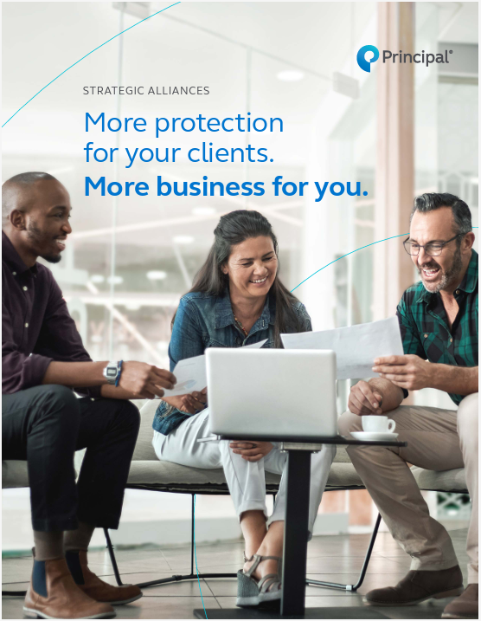
Strategic Alliances approach
Tools to help start the conversation
Approach brochure
P&C Revenue Opportunity calculator
Emails, flyers, and infographics can help the firm introduce the new offering to their clients
Dedicated home office resource available for consultation
Approach brochure (BB11975)
Notes:
Read directly from slide.

Slide 71
Questions
Notes:
[Optional: If time allows, you can offer Q&A at the end of the session.]
Are there any questions I can address for you before we go?

Slide 72
Let’s connect
Contact your wholesaler or the Business and Advanced Solutions hotline at 833-803-8345.
Visit us at advisors.principal.com.
For financial professional use only. Not for distribution to the public.
Notes:
Read directly from slide.

Slide 73
Insurance products issued by Principal National Life Insurance Company (except in NY), Principal Life Insurance Company®, and the companies available through the Preferred Product Network, Inc. Plan administrative services offered by Principal Life. Principal Funds, Inc. is distributed by Principal Funds Distributor, Inc. Securities offered through Principal Securities, Inc., Member SIPC, and/or independent broker/dealers. Referenced companies are members of the Principal Financial Group®, Des Moines, IA 50392.
No part of this presentation may be reproduced or used in any form or by any means, electronic or mechanical, including photocopying or recording, or by any information storage and retrieval system, without prior written permission from the Principal Financial Group®.
Not FDIC or NCUA insured. May lose value . Not a deposit. No bank or credit union guarantee. Not insured by any Federal government agency.
Principal®, Principal Financial Group® , and Principal and the logomark design are registered trademarks of Principal Financial Services, Inc., a Principal Financial Group company, in the United States and are trademarks and service marks of Principal Financial Services, Inc., in various countries around the world.
For financial professional use only. Not for distribution to the public.
BB11336C-04 | 03/2024 | 3455839-032024 | © 2024 Principal Financial Services, Inc.
Notes:
[Leave on screen long enough for people to read.]

