Slide 1
Principal® Deferred Compensation – 457(b) and 457(f)
Strengthen your organization and drive key employee performance
PRESENTER NAME (ALL CAPS)
The presenter’s title goes on this line
Notes:
[ Welcome attendees and introduce yourself. ]

Slide 2
What are 457(b) and 457(f) plans?
These plans are employer-sponsored benefits of 501(c) or non-governmental tax-exempt organizations for the key employees you choose. It’s basically an agreement between you and your key employees.
Those who participate in a 457(b) plan defer a portion of their annual compensation or bonuses into the plan before taxes. You can also make discretionary contributions to a 457(f) plan beyond the 457(b) plan limits. And you promise to distribute that money, plus any earnings and additional employer contributions, to them at a future time.
Notes:
Read slide

Slide 3
Keep your key employees satisfied
What can you do now to help ensure your top talent remains committed to you—and not the competition? Enhance your benefits package with a 457(b) and/or 457(f) plan. These plans can give you a competitive advantage by:
Encouraging the best employees to join your organization as it grows.
Keeping your key employees satisfied and motivated for the long term.
Rewarding them for reaching goals.
Helping employees bridge the retirement gap resulting from 401(k) or 403(b) plan testing and limitations.
Notes:
Read slide

Slide 4
Findings in today’s market* From plan sponsors with existing deferred comp plans
77% concerned about losing key employees
94% concerned about attracting key employees
Primary reason for employer contributions: Retention
Use of plan:
59% recruiting
66% retention
* 2022 Trends in Nonqualified Deferred Compensation, conducted by Principal.
Notes:
Read slide

Slide 5
Helping you choose a plan to fit your needs
Discover. Identify the issues your organization wants to resolve and what you want to achieve.
Solve. Learn how this plan can help solve your business challenges and achieve your objectives.
Design. Use the plan’s flexibility to tailor a plan to your organization’s and participants' needs.
Collaborate. Trust the service and expertise we’ll provide to you and your key employees every step of the way, year after year.
Stay current. Make changes to your plan as your organization’s needs and goals change.
Notes:
Read slide

Slide 6
Discover
Identify issues your organization wants to resolve and what you want to achieve
Notes:
Read slide

Slide 7
What are your organization’s goals?
Recruit
Attract the best employees as part of a competitive benefits package.
Retain
Encourage key employees to remain loyal to your organization.
Reward
Provide performance-based contributions to achieve organizational goals.
Retire
Help your key employees save enough for retirement above what 401(k) or 403(b) plans allow.
Notes:
Read slide

Slide 8
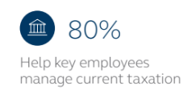
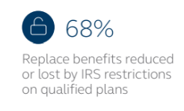
Why plan sponsors offer deferred comp plans*
* 2022 Trends in Nonqualified Deferred Compensation, conducted by Principal.
Notes:
Read slide

Slide 9
What are your key employees’ goals?
Retirement savings
Save beyond 401(k) or 403(b) plan limitations with employee deferrals or optional employer contributions.
Managing taxes
Help manage the impact of taxes using the plan's flexibility for when benefits are paid.
401(k) or 403(b) restoration
Use employee deferrals or employer contributions from deferred comp to restore benefits limited under a 401(k) or 403(b) plan.
Notes:
Read slide

Slide 10
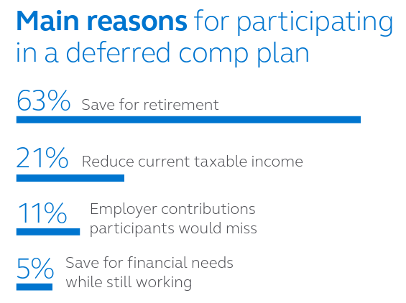
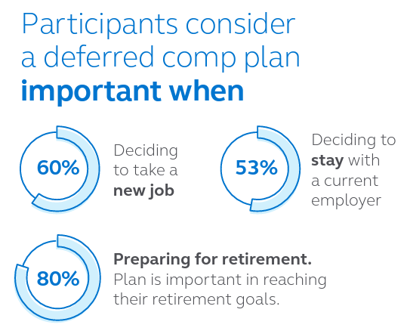
Why participants consider deferred comp important*
* 2022 Trends in Nonqualified Deferred Compensation, conducted by Principal.
Notes:
Read slide

Slide 11
Solve
Learn how this plan can help solve your business challenges and achieve your objectives
Notes:
Solve
Once you’ve identified the most important goals, then consider the role that this plan can play in helping achieve those goals. The plan offers benefits and considerations for both the organization and the key employees.

Slide 12
Are the plans right for you and your key employees?
The 457 plans can be beneficial in helping meet retirement and other savings goals. The 457(b) plan allows your key employees to save beyond retirement plan limits, and the 457(f) plan allows optional employer incentive contributions beyond 457(b) limits. Plus, the plans don't require discrimination testing, minimum participation or Form 5500 filing if set up properly.
Notes:
Read slide

Slide 13
Are the plans right for you and your key employees?
It's also important for plan participants to remember that it's a promise from you, their employer, to pay benefits to them in the future—and compensation deferred into the plan isn't protected in the event of bankruptcy.
But there are security mechanisms, like trusts, that you can put in place to provide a measure of protection.
Notes:
Read slide

Slide 14
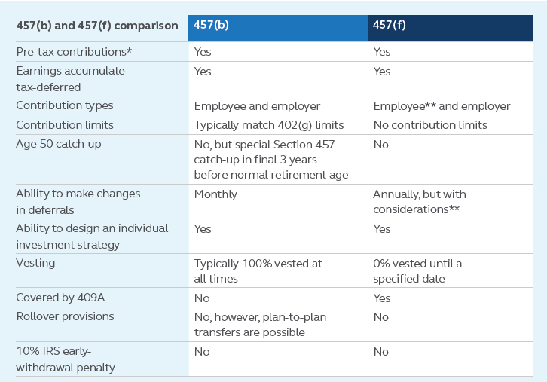
Key features of both plans
* The 457(f) plan balances are subject to FICA and income taxes at vesting. The 457(b) plan contributions are subject to FICA/FUTA at vesting and subject to income taxes at time of distribution. Deferrals may not be treated as pre-tax in all states. Participants should discuss the impact of taxes with their tax advisor.
** Optional, but with considerations for the employee and additional expenses for the employer.
Notes:
To help get a better idea of how 457 plans might help your organization let’s look at some key features of both plans.
Read slide

Slide 15
Design
Use the plan’s flexibility to tailor a plan to help meet your organization’s and participants’ needs
Notes:
Read slide

Slide 16
How’s the plan created?
Who participates
Select the groups of key employees to participate in this plan.
What can be contributed
You can allow key employee deferrals* in excess of retirement plan limits and/or provide employer contributions with the flexibility to vary benefits by employees.
What happens with the contributions
You can select an investment line-up for participants from a broad range of options. In addition, you can decide how and when key employees may receive the benefits based on organizational needs.
How benefits are paid
Decide how payouts can be received from the plan. Benefits from 457(b) plans can be distributed as a lump sum or in annual installments, while 457(f) benefits are usually paid as a lump sum.
* Optional with a 457(f) plan, but with considerations for the employee and additional expenses for the employer.
Notes:
You're in control of making the plan yours – it’s based on the specific goals of your organization and unique needs of your key employees. Together with your financial professional, we’ll walk you through the decisions that need to be made to design a plan that makes sense for your organization:
Read the slide

Slide 17
Design
How it works
* Optional, but with considerations for the employee and additional expenses for the employer.
Notes:
This chart shows how money is contributed to the 457 plan and paid out at a later date. It also points out that when the benefit is distributed to the key employee, the employer receives an income-tax deduction and the key employee pays income tax on it.

Slide 18
How does an organization pay for it?
Company cash
Taxable investments
No specific plan assets are set aside. Instead, benefits are paid through company's cash flow.
The company invests in mutual funds and/or individual securities.
Notes:
Keeping your promise to pay benefits to participants in the future is important. Any of these financing options can help you do that.
Read slide

Slide 19
Collaborate
Trust the service and expertise we’ll provide to you and your key employees every step of the way, year after year
Notes:
Collaborate
You want to offer key employees the benefits they value – and those that will have a positive influence on them and your organization. Trust the service and expertise we’ll provide to you and your key employees every step of the way, year after year

Slide 20
How do we work with your organization?
Our team of professionals will work closely with you and your financial professional to develop a strategy for implementing and servicing your deferred comp plan.
But we don’t stop there. Year after year, we’ll continue to work closely with you and your financial professional to fine-tune your plan to help ensure your organization's goals are met—and your plan is administered as efficiently as possible.
Notes:
Read slide

Slide 21
Keeping you in-the-know
To help you stay on top of your plan, a range of information is available on our website and corporate accounting reports. You also have easy access to plan reporting, investment resources, and other tools to assist with administering your plan. Plus, depending on plan type and design, you’ll receive:
Access to plan participants’ account information.
Daily valuation of assets/liabilities.
Asset/liability information and rebalancing services.
Updates on enrollment progress.
Quarterly newsletter featuring legislative news, service updates, and more.
Notes:
To help you stay on top of your plan, a range of information is available on our website and corporate accounting reports. You also have easy access to plan asset and liability reporting, investment resources and other tools to assist with administering your plan. Plus, depending on your plan type and design, you’ll receive:
Read slide

Slide 22
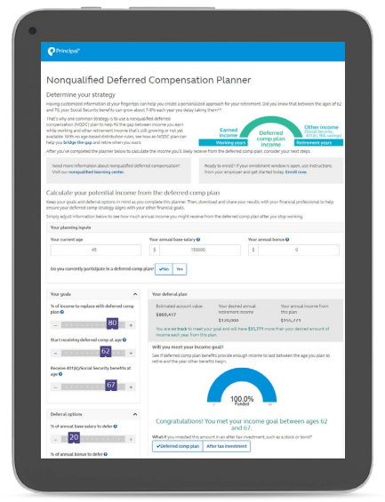
Turning key employees into participants
We’re here to help every step of the way:
Step 1: Introduce the plan. We provide custom education to introduce the plan.
Step 2: Enrollment. Participants can enroll online and our deferred comp professionals are available to answer questions Monday-Friday.
Step 3: Ongoing education and planning. We help your participants stay on track through communication and education, plus plan information online.
Notes:
Understanding the benefits of this exclusive plan is the first step – it’s what will encourage your key employees to participate. We're here to help every step of the way:
Step 1: Introduce the plan
Whether this is a brand-new benefit or employees are familiar with this type of plan, we offer award-winning* custom education to introduce plan basics. We'll help
you make sure your employees are aware they are eligible so they can make an informed decision to participate.
Step 2: Enrollment
Participants can conveniently enroll online at principal.com. Our deferred compensation plan specialists are available to answer questions Monday-Friday.
Step 3: Ongoing education and planning
Your participants need support to stay on track. We can also provide you with additional communication and education to promote greater understanding and appreciation of the benefit. Participants can find information about their accounts, investment strategy, contributions and scheduled distributions at principal.com.

Slide 23
Stay Current
Make changes to your plan as your organization’s needs and goals change
Notes:
Read slide

Slide 24
How does your plan keep up with your needs & goals?
Close attention to the plan over time, such as a participant’s account balance from the beginning of the plan until payout.
Experienced specialists who offer feedback on factors that can influence the plan, such as plan design changes and regulatory updates.
Access to online dashboards of information.
Notes:
The 457 plan is your plan. Its long-term success depends on how well it keeps pace with your organization’s needs and goals -- today and tomorrow. So once your plan is in place, we’ll make sure to provide:
Read slide

Slide 25
Ready to get started?
Once you decide that a 457(b) and/or 457(f) plan is right for your organization and key employees, we’ll bring our expertise and resources to the table to help you put this plan in place within your desired timing.
We’ll begin by:
Gathering information about your organization.
Tailoring the plan to your specific needs and goals.
Thousands of employers value the solutions and services we provide. You can count on us, too. We’ll do our best to deliver a positive experience for everyone involved.
Notes:
Read slide

Slide 26
An industry leader in your corner
Our history speaks for itself. We’ve been providing deferred comp plans for more than 35 years and are the No. 1 provider of deferred comp plans.* What sets us apart from others is our:
Commitment to and experience in the business and retirement plan markets.
Unique plan design and flexibility to tailor it to specific needs and goals.
Specialized team of legal, accounting, and financing resources with more than 200 years of experience to provide support.
Service and commitment to building long-lasting relationships.
* Based on number of NQDC plans (excluding 457 plans), PLANSPONSOR Recordkeeping Survey, July 2022.
Notes:
Our history speaks for itself. We’ve been providing nonqualified deferred compensation plans for more than 34 years, and the No. 1 provider of deferred comp plans.
What sets us apart from others is our:
Commitment to and experience in the business and retirement plan markets.
Unique plan design and flexibility to tailor it to specific needs and goals.
Specialized team of legal, accounting and financing resources with more than 200 years of experience to provide support.
Service and commitment to building long-lasting relationships.
A member of the FORTUNE 500®, our employees are passionate about helping clients of all income and portfolio sizes achieve their goals. You can count on us to offer innovative ideas, investment expertise and real-life solutions to help make financial progress possible.
* Based on number of NQDC plans (excluding 457 plans), PLANSPONSOR Recordkeeping Survey, July 2022.

Slide 27
Thank you
Notes:
Read slide

Slide 28
Before investing, carefully consider the investment option objectives, risks, charges, and expenses. Contact a financial professional or visit principal.com for a prospectus or, if available, a summary prospectus containing this and other information. Please read it carefully before investing.
The subject matter in this communication is educational only and provided with the understanding that Principal® is not rendering legal, accounting, investment, or tax advice. You should consult with appropriate counsel, financial professionals, and other advisors on all matters pertaining to legal, tax, investment, or accounting obligations and requirements.
Insurance products issued by Principal National Life Insurance Company (except in NY) and Principal Life Insurance Company®. Plan administrative services provided through Principal Life Insurance Company®. Principal Funds, Inc. is distributed by Principal Funds Distributor, Inc. Securities offered through Principal Securities, Inc., member SIPC and/or independent broker/dealers. Referenced companies are members of the Principal Financial Group®, Des Moines, IA 50392.
No part of this presentation may be reproduced or used in any form or by any means, electronic or mechanical, including photocopying or recording, or by any information storage and retrieval system, without prior written permission from the Principal Financial Group.
Principal®, Principal Financial Group®, and Principal and the logomark design are registered trademarks of Principal Financial Services, Inc., a Principal Financial Group company, in the United States and are trademarks and service marks of Principal Financial Services, Inc., in various countries around the world.
For Registered Representative Information only. Not for use with the general public.
BB11425-06 | 08/2023 | 3051367-082023 | Copyright © 2023 Principal Financial Services, Inc.
Notes:
Read the slide

