Slide 1
Options for every opportunity
Life insurance portfolio
PRESENTER NAME (ALL CAPS)
Title
Notes:
[Provide introduction.]

Slide 2
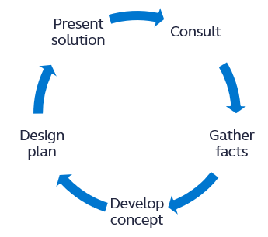
We can help you succeed in the business market
Business & Advanced Solutions talent is comprised of JD*, CPA**, CLU, ChFC, CFP®***, and MBA backgrounds
Deep knowledge in:
Key employee benefits
Business protection
Business succession
Legacy and estate planning
Comprehensive product portfolio to finance the plan
* JD is an educational degree and holder does not provide legal services on behalf of the companies of the Principal Financial Group®.
** CPAs do not provide tax or accounting services on behalf of the companies of the Principal Financial Group.
*** Certified Financial Planner Board of Standards Inc. (CFP Board) owns the certification marks CFP®, CERTIFIED FINANCIAL PLANNERTM, CFP® (with plaque design), and CFP® (with flame design) in the U.S., which it authorizes use of by individuals who successfully complete CFP Board's initial and ongoing certification requirements.
For financial professional use only. Not for distribution to the public.
Notes:
Finding and maintaining a solution gets easier with access to business, legal, and tax consultation at every step. As clients’ needs evolve or tax laws change, help is always available to guide them throughout the life of the plan.
When you collaborate with us, you get experienced sales support and personalized consulting every step of the way – from initial consulting and gathering facts to presenting the package to your clients.
Let’s talk about the comprehensive portfolio of life insurance products we offer to fit the business or personal need.

Slide 3
Find a product to fit the need
All guarantees are based on the claims-paying ability of the issuing insurance company.
For financial professional use only. Not for distribution to the public.
Notes:
Read directly from the slide.

Slide 4
Term life
For financial professional use only. Not for distribution to the public.
Notes:
Read directly from slide

Slide 5
Principal® Term
10-, 15-, 20-, and 30-Year Term
Non convertible and convertible options
2 death benefit increase riders
Quick and easy underwriting programs available
Key person calculator using term insurance
All guarantees are based on the claims-paying ability of the issuing insurance company.
Rider availability varies by state.
For financial professional use only. Not for distribution to the public.

Slide 6
Principal Term
Target market:
Ages 35-55
$1 million and greater death benefit
Better than Standard risk class
Sales opportunities:
Key person insurance
Buy-sell strategies
Limited-time coverage, e.g., proof of credit, business start up
All guarantees are based on the claims-paying ability of the issuing insurance company.
Rider availability varies by state.
For financial professional use only. Not for distribution to the public.

Slide 7
Principal® Guaranteed Issue Term II
Up to $5 million of individual 10- or 20-year Term
10 live minimum*
Issue ages: 20-70 for 10 YT, 20-54 for 20 YT
Offers portability if employee leaves employer
Sales opportunities:
Key person insurance
Buy-sell funding
Supplemental coverage offered as a key employee benefit
* We’ll consider groups of 5-9 lives if they have Principal group Term, VTL, or guaranteed standard issue individual disability insurance
All guarantees are based on the claims-paying ability of the issuing insurance company.
Rider availability varies by state.
For financial professional use only. Not for distribution to the public.

Slide 8
Current assumption universal life
For financial professional use only. Not for distribution to the public.
Notes:
Read directly from slide

Slide 9
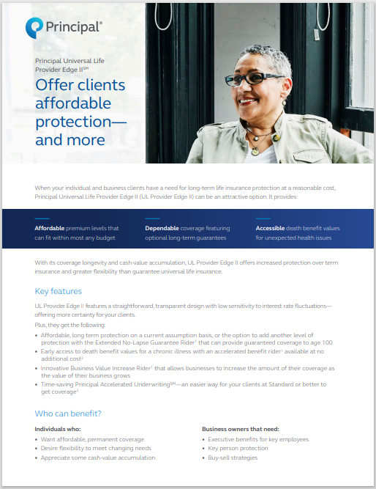
Principal Universal Life Provider Edge II℠
Lower-cost protection with some cash value accumulation
Optional no-lapse guarantee to age 100
Key riders: business value increase, chronic illness, cost of living increase, salary increase
Underwriting programs: Accelerated Underwriting, Business Solutions Enhanced Underwriting, Multi-life, Risk Upgrade
All guarantees based on the claims-paying ability of the issuing insurance company.
Rider availability varies by state.
For financial professional use only. Not for distribution to the public.

Slide 10
Principal Universal Life Provider Edge II
Target market:
Ages 45-70
$1 million and greater death benefit
Better than Standard risk class
Sales opportunities:
Key person insurance
Buy-sell strategies
Key employee benefits
All guarantees are based on the claims-paying ability of the issuing insurance company.
Rider availability varies by state.
For financial professional use only. Not for distribution to the public.

Slide 11
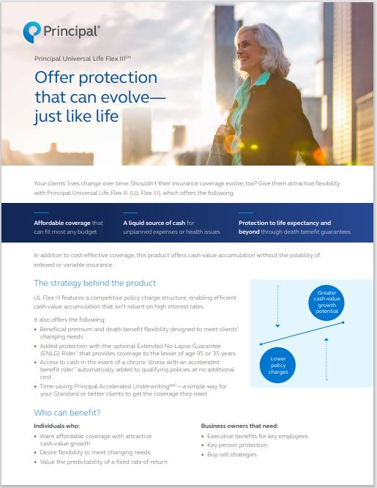
Principal Universal Life Flex III℠
Charge structure enables efficient performance
Optional no-lapse guarantee to age 95/35 years
Key riders: change of insured, chronic illness, cost of living increase, life paid-up, salary increase
Underwriting programs: Accelerated Underwriting, Business Solutions Enhanced Underwriting, Multi-life, Risk Upgrade
All guarantees based on the claims-paying ability of the issuing insurance company.
Rider availability varies by state.
For financial professional use only. Not for distribution to the public.

Slide 12
Principal Universal Life Flex III
Target market:
Ages 45-70
Moderate funding levels
Value flexibility of cash value over guarantees
Sales opportunities:
Key person insurance
Buy-sell strategies
Personal coverage for business owners, key employees, and their families
All guarantees are based on the claims-paying ability of the issuing insurance company.
Rider availability varies by state.
For financial professional use only. Not for distribution to the public.

Slide 13
Principal® Survivorship Universal Life Provider
Cost-efficient protection for two with some cash value accumulation
Optional no-lapse guarantee to age 100 of the younger insured
Key riders: four-year term, policy split option, terminal illness
Underwriting programs: Accelerated Underwriting, Business Solutions Enhanced Underwriting, Risk Upgrade
All guarantees based on the claims-paying ability of the issuing insurance company.
Rider availability varies by state.
For financial professional use only. Not for distribution to the public.

Slide 14
Principal Survivorship Universal Life Provider
Target market
Ages 55-75
$1 million and greater death benefit
Value death benefit guarantees
Sales opportunities:
Business transition planning
Estate planning
Charitable giving
Special needs planning
All guarantees are based on the claims-paying ability of the issuing insurance company.
Rider availability varies by state.
For financial professional use only. Not for distribution to the public.

Slide 15
Indexed universal life
For financial professional use only. Not for distribution to the public.
Notes:
Read directly from slide

Slide 16
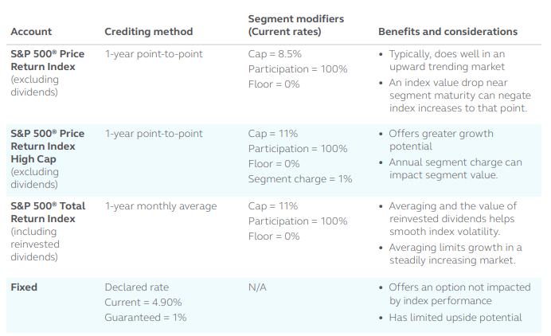
Accounts that fuel growth potential
All guarantees are based on the claims-paying ability of the issuing insurance company.
Rider availability varies by state.
For financial professional use only. Not for distribution to the public.

Slide 17
Principal Indexed Universal Life Accumulation II℠
Accumulation: Account Value Enhancement, adjusted segment balance
Distribution: 2 loan options, auto income
Key riders: change of insured, chronic illness, cost of living increase, life paid-up, surrender value enhancement
Underwriting programs: Accelerated Underwriting, Business Solutions Enhanced Underwriting, Multi-life, Risk Upgrade
All guarantees based on the claims-paying ability of the issuing insurance company.
Rider availability varies by state.
For financial professional use only. Not for distribution to the public.

Slide 18
Principal Indexed Universal Life Accumulation II
Target market:
Ages 35-55
Making max. contributions to Qualified plans, business owners
Seek cash value growth potential, without direct participation in market
Sales opportunities:
Key employee benefits
Buy-sell strategies
Businesses seeking high early cash values for the balance sheet
Business owner or individual retirement planning
All guarantees are based on the claims-paying ability of the issuing insurance company.
Rider availability varies by state.
For financial professional use only. Not for distribution to the public.

Slide 19
Income flexibility with loan options
 | Standard policy loan | Alternate policy loan
Offers | Certainty | Opportunity
Change rate | Fixed | Fixed
Credit rate | Fixed | Variable (ranges between cap and floor)
Advantage | Current zero net-cost years 11+ | Potential for indexed gains
Disadvantage | No indexed gains | Potential for large net cost
All guarantees are based on the claims-paying ability of the issuing insurance company.
Rider availability varies by state.
For financial professional use only. Not for distribution to the public.

Slide 20
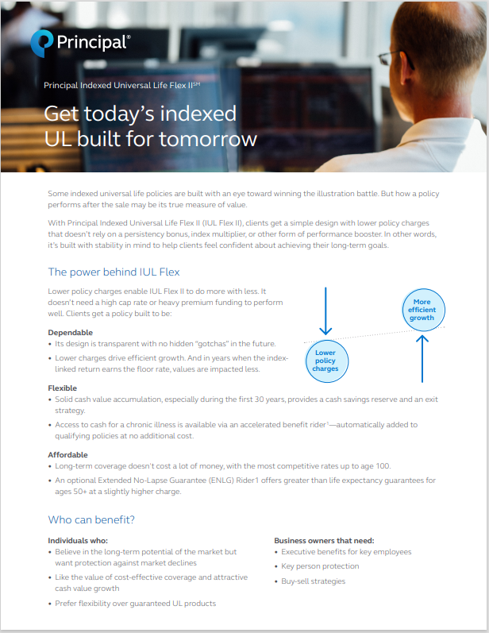
Principal Indexed Universal Life Flex II℠
Charge structure enables efficient performance
Optional no-lapse guarantee to age 90/25 years
Key riders: change of insured, chronic illness, cost of living increase, life paid-up, salary increase
Underwriting programs: Accelerated Underwriting, Business Solutions Enhanced Underwriting, Multi-life, Risk Upgrade
All guarantees based on the claims-paying ability of the issuing insurance company.
Rider availability varies by state.
For financial professional use only. Not for distribution to the public.

Slide 21
Principal Universal Life Flex III
Target market:
Ages 35-65
Moderate funding levels (1-1.5x target premium)
Seeks some cash value growth, without direct participation in the market
Sales opportunities:
Key person insurance
Buy-sell strategies
Personal coverage for business owners, key employees, and their families
All guarantees are based on the claims-paying ability of the issuing insurance company.
Rider availability varies by state.
For financial professional use only. Not for distribution to the public.

Slide 22
Variable universal life
For financial professional use only. Not for distribution to the public.
Notes:
Read directly from slide

Slide 23
Principal Variable Universal Life Income IV℠
60+ investment options from well-known fund mgrs.*
Dollar cost averaging accounts and zero net-cost loans in years 11+
Key riders: change of insured, chronic illness, cost of living increase, life paid-up, surrender value enhancement
Underwriting programs: Accelerated Underwriting, Business Solutions Enhanced Underwriting, Multi-life, Risk Upgrade
*Investing involves risk and the possible loss of principal.
All guarantees based on the claims-paying ability of the issuing insurance company.
Rider availability varies by state.
For financial professional use only. Not for distribution to the public.

Slide 24
Principal Variable Universal Life Income IV
Target market:
Ages 35-55
Business owners and key employees
Seeks cash value growth potential from direct participation in the market
Sales opportunities:
Key employee benefits
Buy-sell strategies
Businesses seeking high early cash values for the balance sheet
Business owner or individual retirement planning
All guarantees based on the claims-paying ability of the issuing insurance company.
Rider availability varies by state.
For financial professional use only. Not for distribution to the public.

Slide 25
Principal Executive Variable Universal Life III℠
Must be business-owned/business-sponsored
100+ investment options from well-known fund mgrs.*
Institutionally priced and designed
High early cash value rider with enhancement options
Key riders: change of insured, life paid-up, enhanced surrender value
Underwriting programs: Accelerated Underwriting, Business Solutions Enhanced Underwriting, Multi-life
*Investing involves risk and the possible loss of principal.
All guarantees based on the claims-paying ability of the issuing insurance company.
Rider availability varies by state.
For financial professional use only. Not for distribution to the public.

Slide 26
Principal Executive Variable Universal Life III
Target market:
Ages 35-55
Business seeking solutions to retain and retire key employees
Seeks cash value growth potential with direct participation in the market
Sales opportunities:
Bonus plans
Nonqualified deferred compensation plans
All guarantees based on the claims-paying ability of the issuing insurance company.
Rider availability varies by state.
For financial professional use only. Not for distribution to the public.

Slide 27
VUL investment story
Funds from Principal® and outside funds from well-known fund managers available
3 investment strategies for policy holders:
Personalized approach
Guided approach
Thematic approach
7 target-date (LifeTime Portfolios)
5 target-risk (Strategic Asset Management (SAM) Portfolios)
3 volatility management (ETF funds)
DCA Accounts
Six- and 12-month accounts
Investing involves risk and the possible loss or principal.
For financial professional use only. Not for distribution to the public.

Slide 28
Key policy riders
For financial professional use only. Not for distribution to the public.
Notes:
Read directly from slide

Slide 29
Business value increase rider
How it works
Business is valued before policy is issued
Coverage is automatically increased 5% per year after years 1 and 2
After year 3, business is valued again and any increase above 10% results in matching increase in face amount
Next year, starts the process again
Hypothetical example
At policy issue:
Business value: $1 million
Policy face amount: $1 million
After yr. 1, face amount automatically increased: $1,050,000
After yr. 2, face amount automatically increased: $1,100,000
Business value at end of yr. 3: $1,200,000
Business value increase over 3 years: 20%, face amount is increased 20%: $1,200,000
Process starts over with $1,200,000 face amount as new baseline
Our complimentary informal business valuation service can provide the valuations needed for your clients.
All guarantees based on the claims-paying ability of the issuing insurance company.
Rider availability varies by state.
For financial professional use only. Not for distribution to the public.

Slide 30
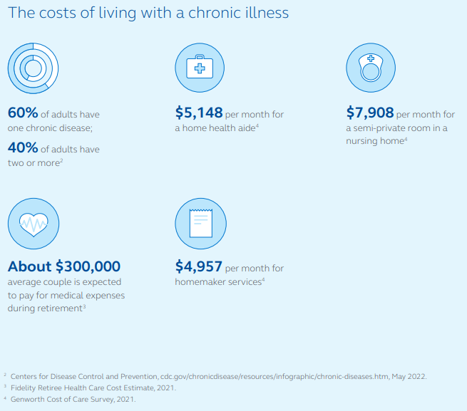
Chronic illness death benefit advance rider
Available on UL, IUL, and VUL Income products
It’s an accelerated benefits rider – not a Long Term Care rider
Issue ages 20-75
Underwriting: Table 3 or better and flat extras up to $7.50/$1,000 face amount
No up-front cost – benefit is discounted if used
Maximum benefit = 75% of death benefit (25% per year, except in CA )
All guarantees based on the claims-paying ability of the issuing insurance company.
Rider availability varies by state.
For financial professional use only. Not for distribution to the public.

Slide 31
Life paid-up rider Helps protect your clients from an unexpected taxable event.
Included on all cash value products, except SUL Provider
Triggers when loan balance reaches 92% of cash value
Converts policy to paid-up death benefit
Prevents policy from lapsing, preserving tax-income free status of distributions
All guarantees based on the claims-paying ability of the issuing insurance company.
Rider availability varies by state.
For financial professional use only. Not for distribution to the public.

Slide 32
Services that can help you stand out
For financial professional use only. Not for distribution to the public.
Notes:
Read directly from slide

Slide 33
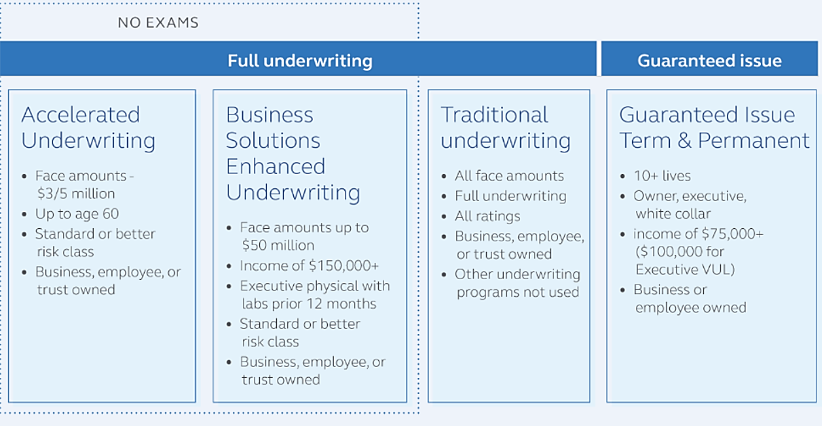
SMB underwriting solutions
For financial professional use only. Not for distribution to the public.

Slide 34
Automated policy distributions Helps maximize income keep distributions income tax-free
 | What it does | Benefit
Payment start | Single form begins income stream | Lets client make better use of time
Death benefit option changes | Flips from DBO 2 to DBO 1 | Maximizes accumulation, prepares for distribution
Distribution type changes | Switches from surrenders to loans at cost basis | Keeps income tax-free
Income re-calculated | Amount is adjusted based on actual performance | Ensures target-ending cash value goal
Life Paid-Up Rider activities | Policy converts to reduced paid-up status | Prevents policy lapse and resulting taxes
For financial professional use only. Not for distribution to the public.

Slide 35
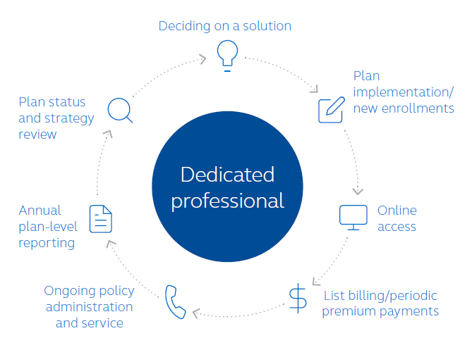
Business Market Administration You and your clients get ongoing support throughout the life if the plan.
For financial professional use only. Not for distribution to the public.

Slide 36
Principal National Life Insurance Company and Principal Life Insurance Company®, Des Moines, Iowa 50392-0001
Insurance products issued by Principal National Life Insurance Company (except in NY), Principal Life Insurance Company®, and the companies available through the Preferred Product Network, Inc. Plan administrative services provided through Principal Life Insurance Company®. Securities offered through Principal Securities, Inc., member SIPC, and/or independent broker/dealers. Referenced companies are members of the Principal Financial Group®, Des Moines, IA 50392.​
S&P® and S&P 500 ® and S&P 500 ® Total Return are registered trademarks of Standard & Poor’s Financial Services LLC and have been licensed for use by S&P Dow Jones Indices LLC and sublicensed for certain purposes by The Company. The S&P 500 ® and S&P 500 ® Total Return is a product of S&P Dow Jones Indices LLC and has been licensed for use by The Company. The Company’s policy is not sponsored, endorsed, sold or promoted by S&P Dow Jones Indices LLC or its affiliates and none of S&P Dow Jones Indices LLC or its affiliates make any representation or warranty regarding the advisability of investing in such product(s).
No part of this presentation may be reproduced or used in any form or by any means, electronic or mechanical, including photocopying or recording, or by any information storage and retrieval system, without prior written permission from the Principal Financial Group®.
Not FDIC or NCUA insured. May lose value . Not a deposit. No bank or credit union guarantee. Not insured by any Federal government agency.
Principal®, Principal Financial Group®, and Principal and the logomark design are registered trademarks of Principal Financial Services, Inc., a Principal Financial Group company, in the United States and are trademarks and service marks of Principal Financial Services, Inc., in various countries around the world.
For financial professional use only. Not for distribution to the public.
BB11519-05 | 10/2023 | 3173039-10/2023 | © 2023 Principal Financial Services, Inc.

