Slide 1
Principal Deferred Compensation Incentive Bonus plan
Recognize and motivate your key employees
PRESENTER NAME (ALL CAPS)
Title
Notes:
Read slide

Slide 2
What’s a Deferred Comp – Incentive Bonus plan?
It’s an employer-sponsored, long-term incentive plan for the key employees you choose—including employees who can’t participate in traditional nonqualified deferred compensation plans.
You make contributions into the plan for your key employees and promise to pay that money, plus any potential earnings, to them at a future date based on the vesting schedules you set.
Notes:
Read slide

Slide 3
Keep your key employees satisfied
What can you do now to help ensure your top talent remains committed to you—and not the competition? Enhance your benefits package with a Deferred Comp – Incentive Bonus plan. It can give you a competitive advantage by:
Encouraging the best employees to join your organization as it grows.
Keeping your key employees satisfied and motivated for the long term.
Rewarding them for reaching goals.
Notes:
Read slide

Slide 4
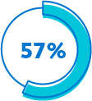
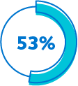
Findings in today’s market
From plan sponsors with existing deferred comp plans
57% concerned with attracting key employees.
53% concerned with losing key employees.
Source: 2021 Trends in Nonqualified Deferred Compensation, conducted by Principal®.
Notes:
Read slide

Slide 5
Helping you choose a plan to fit your needs
Discover. Identify the issues your organization wants to resolve and what you want to achieve.
Solve. Learn how this plan can help solve problems and achieve your objectives.
Design. Use the plan’s flexibility to tailor a plan to your organization’s and participants' needs.
Partner. Trust the service and expertise we’ll provide to you and your key employees every step of the way, year after year.
Stay current. Make changes to your plan as your organization’s needs and goals change.
Notes:
Read slide

Slide 6
Discover
Identify issues your organization wants to resolve and what you want to achieve
Notes:
Read slide

Slide 7
What are your organization’s goals?
Recruit
Attract the best employees as part
of a competitive benefits package.
Retain
Encourage key employees to remain
loyal to your organization.
Reward
Provide performance-based contributions
to achieve organizational goals.
Motivate
Encourage high-performance employees
to achieve results through incentives.
Notes:
Read slide

Slide 8
What are your key employees’ goals?
Savings goals
Control timing of payouts to help meet savings goals.
Managing taxes
Help manage the impact of taxes using the plan's flexibility for when benefits are paid.
Notes:
Read slide

Slide 9
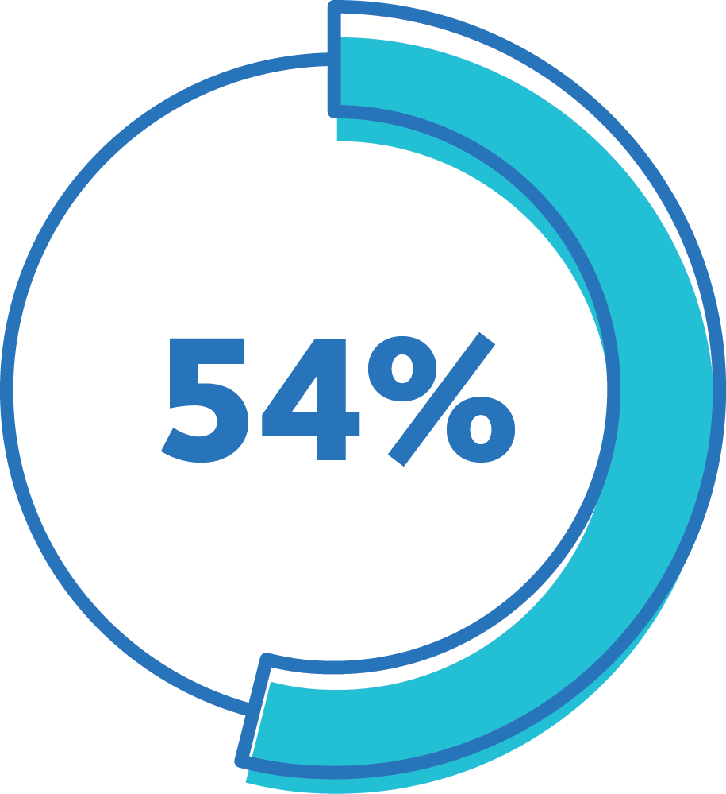
Participants consider the plan important in
Deciding to take a new job.
Deciding to stay with a current employer.
Source: 2021 Trends in Nonqualified Deferred Compensation, conducted by Principal®.
Notes:
Read slide

Slide 10
Solve
Learn how this plan can help solve your business challenges and achieve your objectives
Notes:
Read slide

Slide 11
Is it right for your key employees?
Benefits for your key employees:
Take advantage of employer contributions, tax-deferred growth, and compounded earnings.
Both “top hat” and “non-top hat” employees are eligible to participate in the plan.
Design a personalized investment strategy.
Notes:
Once you’ve identified the most important goals, then consider the role that a deferred comp plan can play in helping achieve those goals. The plan offers benefits and considerations for both the organization and the key employees.
Read slide

Slide 12
Is it right for your key employees?
Considerations for your key employees:
Contributions into the plan aren’t protected in the event of company bankruptcy.
Only employer contributions are allowed.
Notes:
Read slide

Slide 13
Is it right for you?
Benefits for you:
Easier to administer with no discrimination testing, minimum participation, or Form 5500 filing, if set up properly.
Use discretionary company contributions with vesting schedules to help achieve corporate goals.
Money set aside to finance the plan remains an asset on the company’s balance sheet, while providing liquidity for paying benefits.
Notes:
Read slide

Slide 14
Is it right for you?
Considerations for you:
The corporate tax deduction is deferred until benefits are paid, rather than a current deduction.
Distributions to plan participants must be paid within 10 years of the original date of each employer grant.
To qualify as a bonus plan not subject to ERISA, the plan cannot be designed to “systematically” provide benefits to participants after separation from service.
This determination must be made by the plan sponsor.
Notes:
Read slide

Slide 15
Top reasons why plan sponsors offer deferred comp plans
Retention tool for key employees.
Provide a competitive benefits package for key employees.
Source: 2021 Trends in Nonqualified Deferred Compensation, conducted by Principal®.
Notes:
Read slide

Slide 16
Design
Use the plan’s flexibility to tailor a plan to help meet your organization’s and participants’ needs
Notes:
Read slide

Slide 17
How’s the plan created?
Who participates
Select the groups of key employees (“top hat” and “non-top hat”) to participate in this plan.
What can be offered
You can provide one contribution per participant each year with the flexibility to vary benefits by individual employees.
What happens with the benefit
You can select an investment lineup for participants from a broad range of options. In addition, you can decide how and when key employees may receive the benefits based on organizational needs. However, benefits must be paid to them within 10 years of the date of the original employer grant.
How benefits are paid
Decide how payouts can be received from the plan. Benefits can be distributed as a lump sum.
Notes:
You're in control of making the plan yours – it’s based on the specific goals of your organization and unique needs of your key employees. Together with your financial professional, we’ll walk you through the decisions that need to be made to design a plan that makes sense for your organization:
Read the slide

Slide 18
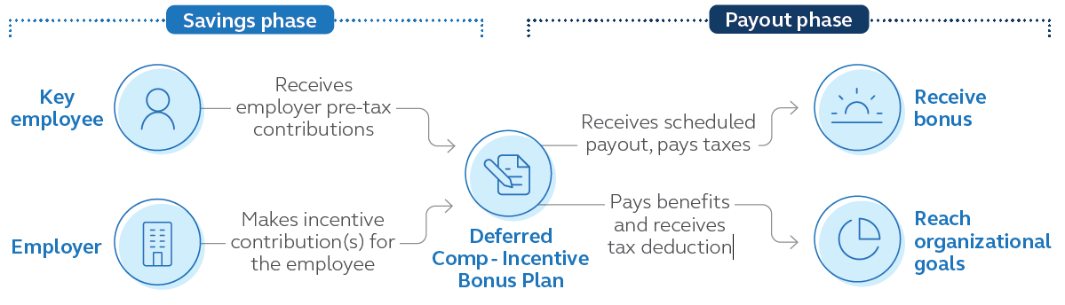
Design
How it works
Notes:
This chart shows how money is contributed to the incentive bonus plan and paid out at a later date. It also points out that when the benefit is distributed to the key employee, the employer receives an income-tax deduction and the key employee pays income tax on it.

Slide 19
How does an organization pay for it?
Company cash
Taxable investments
Corporate-owned life insurance
No specific plan assets are set aside. Instead, benefits are paid through the company's cash flow.
The company invests in mutual funds and/or individual securities.
The company purchases a policy to pay future obligations.
Notes:
Keeping your promise to pay benefits to participants in the future is important. Any one of these three (or combination of) financing options can help you do that. Plus, we’ll provide a detailed financial model comparing the options to help you make this decision.
Read slide

Slide 20
Partner
Trust the service and expertise we’ll provide to you and your key employees every step of the way, year after year
Notes:
Read slide

Slide 21
How do we work with your organization
Our team of experts will work closely with you and your financial professional to develop a strategy for implementing and servicing your plan.
And year after year, we’ll continue to work closely with you and your financial professional to fine-tune your plan to help ensure you’re working toward meeting your organization’s goals—and your plan is administered as efficiently as possible.
Notes:
Read slide

Slide 22
Keeping you in-the-know
To help you stay on top of your plan, a range of information is available on our website and corporate accounting reports. You also have easy access to plan reporting, investment resources, and other tools to assist with administering your plan. Plus, depending on plan type and design, you’ll receive:
Access to plan participants’ account information.
Daily valuation of assets.
Asset and benefit information and rebalancing services.
Financing reviews to assess plan performance.
Notes:
To help you stay on top of your plan, a range of information is available on our website and corporate accounting reports. You also have easy access to plan asset and liability reporting, investment resources, and other tools to assist with administering your plan. Plus, depending on your plan type and design, you’ll receive:
Read slide

Slide 23
Turning key employees into participants
We’re here to help every step of the way
Whether this is a brand-new benefit or employees are familiar with this type of plan, we offer custom education to introduce plan basics. We'll help you make sure your employees are aware they’re eligible, so they can make an informed decision to participate. Our nonqualified plan specialists are available to answer questions Monday-Friday.
Notes:
Read slide

Slide 24
Stay Current
Make changes to your plan as your organization’s needs and goals change
Notes:
Read slide

Slide 25
How does your plan keep up with your needs and goals?
Close attention to the plan over time, such as a participant’s benefit from the beginning of the plan until payout.
Experienced specialists who offer feedback on factors that can influence the plan, such as plan design changes and regulatory updates.
Analytical tools and resources are available for new and existing plans—all while watching out for your bottom line.
Periodic financial reviews help ensure the plan’s financing continues to meet your goals.
Access to online dashboards of information.
Notes:
The deferred comp plan is your plan. Its long-term success depends on how well it keeps pace with your organization’s needs and goals -- today and tomorrow. So once your plan is in place, we’ll make sure to provide:
Read slide

Slide 26
Ready to start?
Once you decide that a Deferred Comp – Incentive Bonus plan is right for your organization and key employees, we’ll bring our expertise and resources to the table to help you put this plan in place within your desired timing. We’ll begin by: • Gathering information about your organization. • Tailoring the plan to your specific needs and goals. Thousands of employers value the solutions and services we provide. You can count on us, too. We’ll do our best to deliver a positive experience for everyone involved.
Notes:
Read slide

Slide 27
An industry leader in your corner
Our history speaks for itself. We’ve been providing deferred comp plans for more than 30 years and are the No. 1 provider of deferred comp plans*. What sets us apart from others is our:
Commitment to and experience in the business and retirement plan markets.
Unique plan design and flexibility to tailor it to specific needs and goals.
Specialized team of legal, accounting, and financing resources with more than 200 years of experience to provide support.
Service and commitment to building long-lasting relationships.
* Based on number of Section 409A plans, PLANSPONSOR 2021 Defined Contribution Recordkeeping Survey, July 2021.
Notes:
Our history speaks for itself. We’ve been providing nonqualified deferred compensation plans for more than 30 years and are the No. 1 provider of deferred comp plans.
What sets us apart from others is our:
Commitment to and experience in the business and retirement plan markets.
Unique plan design and flexibility to tailor it to specific needs and goals.
Specialized team of legal, accounting and financing resources with more than 200 years of experience to provide support.
Service and commitment to building long-lasting relationships.
A member of the FORTUNE 500®, our employees are passionate about helping clients of all income and portfolio sizes achieve their goals. You can count on us to offer innovative ideas, investment expertise and real-life solutions to help make financial progress possible.
* Based on number of Section 409A plans, PLANSPONSOR 2021 Defined Contribution Recordkeeping Survey, July 2021.

Slide 28
Thank you
Notes:
Read slide

Slide 29
Before investing, carefully consider the investment option objectives, risks, charges, and expenses. Contact a financial professional or visit principal.com for a prospectus or, if available, a summary prospectus containing this and other information. Please read it carefully before investing.
The subject matter in this communication is educational only and provided with the understanding that Principal® is not rendering legal, accounting, investment, or tax advice. You should consult with appropriate counsel, financial professionals, and other advisors on all matters pertaining to legal, tax, investment, or accounting obligations and requirements.
Insurance products issued by Principal National Life Insurance Company (except in NY) and Principal Life Insurance Company ®. Plan administrative services offered by Principal Life. Principal Funds, Inc. is distributed by Principal Funds Distributor, Inc. Securities offered through Principal Securities, Inc., member SIPC and/or independent broker/dealers. Referenced companies are members of the Principal Financial Group®, Des Moines, IA 50392.
No part of this presentation may be reproduced or used in any form or by any means, electronic or mechanical, including photocopying or recording, or by any information storage and retrieval system, without prior written permission from the Principal Financial Group.
Principal®, Principal Financial Group®, and Principal and the logomark design are registered trademarks of Principal Financial Services, Inc., a Principal Financial Group company, in the United States and are trademarks and service marks of Principal Financial Services, Inc., in various countries around the world.
BB10870-06 | 05/2023 | 2251714-072022 | Copyright © 2022 Principal Financial Services, Inc.
Notes:
Read slide

