Slide 1
Important information for financial professionals
By using this communication you agree to the following: This communication is provided to you by Principal Life Insurance Company SOLELY for use by you with clients that utilize the services of the member companies of the Principal Financial Group® as their retirement plan service provider (Permitted Use). In doing so Principal® is not responsible for any use outside of the Permitted Use. In granting you Permitted Use, no member company is surrendering any right, title or interest in the communication, including any intangible ownership such as copyright or trademark protection. Principal does not authorize you to create any derivative work, edit, copy or otherwise alter the communication, including but not limited to affixing any branding or creating any “co-branded communication.”
It should be noted that removing this license is expected and permitted when the communication is utilized within its Permitted Use. In granting Permitted Use, no member company of Principal makes any warranty of fitness for your intended use. Please consult your legal and compliance areas to confirm that your intended use of this resource is appropriate and that it contains all appropriate information and disclosures, names the correct parties and provides the appropriate limitations for your business. It is your responsibility to determine if filing with any regulatory authority is necessary (e.g., FINRA or other regulators) and that it is appropriate for the intended use and audience.

Slide 2
Ease the transition
By creating an estate plan
Presenter’s name
The presenter’s title goes on this line
PD529-15 | 2878019-052023
Notes:
Hello! My name is _______, and I’m with Principal. Thanks for coming today.
Estate planning – not exactly a fun topic, right? But it’s great that we’re going to talk about it today, because a good estate plan can do a lot for you and for your loved ones. It doesn’t matter how much money you have; it can be beneficial to have one.

Slide 3
What’s an estate plan?
PD529-15 | 2878019-052023
Notes:
First things first. What exactly IS an estate plan?

Slide 4
An Estate Plan
An estate plan may include
Wills
Trusts
Beneficiary designations*
Distribution of assets/property
Ownership designations
Financial and medical powers of attorney
Living wills
Outlines your wishes
Adults should have one
A financial professional and/or attorney can help
*Qualified retirement plans typically have requirements on who can receive benefits; these will supersede a will.
PD529-15 | 2878019-052023
Notes:
Basically, your estate plan outlines your wishes on a lot of different topics. Having all these things in writing can give you peace of mind, and it can make things easier for your loved ones down the road.
An estate plan is more than a will. An estate plan includes your will, but it may also include trusts, beneficiary designations, a plan for distribution of your assets and property, ownership designations, durable financial and medical powers of attorney, and living wills.
It’s a good idea for many adults to have an estate plan: not just older adults; not just people with young kids; and not just the wealthy.
You can handle some aspects of estate planning yourself; but for some things, you’ll likely need to work with a financial professional and/or an attorney.

Slide 5
Here’s what an estate plan can do
Direct the distribution of your assets
Direct what happens with your minor children
Communicate your health care and end-of-life wishes
Help deliver peace of mind
PD529-15 | 2878019-052023
Notes:
A good estate plan puts you in control. It lets you choose who gets what property you own, as well as when and how they’ll get it.
Your estate plan should provide custodians for your minor children, if you have any. It should also set up a durable power of attorney in case you ever become physically or mentally unable to communicate your wishes.
Making these decisions in advance can help eliminate some of those middle-of-the-night worries — giving you a sense of comfort that your last wishes will be carried out.

Slide 6
Slides 6-17 & 21 of PD529-15 must REMAIN together
Ten tips when creating your estate plan
We believe these tips to be important to estate planning. Be sure you consult with appropriate counsel, financial professionals, and other advisors on all matters pertaining to legal, tax, investment or accounting obligations and requirements.​
PD529-15 | 2878019-052023
Notes:
Now you know why you should create an estate plan, let’s talk about how to do it.
Remember, you don’t have to create these documents on your own. An attorney with estate planning expertise can help.

Slide 7
Create a will
Slides 6-17 & 21 of PD529-15 must REMAIN together
TEN TIPS WHEN CREATING AN ESTATE PLAN
1
A will can help you:*
Divide assets between your heirs the way you wish
Avoid the state’s involvement in the division of your assets
*Qualified retirement plans typically have requirements on who can receive benefits; these will supersede a will.
PD529-15 | 2878019-052023
Notes:
Before you do anything else with your estate plan, create a will.
If you die without a will, it can create a lot of problems for your heirs. Without a will, the state uses a formula to determine who’s an heir and what share of your property they’ll get; and that might not line up with your wishes.
Talk to an attorney who can help you set up a will. As a resource, we have partnered with ARAG to help you prepare a variety of legal documents, and we will talk more about that later in the presentation. Remember to keep your legal documents current as your life changes.

Slide 8
Slides 6-17 & 21 of PD529-15 must REMAIN together
TEN TIPS WHEN CREATING AN ESTATE PLAN
Avoids an expensive judicial conservatorship
Can take effect now or only if you become incapacitated
2
Designate a financial power of attorney
Choose someone you know well and trust.
PD529-15 | 2878019-052023
Notes:
Next, create a financial power of attorney. A power of attorney can be all encompassing to handle all your financial matters or designated to handle specific events and/or transactions. One way a power of attorney can help is if you become incapacitated, this person can act on your behalf and pay your taxes and bills. He or she can also make investment decisions and take care of other financial issues.
If you don’t have a financial power of attorney and get too sick or hurt to make decisions, a financial conservatorship is opened. In this situation, a court appoints someone to manage your finances. This can get expensive, and regular hearings and attorney fees continue throughout.
Note — You should typically specify that you want your power of attorney to be "durable." If you don't, in most states, it will automatically end if you later become incapacitated.
Or you can specify that the power of attorney does not go into effect unless a doctor certifies that you have become incapacitated. This is called a "springing" durable power of attorney. It allows you to keep control over your affairs unless and until you become incapacitated, when it springs into effect. However, this can cause delays since you need a doctor’s certification.
Of course, who you choose for this role is a big decision. Make sure you choose someone you know well and trust.

Slide 9
Slides 6-17 & 21 of PD529-15 must REMAIN together
TEN TIPS WHEN CREATING AN ESTATE PLAN
3
Puts someone in charge of your health care if you’re unable to make decisions
Avoids an expensive judicial guardianship
Appoint a medical power of attorney
PD529-15 | 2878019-052023
Notes:
It’s a good idea to name a health advocate. This is also known as a durable power of attorney for health care. The person you choose for this role can make certain health care decisions for you if you’re unable.
Doing this also avoids an expensive judicial guardianship. This is when the court appoints someone to make medical decisions for you.

Slide 10
Slides 6-17 & 21 of PD529-15 must REMAIN together
TEN TIPS WHEN CREATING AN ESTATE PLAN
4
States whether life-sustaining measures are to be used in certain situations
Clearly states your wishes
Relieves your loved ones from the decision-making burden
Include a living will
PD529-15 | 2878019-052023
Notes:
Another important document is a living will. It’s also known as a health care directive or an advance directive.
It lets you state your end-of-life wishes for medical care, and it takes the decision-making burden off your loved ones.

Slide 11
Slides 6-17 & 21 of PD529-15 must REMAIN together
TEN TIPS WHEN CREATING AN ESTATE PLAN
5
Review beneficiaries
Beneficiaries you’ve designated for:
Life insurance
IRAs/401(k)s
Investment accounts
Other accounts
PD529-15 | 2878019-052023
Notes:
It’s important to review your designated beneficiaries to help keep control over your assets. Review your beneficiaries to:
Life insurance,
IRAs/401(k)s and other retirement plans,
Investment accounts, and
Other accounts you may have
To make sure they’re distributed according to your wishes.
One of the values of designating beneficiaries is that the beneficiary doesn’t have to wait for probate court to receive distribution of the assets. If you have a minor child listed as a beneficiary, it is a good idea to name a custodian to oversee the payout of benefits. If you do not designate a custodian for the minor beneficiary, the financial institution releasing the benefits will still have to wait for probate court to determine who will serve as custodian on behalf of the minor. Keep in mind this court appointed custodian may not be who you would have chosen.

Slide 12
Slides 6-17 & 21 of PD529-15 must REMAIN together
TEN TIPS WHEN CREATING AN ESTATE PLAN
6
Allows you to:
Support your children while they’re still minors
Spell out how and when they can receive an inheritance
Appoint a trustee to administer trust(s) in accordance with your wishes
Set up trusts
PD529-15 | 2878019-052023
Notes:
Set up trusts for beneficiaries when advisable. A trust lets you spell out how heirs can receive an inheritance and at what age they receive it. You can also appoint a trustee to make those decisions for you after you die, guided by your written wishes.
If you have more questions about trusts, I encourage you to visit the Learning Center on the ARAG website, which has quite a bit of information. If you need specific information, it is a good idea to contact a trust attorney. Your local bar association may be able to make a recommendation.

Slide 13
Slides 6-17 & 21 of PD529-15 must REMAIN together
TEN TIPS WHEN CREATING AN ESTATE PLAN
7
Control over wills/trusts
Designations for:
Bank accounts
Safe deposit box(es)
Real estate
Vehicles
Review ownership designations
PD529-15 | 2878019-052023
Notes:
Reviewing your ownership designations is also something you can do on your own. It’s pretty simple and yet it’s one of the most-overlooked parts of estate planning.
It’s important to review your designations for:
Control over wills/trusts
Ownership of:
Bank accounts
Safe deposit box(es)
Real estate
Vehicles

Slide 14
Slides 6-17 & 21 of PD529-15 must REMAIN together
TEN TIPS WHEN CREATING AN ESTATE PLAN
8
Pass on more to heirs while you are still living:
Give up to $17,000 (2023 IRS limit) to as many people as you wish
For couples, that’s $34,000 total ($17,000 each)
Neither party pays taxes or files gift tax returns
Share the wealth – now
Source: https://www.irs.gov/businesses/small-businesses-self-employed/frequently-asked-questions-on-gift-taxes
PD529-15 | 2878019-052023
Notes:
Why wait? You can see your heirs enjoy their inheritance by passing along some of your assets now. You can give up to $17,000 to as many people as you wish, without either party having to pay a tax or file gift tax returns. Couples can give $17,000 each, or a total of $34,000 for both.

Slide 15
Slides 6-17 & 21 of PD529-15 must REMAIN together
TEN TIPS WHEN CREATING AN ESTATE PLAN
9
Update your plan
Review and update your plan every now and then to reflect:
Life changes
Financial changes
Changes in tax laws
PD529-15 | 2878019-052023
Notes:
Life changes, and it’s really important to keep your plan up-to-date.
Put a reminder on your calendar to go over your estate plan once a year. Marriage, divorce, children, grandchildren, or another big life change – or even a change in tax laws – can all be reasons to adjust your plan.

Slide 16
Slides 6-17 & 21 of PD529-15 must REMAIN together
TEN TIPS WHEN CREATING AN ESTATE PLAN
10
Get a safe deposit box at your bank or credit union
Give authorization to your executor or heir
Make sure they know the location of the key
Tell your heirs where to find documents
PD529-15 | 2878019-052023
Notes:
Stay organized. Keep your estate planning documents in a safe deposit box, or another secure spot.
And make sure your executor or heir has the authorization to open the box and knows where to find the key. Otherwise, once a lockbox owner dies, the lock box can’t be opened without following certain formalities based on state law. Take the time to speak to your bank representative about what is needed.

Slide 17
Plan for estate taxes
Federal and (in some cases) state taxes
No estate tax return for estates < $12.92M*
Up to 40% marginal tax rate on assets above that amount
Talk to a CPA or estate attorney
*Source: https://www.irs.gov/businesses/small-businesses-self-employed/estate-tax
PD529-15 | 2878019-052023
Notes:
Another reason to create an estate plan is because of estate taxes. The federal government — and in some cases, state governments — can tax the transfer of your estate when you pass away.
There’s some good news. Unless an estate is valued at more than $12.92 million per person (according to 2023 limits), a federal estate tax return usually doesn’t need to be filed. Anything over that, though, is taxed at a whopping 40%. (Note that you’ll still need to complete a personal final tax return, even if you don’t need to file an estate tax return.) Please note, the 2018 estate tax exemption increase is only temporary, so the base exemption amount is set to drop back down to $5 million (adjusted for inflation) in 2026.
In general, the value of your estate includes everything you own or have certain interests in at the date of death. This could include cash and securities, real estate, insurance, trusts, annuities, business interests and other assets. The total of these items is your “gross estate.” Once the value of the gross estate is calculated, the IRS allows certain deductions.
It gets pretty complicated, so it’s a good idea to work with a CPA or estate attorney.

Slide 18
Find an attorney
Slides 6-17 & 21 of PD529-15 must REMAIN together
Find an attorney who specializes in estate planning
Ask around
Financial professionals
Accountants
Friends or relatives
naepc.org*
*The National Association of Estate Planners & Councils is not an affiliate of any company of the Principal Financial Group®.
PD529-15 | 2878019-052023
Notes:
As I said earlier, some of these estate planning tasks can be a bit complicated. It’s usually a good idea to get help from an estate attorney. That’s especially true if you have kids, a business, substantial assets or otherwise complicated finances.
An estate attorney can help you navigate federal and state tax laws. To find an attorney who specializes in estate planning, ask your financial professional, accountant or friends in your area for recommendations.
Decide which attorneys to contact. As you talk with each one, ask about their experience and their fees. You could even ask for an estimate up-front. (Attorneys who create a lot of estate plans should know about how much their services will cost.)

Slide 19
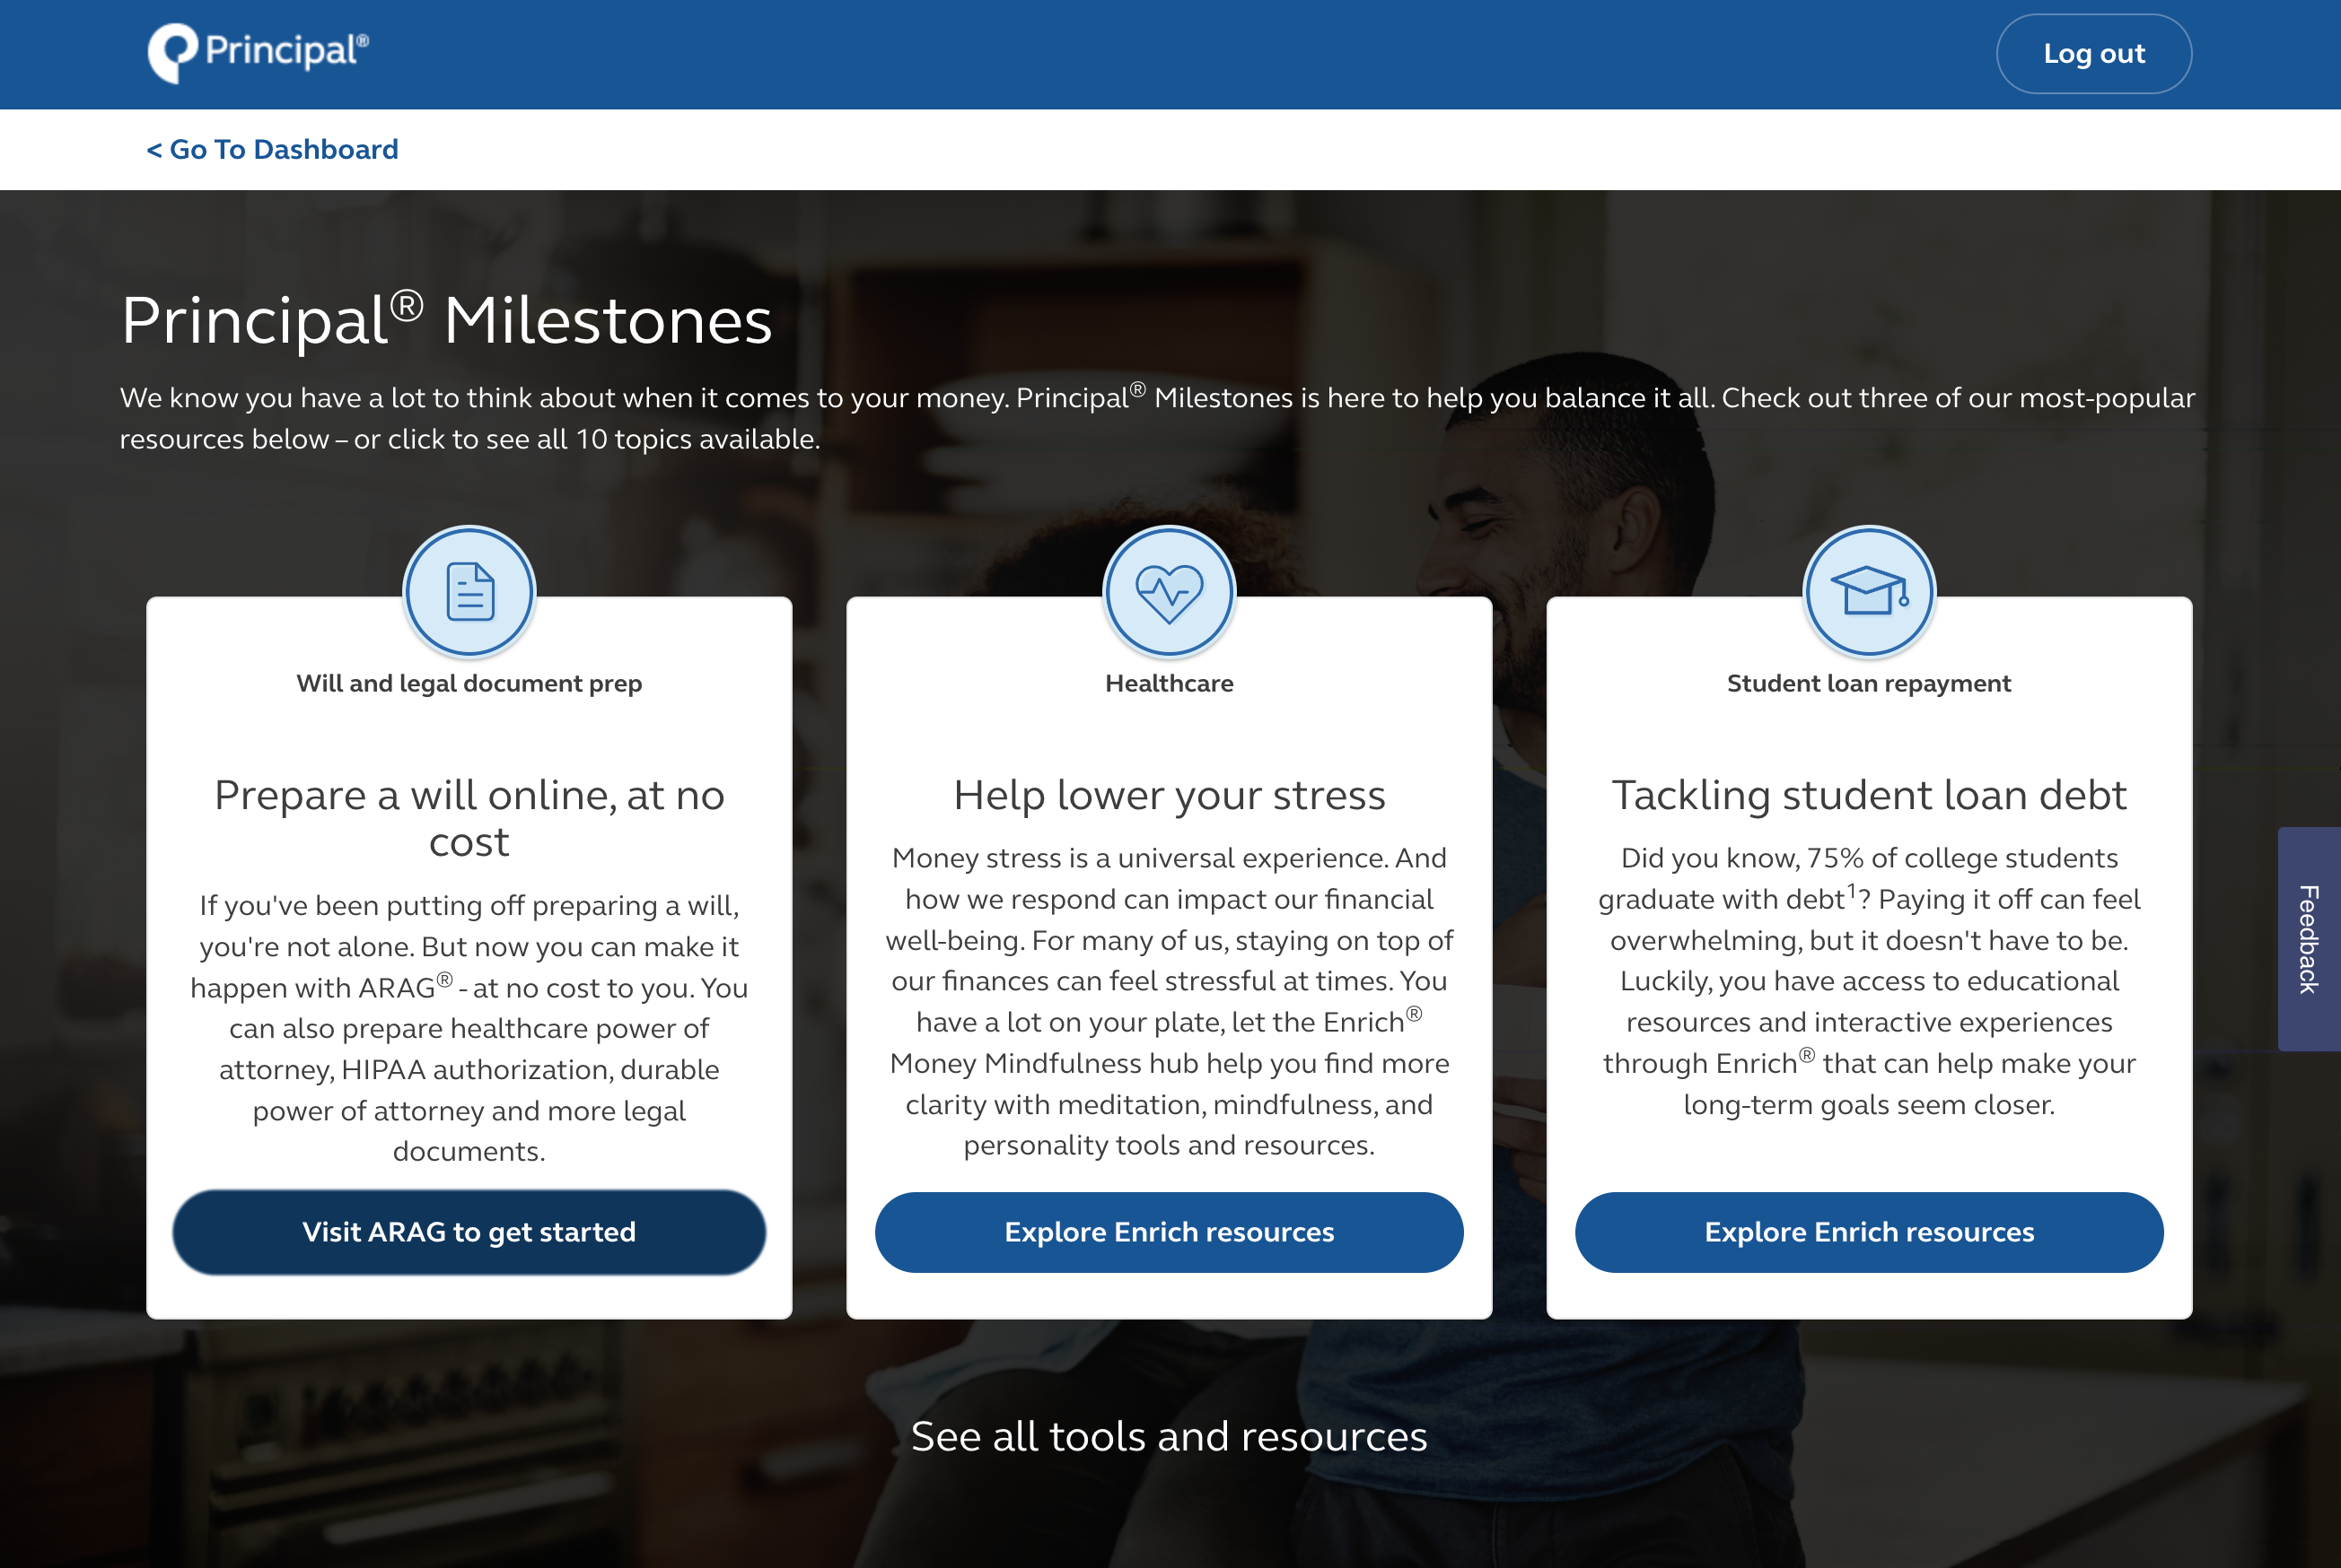
Slides 18 & 21 of PD529-15 must REMAIN together
ARAG will prep resource
Log into your account on principal.com and go to Planning Resources > Principal Milestones
PD529-15 | 2878019-052023
Notes:
We offer will prep resources – provided by ARAG® - at no cost to you.
Something to keep in mind - when an estate is in probate, a 401k beneficiary will take precedence over a will designation. For those of you who already have a will, it is important to remember this for consistency as you make estate plans. For those of you who don’t have a will, this new resource will provide tips like that as well as:
Education on a variety of risk-planning topics and legal terms.
Easy interactive document prep software to help prepare documents based on personal needs.
A Personal Information Organizer to document and manage important financial information for loved ones should the unexpected happen.
Once signed up, participants can access a library of documents — legally valid for each state — to prepare based on specific legal needs/location:
Standard will
Healthcare power of attorney
HIPAA authorization
Durable power of attorney
Living will
Medical treatment authorization for minors
The documents are not just for you as the 401k owner, but also for your spouse. You will each need your own full set of documents.

Slide 20
We’re here to help
Call us at 800-547-7754
Retirement Specialists are available from M-F, 7am – 9pm CT
Visit principal.com
Call ARAG at 800-546-3718
PD529-15 | 2878019-052023
Notes:
I hope this has helped. If you’d like to learn a little more about estate planning or retirement planning, visit principal.com. You’ll find some helpful articles, calculators and more. Or give us a call at 800-547-7754.
Just don’t put this off. Get started today so you can be the one to make these big decisions.

Slide 21
Questions?
PD529-15 | 2878019-052023

Slide 22
Slides 6-17 & 21 of PD529-15 must REMAIN together
Slides 18 & 21 of PD529-15 must REMAIN together
Important information
The value-added resources provided through ARAG Services, LLC (ARAG®) are not a part of any insurance products and plan administrative services provided through Principal Life Insurance Co or affiliated with any company of the Principal Financial Group®. All resources may be changed or canceled at any time.
The use of resources provided by ARAG Services, LLC should not be considered a substitute for consultation with an attorney or advisor. Principal® is not responsible for any loss, injury, claim, liability, or damages related to the use of the ARAG Will & Legal Document Center resources.
Please remember that the ARAG legal documents, DIY Docs® are accurate and useful in many situations. Due to possible changes by a state, it is a good idea to periodically review a template used to be sure it is the most current template. Whether or not the document is right for you and your situation depends on your circumstances. If you want specific advice regarding your situation, consult an attorney.
Information is intended to be educational in nature and is not intended to be taken as a recommendation.​
Insurance products and plan administrative services provided through Principal Life Insurance Company., a member of the Principal Financial Group®, Des Moines, IA 50392.
© 2023 Principal Financial Services, Inc. Des Moines, IA 50392-0001
PD529-15 | 2878019-052023 | 05/2023
PD529-15 | 2878019-052023

