Slide 1
Define your legacy.
What to do with the family farm/ranch
PRESENTER / SUBTITLE (IF ANY, ALL CAPS)
Title, Date, etc.
Notes:
Introduce self and Principal.
“What to do with the family farm/ranch?”
That is the Big Question, isn’t it?
Sometimes that question can feel overwhelming.

Slide 2
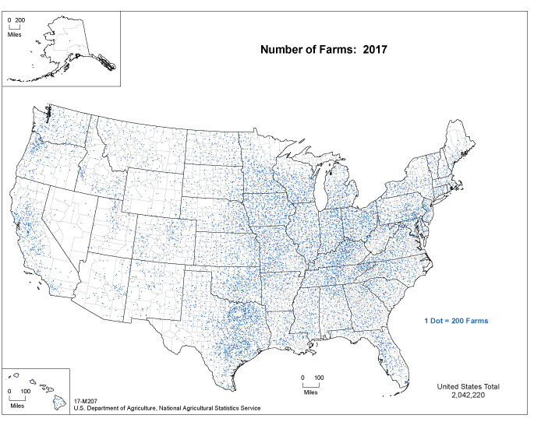
You’re not alone.
2 million+ farms across the U.S.
Source: 2017 Census of Agriculture. Last modified: 4/4/2019.
nass.usda.gov/Publications/AgCensus/2017/Online_Resources/Ag_Atlas_Maps/17-M207.php
Notes:
The good news is, you’re not alone. As you can see in this graphic, there are almost 2.1 million farms/ranches in the US (the peak was 6.8 million in 1935).¹
52% of the U.S. land base is devoted to agricultural production.² And U.S. farm real estate is worth $2.55 trillion.²
So you’re not the first one to ask the Big Question of what to do with the family farm or ranch.
¹ https://www.agcensus.usda.gov/Publications/2012/Full_Report/Volume_1,_Chapter_1_US/
² https://www.ers.usda.gov/topics/farm-economy/land-use-land-value-tenure/ 2019

Slide 3
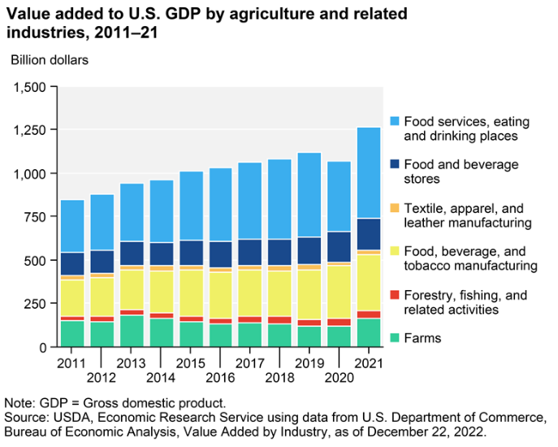
Agriculture’s share of the U.S. economy Agriculture, food, and related industries contributed roughly $1.3 trillion to the U.S. gross domestic product (GDP) in 2021, a 5.4% share. The output of America’s farms contributed $164.7 billion of this sum—about 0.7%of GDP. (Jan. 2023)
https://www.ers.usda.gov/data-products/chart-gallery/gallery/chart-detail/?chartId=58270
Notes:
Read slide.

Slide 4
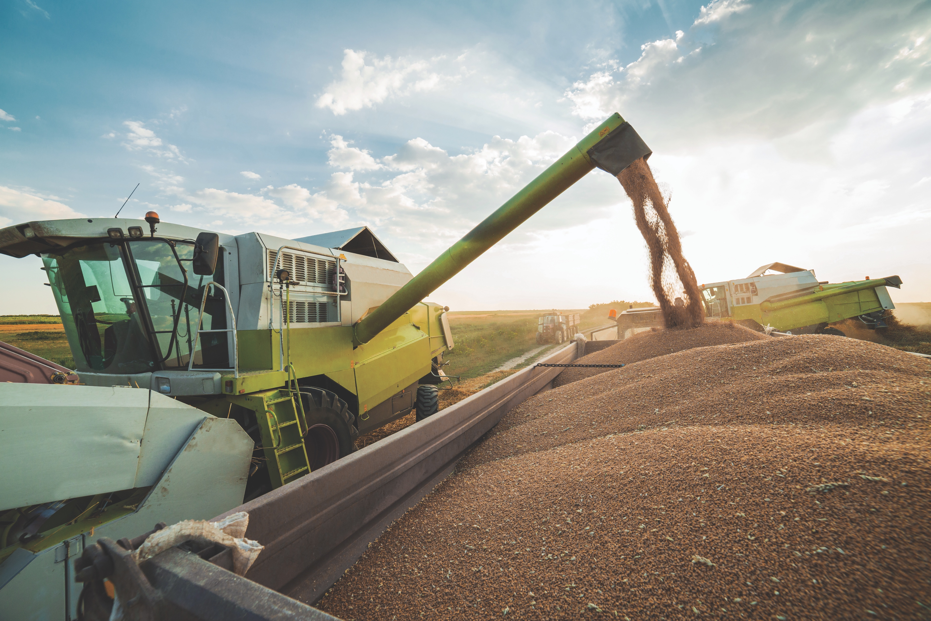
You’re not alone
Farms across the U.S.
98% of farms/ranches are family owned.*
* USDA Economic Research Service: America’s Farms and Ranches at a Glance, 2022 Edition, December 2022
Notes:
98% of farms/ranches are family owned.* “Family” greatly complicates the situation.
Thankfully, there are many ways we can help you keep the family on the farm, and conflict out.
You’ve spent a lifetime building your operation. Keeping your legacy alive, and the business in the family, is important to you and those you leave behind.
* USDA Economic Research Service: America's Family Farms and Ranches at a Glance: 2022 Edition, December 2022

Slide 5
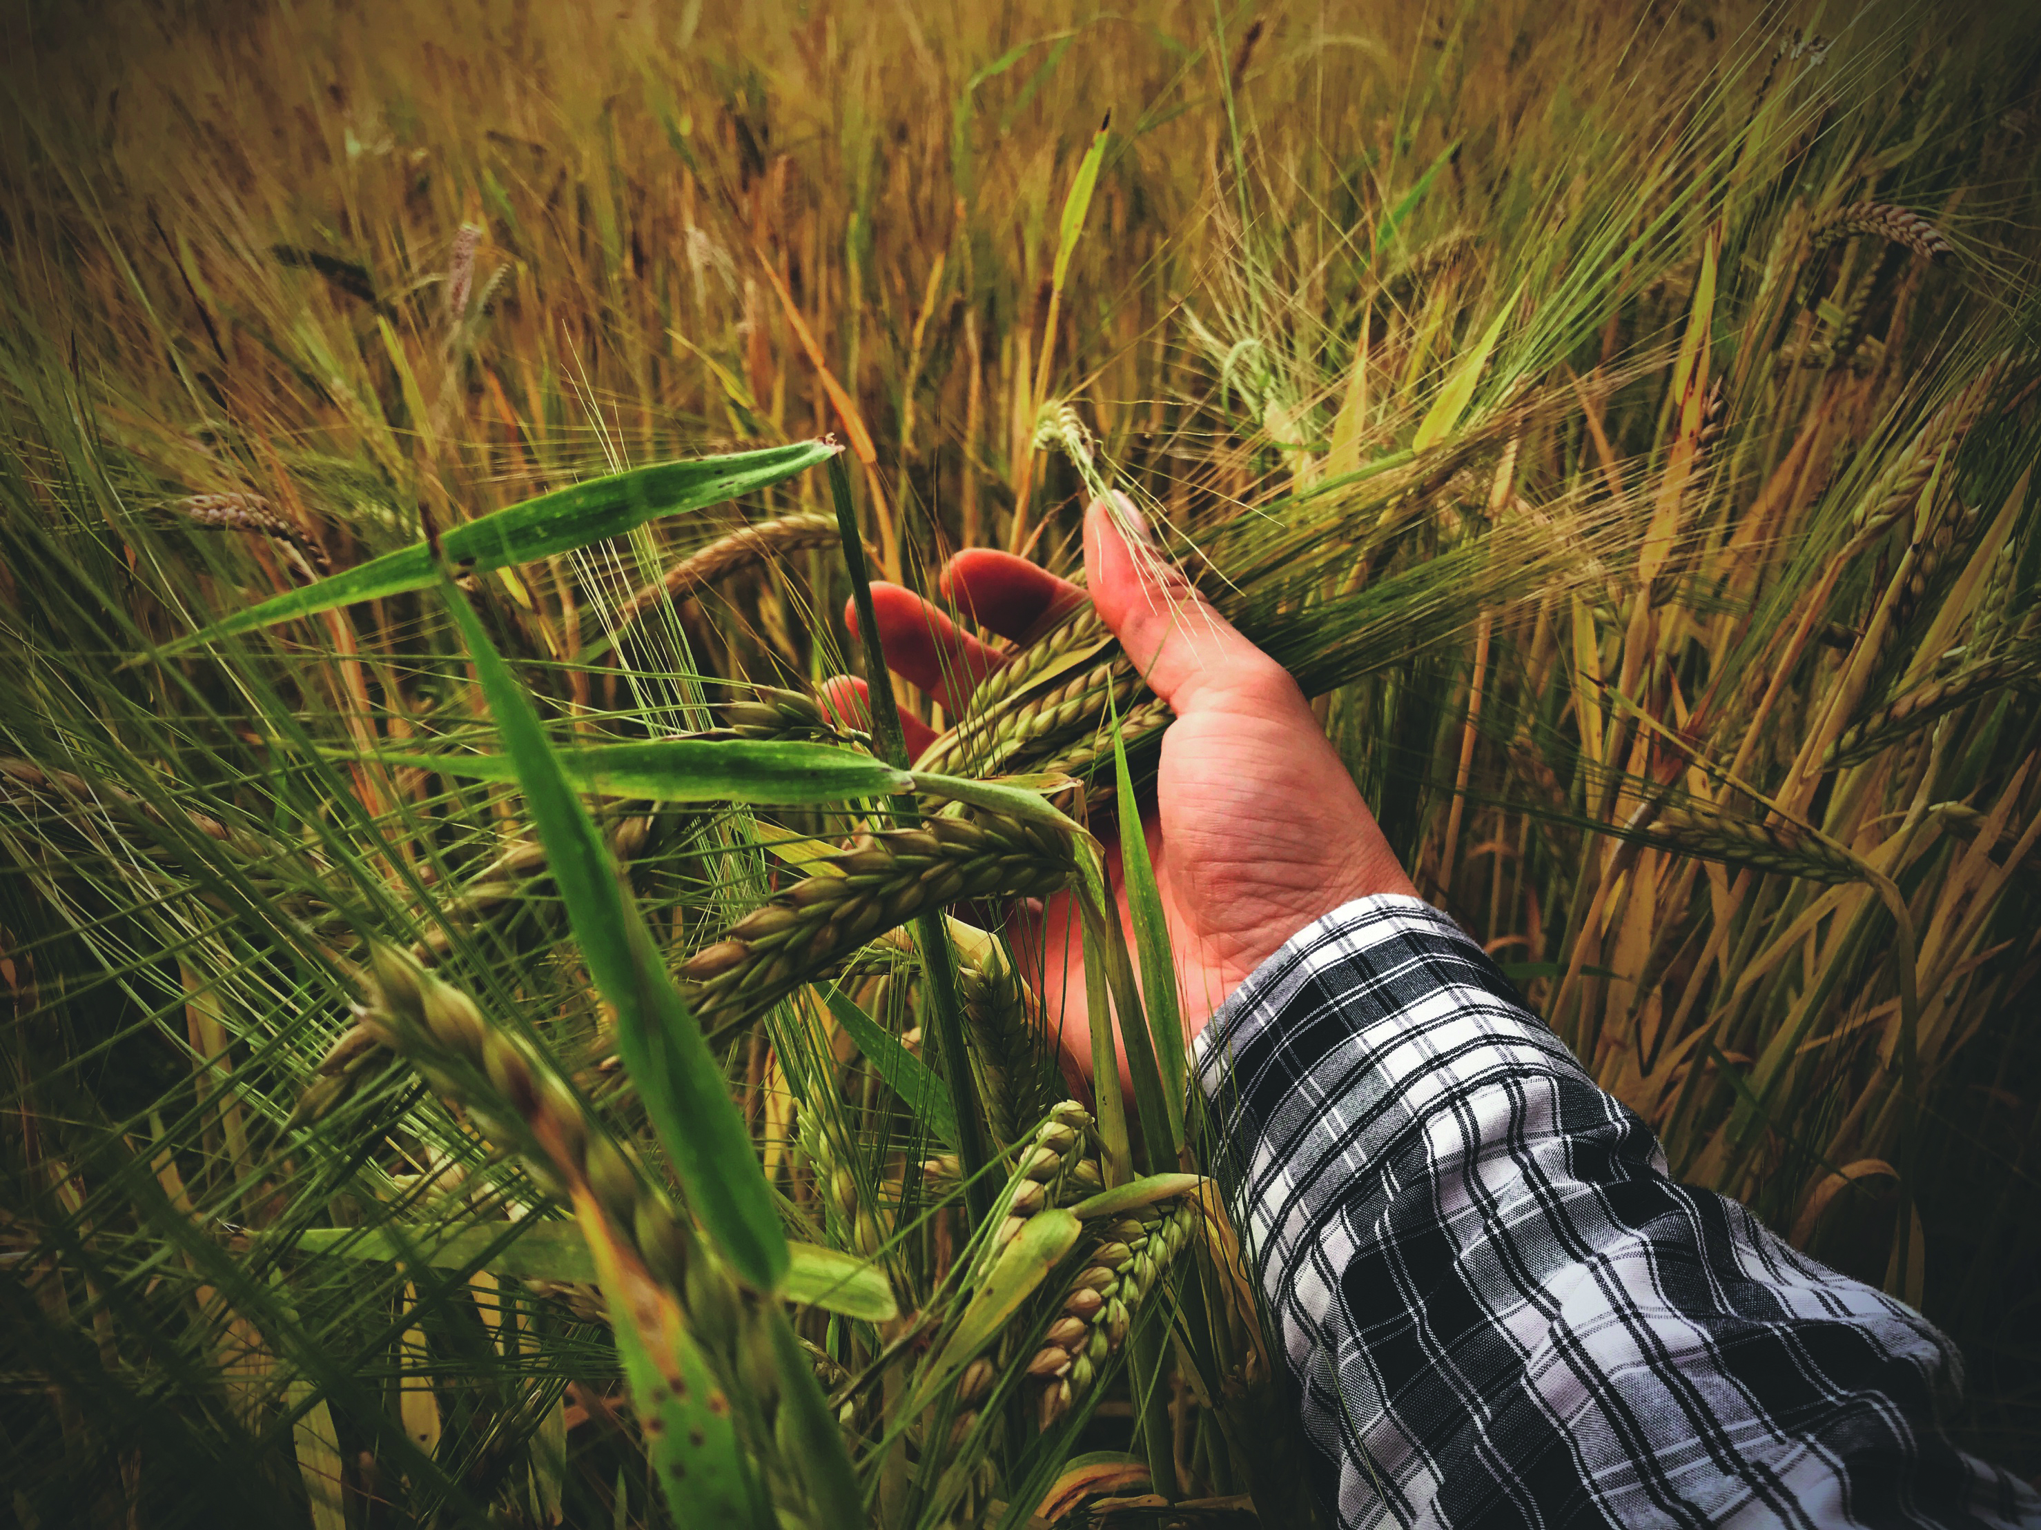
Everyone’s situation is unique.
Your analysis should be unique, too.
Notes:
Though you’re not the first one to ask the Big Question, everyone’s situation is unique.
That’s because everyone has different family dynamics, different priorities, different beliefs, and different finances.
So the analysis should be unique to your family.

Slide 6
Where do I start?
Addressing the Big Question
Break the Big Question into smaller, manageable ones.
Where are you now?
Where are you going?
How will you get there? there?
Notes:
Often, the Big Question may seem to be too big, too complex, with too many moving parts.
But you’ve resolved to do something about it, despite these doubts and fears.
Once you’ve made up your mind, the question changes: Where do you start?
It helps to break the Big Question into smaller, more manageable ones. We need to know where you are now and where you want to be before we can determine how you can get there.

Slide 7
Financial review
Getting started: where are we now?
Review of Balance Sheet
Hypothetical example for illustrative purposes only.
Notes:
It starts with a financial review to understand the size of your estate, whether debt is a concern, and the types of assets you have. This gives you some idea of which assets may be subject to capital gains, which assets are passive income generating, and which assets might need debt protection insurance.

Slide 8
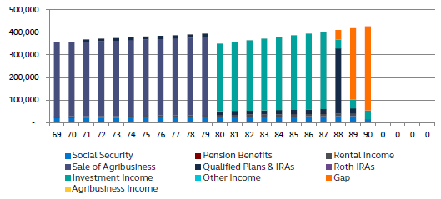
Financial review
Getting started: where are we now?
Review of current and retirement income sources
Retirement income analysis
Hypothetical example for illustrative purposes only.
Notes:
The financial review continues by examining your various sources of current and potential future income, including farm income, rent, social security, pensions, or potential sales of equipment or land. This review helps determine whether you have sufficient retirement income to meet your retirement income needs, so that you can plan accordingly.

Slide 9
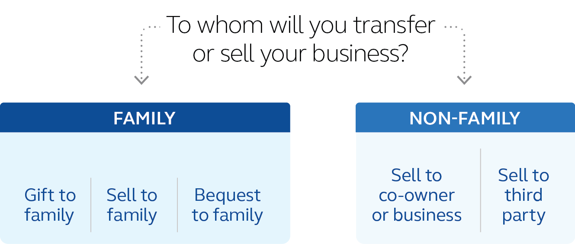
Agribusiness goal setting
Moving forward: where are we going?
Reviewing current agribusiness structure
Identifying an agribusiness successor
Delineating respective roles
Determining timelines
Notes:
Having done a financial inventory of sorts, the next task at hand is goal setting. As it relates to the agribusiness, you’re looking to determine who the successor may be, when that transition may occur, and what the respective roles may look like during that transition. Review slide.

Slide 10
Personal goal setting
Moving forward: where are we going?
Preserving retirement income needs for self and spouse
Distribution of assets to family/heirs/beneficiaries
Determining timelines
Notes:
At the same time, goal setting needs to occur with the distribution of the personal assets. While accomplishing all these goals at the same time would be ideal, agribusiness succession goals and personal financial goals often affect one another and should therefore be prioritized. Some goals are more important than others, and it takes good planning to accomplish as many goals as possible.
This slide provides an example of our Inheritance equalization calculator, a tool designed to better balance the children’s inheritance while leaving the farm/ranch to one successor.

Slide 11
Four key areas
Planning process
Business organizations
Succession strategies
Legacy and estate planning
Retirement income
Notes:
Once we have a better understanding of your current financial situation, as well as prioritized goals, the path to accomplish these priorities must be mapped based on your specific situation.
At Principal, we start by breaking the Big Question down and examining 4 key areas: Business organizations, succession strategies, legacy and estate planning, and retirement income.
From there, we approach each key area as a building block for the next, one at a time.
Within each building block of the agribusiness planning report, the information and solutions are customized to focus in on your specific conditions and goals. By tackling them one at a time,, we can make steady, tangible, and coordinated progress.

Slide 12
Key questions
Business organizations
What does my operation look like now?
What will the operation look like when I’m gone?
Would a formal business structure benefit me now and in the future?
Notes:
We start with “Business organizations” and some common, related questions.
Choosing a formal entity (e.g., LLC, S corporation, etc.) can be a key component to your overall plan. Each entity type has pros and cons affecting liability, taxes and control issues. So, ask yourself:
Read from slide

Slide 13
Business types and characteristics
Business organizations
Common business types
Sole proprietorship
General partnership
Family limited partnerships
S corporations
C corporations
Limited liability corporations
Considerations
Liability protection
Control issues
Profit allocation
Transferability
Income taxation
Notes:
A business organization is extremely important as a strong base for the rest of the agribusiness solutions– it’s why we start here.
Different types of business organizations have different characteristics. The most common organization types that we see in farm and ranch operations are sole proprietorships, general partnerships, Limited Liability Companies (LLC), Family Limited Partnerships (FLPs), S-Corporations, and C-Corporations.
Each one has a different combination of the same characteristics:
Examples:
Liability protection: Cow escapes onto the highway and causes a fatal car crash, sole proprietor is personally liable. LLC would limit the personal liability and protect the land.
Control: Some business types (like an FLP) allow an owner to maintain managerial control, despite becoming a minority owner.
Profit allocation: Different business types requires profits be divided according to ownership percentages; others have more flexibility in re-allocating profits among owners.
Transferability: It’s easier and cheaper to transfer shares, than it is to do the same with acres.
Income Tax example: a C-Corporation can claim more tax deductions, but profits are taxed at both the Company and personal levels (double-taxation); an S-Corporation claims fewer deductions but is only taxed at the personal level.
The agribusiness planning report provides you with business organization information, so you can make an informed decision as to which, if any, organization could benefit your specific goals.

Slide 14
Entity discounting
Business organizations
Currently still available
Proposed IRS regulations may change
Unclear if regulations will take effect
Notes:
Another benefit of having a formal business entity is a common technique called “Entity Discounting”.
This estate planning technique decreases size of taxable estate, potentially saving Federal Estate Taxes and Transfer Taxes.
How it works:
Asset, such as ag land, is transferred into a formal business entity, thus creating shares or membership units.
These shares / units are succession currency, more readily gifted / sold to the next generation in fractions than a sole proprietorship.
The shares are then gifted / divided amongst the minority shareholders.
This frequently occurs between spouses where each spouse will take 49% (there is an unlimited marital exclusion between spouses) and they gift 1-2% to their child / children using the annual gift exclusion of $17,000 (as of 2023) p/donor/donee/year.
IRS recognizes a discount based upon:
Lack of Control – no one owner controls the majority shares of the company
Lack of Marketability – fewer outside people are likely to buy-in as a minority shareholder into a family owned company

Slide 15
Entity discounting savings
Business organizations
 | No entity discounting | With entity discounting
Land value | $8,000,000 | $8,000,000
Hypothetical entity discount | x 0% | x 30%
Less discount | - $0 | - $2,400,000
Post-discount value | = $8,000,000 | = $5,600,000
Less estate tax exemption | - $25,840,000* | - $25,840,000*
Taxable portion | = $0 | = $0
Federal estate tax rate | x 40% | x 40%
Estate tax liability | = $0 | = $0
Hypothetical difference |  | $0
Additional available Unified Credit |  | $2,400,000
Hypothetical example for illustrative purposes only.
* 2023 estate tax exemption amount
Notes:
The Ag Planning report’s Entity Discounting Calculator can illustrate hypothetical Federal Estate Tax savings based on the agribusiness owner’s reported information:
Married couple - $8M asset
A Married $23.84M Federal Estate Tax Exclusion applies
With a 30% entity discount: $8M asset discounted to $5.6M
In this medium sized case, Entity Discounting does not result in any current estate tax savings, but it creates an additional $2,400,000 in available Unified Credit that can be put toward gifting now or saved for estate tax savings when then current threshold sunsets in 2026.
Can be applied to any closely held business:
Seed company
Custom Farming: Combining/Spraying/Etc.
Dirt Work/Tiling

Slide 16
Key questions
Succession strategies
How will I transfer my operation to the next generation?
Who will own and control my operation?
How do I minimize transfer taxes?
Notes:
Perhaps you’ve trained a family member or younger partner to carry on the operation, but you’re unsure how and when to turn over control. Some transitions can be anticipated, like a planned retirement. Other events are less predictable, such as an untimely death or disability. Being prepared for both with a formal succession plan increases the next generation’s chance of success.
Have you asked yourself:
Read from slide

Slide 17
Buy-sell arrangements
Succession strategies
Immediate need
Evolving need
Buy-sell agreement
Covers events such as death, disability, and divorce
Protects successors/heirs
Succession plan
Covers succession strategies
Protects successors/heirs
Notes:
The need for both types of planning, may come down to timing. A planned transition (succession) when the owners are ready to think about moving on is usually later in their business cycle, versus a transition that results from an unplanned event, which could happen at any time. Both sets of needs would ideally be governed by an Agreement, but the succession plan down the road might look different from an initial plan that needs to protect against a “worst case scenario” that could happen from day one, such as death, disability, bankruptcy, or divorce.
Another way of contrasting the two concepts is (1) planning that is needed right now(an Immediate Need), from day one, and (2) planning that will occur sometime down the road when the owners are ready to move on—an evolving need which may happen over time, particularly as children who are active in the business may be maturing to a point of being able to be considered a successor.

Slide 18
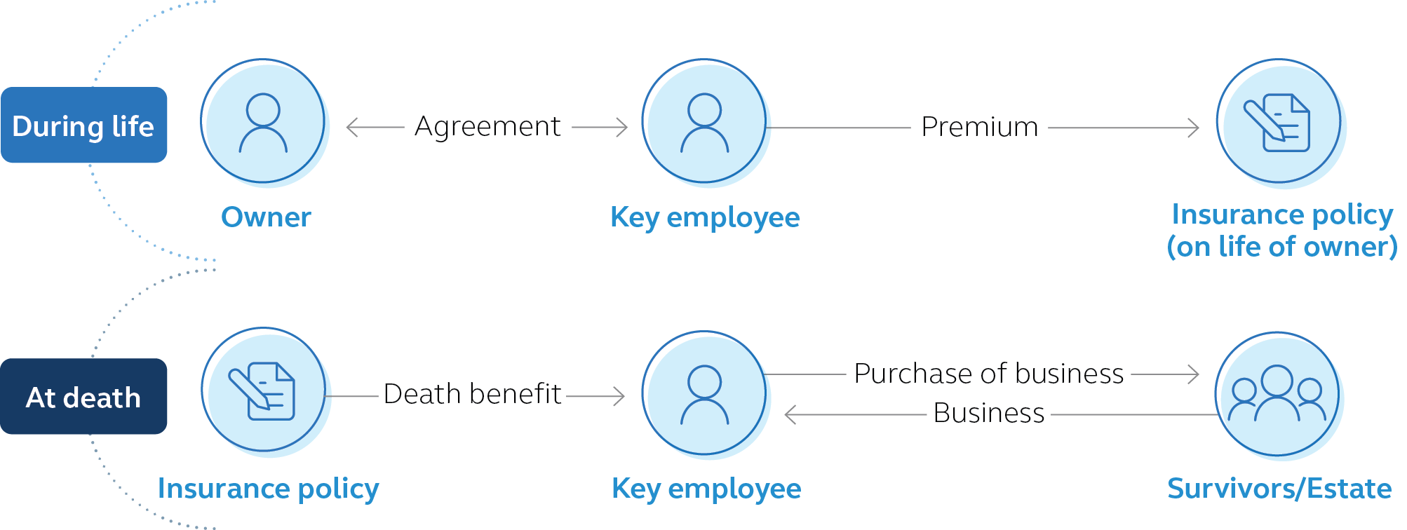
Implementing a buy-sell arrangement
Succession strategies
Notes:
To whom will you sell or transfer the operation?
When will the transition happen?
Will the necessary funding be in place?
You may be in a partnership with your brother; when one of you dies, the other will buy out the surviving spouse using a buy-sell agreement.
You may have a child that is already working the family farm and is looking to take it over some day, so you can leave it to him or her using your will or trust.
You may have a trusted worker or tenant that you’re looking to sell land to. An installment contract could help them overcome credit issues and provide you with retirement income.

Slide 19
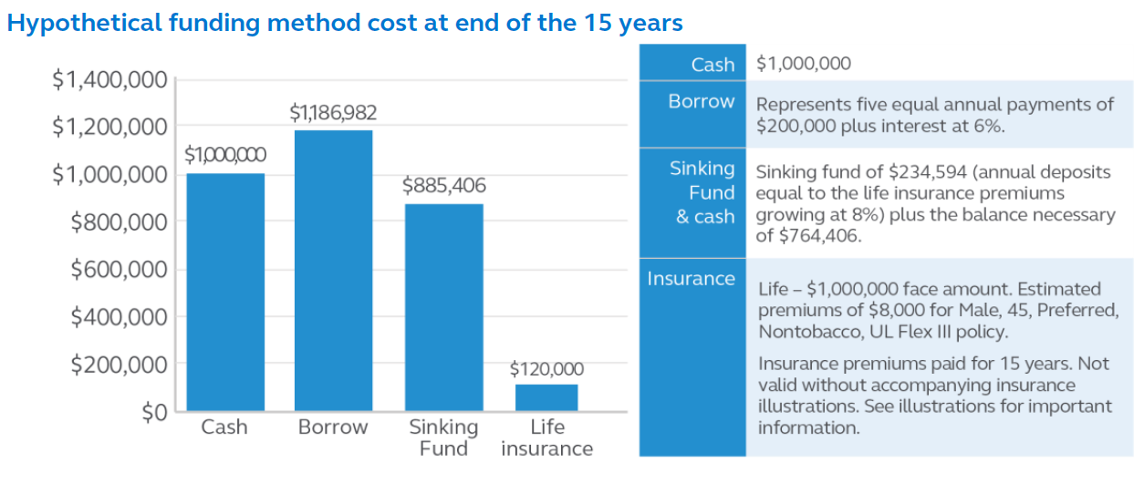
Buy-sell arrangements and funding
Succession strategies
Hypothetical example for illustrative purposes only.
Notes:
“Funding” the Buy-Sell Agreement is equally as important. You don’t want to have a legal / contractual obligation to purchase, but not have enough money to complete the purchase.
There are any number of ways to fund the Buy-Sell Agreement, each with benefits and pitfalls.
In this example, the buyer needs $1,000,000 to fund the buy-sell agreement.
Cash. Not many farm or ranch operations keep $1,000,000 in cash on hand. Farmers don’t let their land lay fallow. They don’t let their money lay fallow either; they put it to work.
Borrow. The buyer becomes dependent on the Bank and may face credit issues, fluctuating interest rates, etc. At the end of the day, the land is used as collateral, so there is always the risk of losing the land altogether. (may need to remove this bullet or this slide when presenting for a bank).
Sinking fund. Start saving money and grow it conservatively. The biggest risk here is timing. If the purchase obligation is triggered sooner than later, the buyer will not have had enough time to save the money – then they’re heading to the bank for the shortfall.
Life insurance. Because the death benefit pays upon the death of the owner, the purchase money is available at the right time. Often, the insurance premiums may cost less than the death benefit. This may be particularly true in the event of an early, unexpected death.

Slide 20
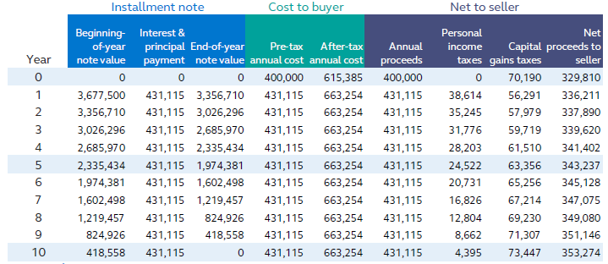
Installment sale
Succession strategies
Common transfer technique between current owner and trusted buyer (family, tenant, etc.)
Benefits/Considerations
Hypothetical example for illustrative purposes only.
Notes:
A common technique used in family farm/ranch succession plans are installment contracts.
The owner, acting as the bank, sells the land to the buyer and retains a mortgage note that is repaid annually by the buyer until paid in full.
Benefits:
Installment sales make the purchase price more affordable for the buyer by stretching the loan period
Can charge lower interest rates than available at a commercial bank.
It can also stretch the seller’s capital gains tax bill out over a longer time frame – as opposed to paying all of the taxes up front.
The agribusiness planning report can show the seller the net annual installment payment, after capital gains and income taxes, as well as show the buyer the pre-tax income necessary to pay the annual installment.
Considerations:
If either the buyer or seller dies part way through the installment contract, the best-case scenario is a new (perhaps unwanted ) business partner.
The worst-case scenario is that the buyer’s family/estate doesn’t want to complete the contract, so the deal falls through – but you are still business partners because of the equity purchased. That’s a pretty awkward situation.
In order to make sure that the sale goes through as intended, the buyer might carry life insurance on the owner/seller, so the death benefit can be used to pay the balance of the installment contract upon owner’s death.

Slide 21
Key questions
Legacy and estate planning
How do I protect my assets while I’m alive?
How do I reward my successor’s efforts?
How can I be fair to my other heirs?
Notes:
Estate planning questions are often the questions that farmers/ranchers struggle with the most. After all, deciding where your assets go when you are gone is a tough, and important, decision to make. They are deeply personal and often result in conflicting feelings. And you’re the only one who can decide what is fair. But doing it now allows you to gather input, explain decisions, equalize your estate and leave a plan that is easy to execute without unnecessary tax burdens.
The goal with the Ag Report is to provide multiple solutions that align with owners’ goals. We’ll walk you though the pros and cons of your options so you can be confident in your decision as the owner of the operation.
Some of these questions are:
Read from slide

Slide 22
Estate documents
Legacy and estate planning
Medical power of attorney
Financial power of attorney
Living will
Will
Revocable living trust
Family trust
Irrevocable living trust
Distribution plans
Notes:
The agribusiness planning report provides additional information regarding estate planning
Medical power of attorney. Designates someone in charge of your medical decisions when you are unable to do so. This simple document is designed to avoid the unnecessary effort, reporting, and expense of a court-supervised Guardianship.
Financial power of attorney. This is much like the medical power of attorney, but for your finances and assets. It designates someone in charge of your financial decisions when you are unable to do so. This simple document is designed to avoid the unnecessary effort, reporting, and expense of a court-supervised Conservatorship.
Living will. This document clearly states your end-of life instructions regarding pain assistance, artificial feeding and artificial breathing. Importantly, a living will relieves your family of having to make a very difficult decision.
Will. Distributes your assets through the court-supervised probate process.
Revocable living trust. Distributes your assets, while skipping the unnecessarily expensive and time-consuming probate process.
Family trust. Holds assets for the benefit of your family (typically children) until a specific age, when the assets are distributed out to the beneficiaries (children).
Irrevocable living trust. For larger estates looking to mitigate federal estate taxes, gifting rapidly appreciating assets out of the taxable estate to avoid paying tax on the growth. The fact that it is “irrevocable” means it is extremely difficult to unwind / undue.
Distributions plans. If you don’t formalize your asset distribution plan, the state has a default plan for you—that you may not agree with.

Slide 23
Inheritance equalization calculator
Legacy and estate planning
Compares current distribution plan to proposed distribution plan.
Current plan
Proposed plan
Notes:
Inheritances: One of the toughest (smaller) questions to answer.
Farmers and rancher are known to reinvest profits into the operation by paying off mortgages, upgrading equipment, building buildings, etc. As a result, the operation is often 80%-90% of their total estate value. At this point, there seems to be only 2 choices.
Option 1: Divide the operation ownership equally between all the heirs.
It only takes one of the children, however, to bring partition action and force a partial sale of the farm – you probably don’t want that.
If the children decide to keep the farm, the successor does all the work, and the non-successors collect a proportionate share of the profits – that doesn’t seem fair.
Option 2: Leave the operation solely to the successor, and the other children get the rest of the liquid assets. Problems exist there too:
The successor gets 90% of the estate – that may lead to litigation by the other children (who in this case get 5% each)
As you age and have increased health care and long-term care needs (with limited income), you tend to use up those liquid assets before accessing the equity in the land. As a result, there may be even less (or no) cash to pass to the non-successor heirs.
There are other options: Start by focusing on “fair” rather than “equal:.
“Fair” and “Equal” don’t necessarily mean the same thing.
Often, owners struggle with what is “fair”.
In order to reward the successor for their hard work and loyalty, it may be “fair” to leave them more of the operation’s assets (land, equipment, crops, livestock).
At the same time, it may also be fair to leave the non-successors heirs with less total value, but in cash, because the non-successor has no interest in the farm / ranch assets.
Only you can decide what is “fair”, my job is to help you make the plan work.
The agribusiness planning report has an Inheritance Equalization Calculator to assist you in finding your “fair”:
Your “fair” may be keeping the farm/ranch in one piece with successor, and creating a protected and “fair” cash inheritance for the non-successors.
Review Example:
Under the “Current Distribution Plan” (where the operation heir gets all of the operation – 2 siblings split the rest)
Operation ‘heir gets $12M in operation’s assets (84% of the estate)
Non-operation heirs get $1,125,000 in cash (8% each)
This imbalance may result in litigation and forced liquidation.
By adding new life insurance ($7.25M) to the “Proposed Plan”, a “Fair” non-successor cash inheritance
Operation heir still gets $12M in operation assets (55%)
Non-operation heirs get $4,750,000 each (27.5% each)
Though unequal, the new “fairer” distribution may help avoid litigation and forced liquidation
This can be scaled up or down to fit any farm / ranch size.

Slide 24
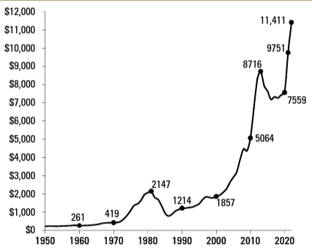
Land values and federal estate tax
Legacy and estate planning
Farmland values are back on the rise
635,000 farm estates paid federal estate tax in 2017
Avg. value per acre of Iowa farmland
2022 Iowa State University Farmland Value Survey (iastate.edu)
Source:
Notes:
The previous drastic increase in farmland prices has created unexpected multi-millionaires with Federal Estate Tax issues
For example, in Iowa, land prices have begun to climb again, following a recent decline after the drastic increase from the late 80s to 2013.
If you intend to keep your land for the next 10, 20, 30, or 40 years, some of you could owe Federal Estate Taxes.
Wouldn’t you like to have some idea of whether that might include you?

Slide 25
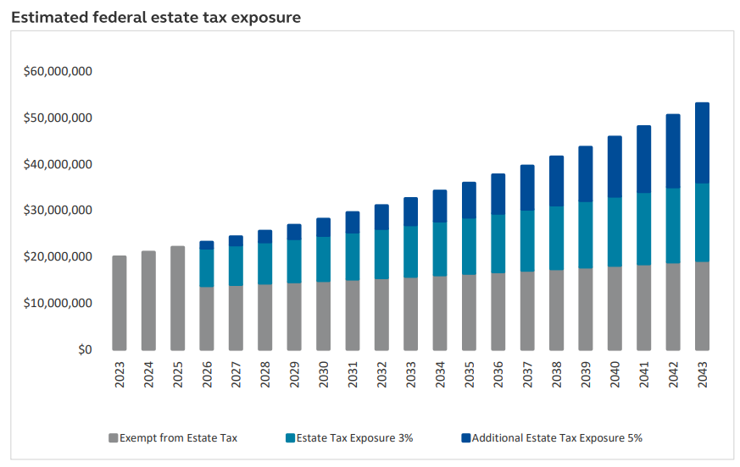
Federal estate tax exposure
Legacy and estate planning
2021 fair market value: $13,850,000
Current exclusion is $11.92 million (single); $23.84 million (couple)
Under current legislation, amount will drop approximately in half in 2026
Hypothetical example for illustrative purposes only.
Notes:
The agribusiness planning report will provide you an estimate of current federal estate tax liability based on estimated land values, adjusted for growth.
Due to the lack of liquidity, federal estate tax is a common cause of farm and equipment liquidation.
The current (2023) federal estate tax is at an all-time high of $11.92M (single person) and $23.84M (for a married couple). Estates with assets over those exclusion levels pay 40% tax on the excess amount. While that excludes most farmers and ranchers, a drastic drop in the exclusion is set for 2026, when that amount is cut approximately in half.
That means that, if you’re married with an $13M estate now, combined with rising land values and the impending drop in the federal estate tax exclusion, you will likely have a substantial federal estate tax liability after 2026. That leaves only a few more years to take advantage of the large estate friendly laws to gift assets to the next generation or create sufficient, federal estate tax free liquidity to pay a potentially large federal estate tax bill.
We can assist in creating additional―potentially non-taxable―insurance proceeds to avoid liquidation of farm / ranch assets.
Additional life insurance may increase the tax liability if not owned properly, in many cases an irrevocable life insurance trust is used to accomplish this.

Slide 26
How much can I gift?
Legacy and estate planning
2023 federal gifting limit: $17,000 per year/per donor/per recipient
Example for married couple
Notes:
In this case, the spouses can gift $102,000 per year without filing federal gift tax returns or paying federal gift taxes.
Establishing a gifting program can be an effective way to pass assets to your children while shrinking the size of your taxable estate.
Though you may lose the use, control, and income from the asset, you can ensure it stays in the family while reducing/avoiding estate and transfer taxes.
The recipient takes asset at the original basis (the donor’s original cost); if they sell the asset down the road, could incur additional capital gains taxes.
This may encourage the recipient of the gift to keep it (such as land) in order to avoid having to pay the capital gains taxes (up to 20%).

Slide 27
Why gift to an irrevocable life insurance trust (ILIT)?
Legacy and estate planning
Annual gifts purchase life insurance policy
Tax-free death benefit can purchase assets from the estate
Estate can then use liquidity for: inheritance equalization, estate tax liability, debt
Notes:
Explain gifting to ILIT infographic.
Spouses can now gift their $90,000 a year, without paying gift taxes, to an Irrevocable Life Insurance Trust, to purchase a life insurance policy.
Read slide

Slide 28
Key questions
Retirement income
What will be my sources of retirement income?
How much of my income needs will be covered by each resource?
Will my resources meet my retirement income goal?
Notes:
Farmers and ranchers “retire” in their own way, whether that means focusing on management (rather than labor), renting the land, or selling the operation altogether.
Despite this, every owner needs to ask themselves these same questions:
Review slide.

Slide 29
Retirement analysis
Retirement income
Agribusiness income
Rent
Social security
Partial/total sale of operation
Investment income
Pension benefits
Qualified plans, Individual Retirement Accounts (IRAs), Roth IRAs
Notes:
Hiring replacement labor or cash leasing farmland cuts into your income.
Regardless, you owners have ongoing income needs to pay for daily expenses, taxes, insurance, and chronic illnesses/potential nursing home bills.
A Retirement Analysis from the agribusiness report provides you with the answers to those income questions and begins the discussion as to what needs to be changed, if anything, to reach your income goals.

Slide 30
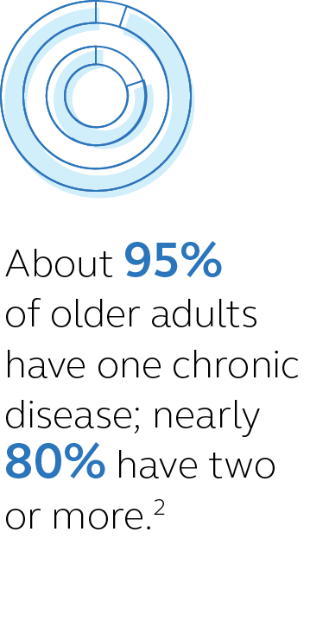
Is your retirement income protected?
Retirement income
The national average cost for long term care in the U.S. is $7,908/month for a semi-private nursing home room.¹
How would that affect your retirement income goals?
¹ Genworth Cost of Care Survey, 2021.
² National Council on Aging, “Get the facts on healthy aging,” March 2023.
Notes:
Is your retirement income protected from unforeseen events?
A potential curveball to meeting your retirement income goals is chronic illness/nursing home bills. This effect is even more drastic on a fixed income.

Slide 31
Potential protection solutions
Retirement income
Long term care insurance
Liquidate your assets
Medicaid
Life insurance chronic illness riders
Notes:
Long term care—can be expensive and many people fear that they’ll buy it – and never use it. Then they feel like they’ve wasted their money.
Liquidate assets―are you going to sell land? Pay capital gains taxes on the sale?
You only qualify for Medicaid if you have less than $2,000 in assets, and less than $2,022 in annual income.
Chronic Illness riders are available on certain life insurance policies. This may provide a source of funds to help protect you from the potentially devastating expenses of a long-term illness
Attaches to a life insurance policy that you may be purchasing for another purpose.

Slide 32
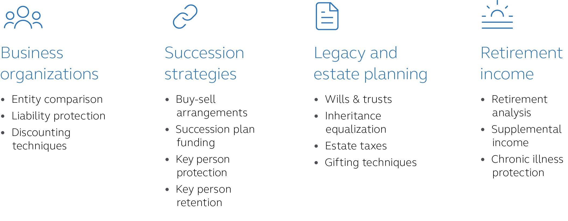
Four key planning areas
Putting it all together
Notes:
Now that we’ve discussed the four key areas and some of the key questions, let’s take a step back to see how the pieces fit together for you and how you can get started today.

Slide 33
What’s next?
Putting it all together
Complete the agriculture planning questionnaire.
Receive and review the agribusiness planning report.
Notes:
Explain slide.

Slide 34
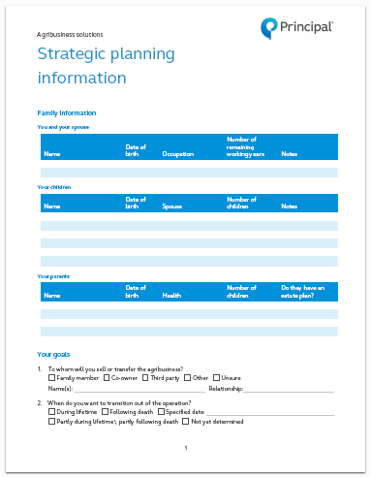
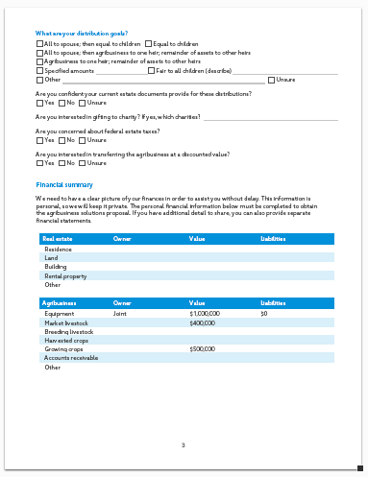
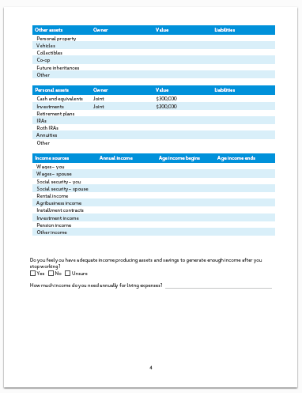
Complete agribusiness request for proposal
Take action
Information remains confidential
Condensed for quick and easy completion (five pages)
Complete and provide to your financial professional
Notes:
Review slide

Slide 35
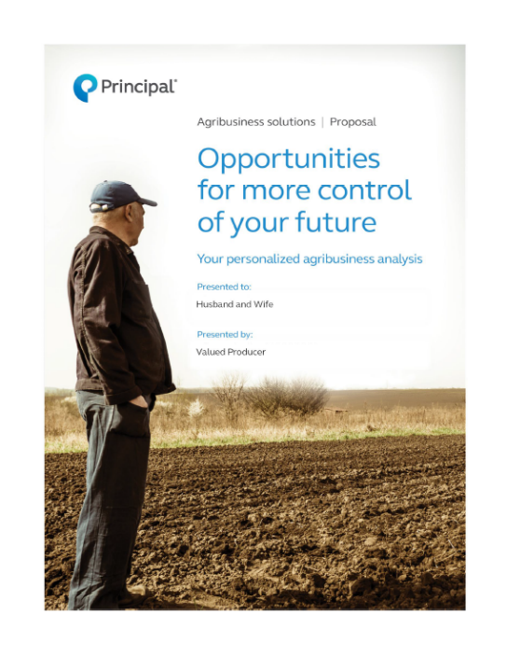
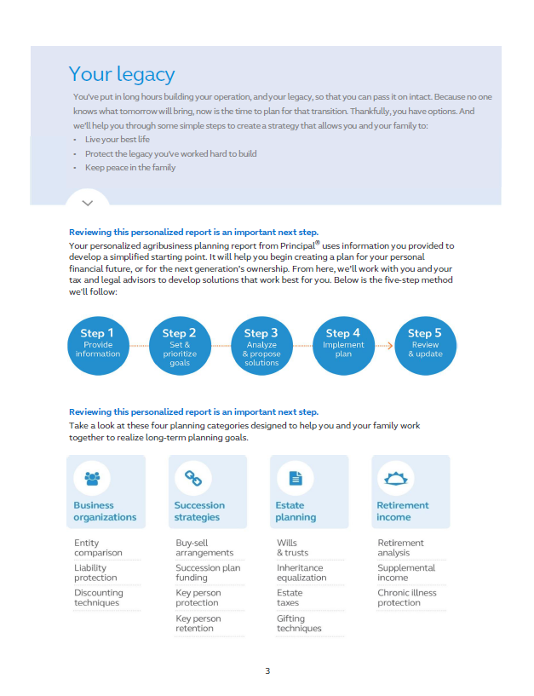
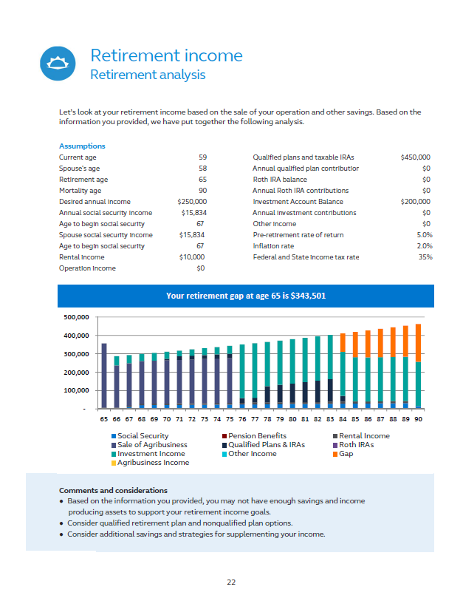
Review your customized proposal
Take action
Complimentary agribusiness planning proposal, customized for your needs
Prioritize and target your planning needs
Work with your team of professionals to implement and maintain a succession plan
Attorney
CPA
Financial professional
Notes:
Review slide

Slide 36
Questions?
Presenter’s name
Phone Email Website
Notes:
Take some information to learn more.
Contact me.
We’ll discuss if the agribusiness planning report could be beneficial to you.
If you’re comfortable, we can complete the agribusiness fact finder and get the ball rolling.

Slide 37
The subject matter in this communication is provided with the understanding that Principal® is not rendering legal, accounting, or tax advice. You should consult with appropriate counsel or other advisors on all matters pertaining to legal, tax, or accounting obligations and requirements.
Insurance products issued by Principal National Life Insurance Company (except in NY), Principal Life Insurance Company®, and the companies available through the Preferred Product Network, Inc. Plan administrative services provided through Principal Life. Securities offered through Principal Securities, Inc., member SIPC, and/or independent broker/dealers. Referenced companies are members of the Principal Financial Group®, Des Moines, IA 50392.​
No part of this presentation may be reproduced or used in any form or by any means, electronic or mechanical, including photocopying or recording, or by any information storage and retrieval system, without prior written permission from the Principal Financial Group.
Principal®, Principal Financial Group®, and Principal and the logomark design are registered trademarks of Principal Financial Services, Inc., a Principal Financial Group company, in the United States and are trademarks and service marks of Principal Financial Services, Inc., in various countries around the world.
Not FDIC or NCUA insured
May lose value • Not a deposit • No bank or credit union guarantee Not insured by any Federal government agency
BB10368-09 | 07/2023 | 2951680-062023 | © 2023 Principal Financial Services, Inc.
Notes:
Read slide.

