Slide 1
Principal Deferred Compensation - Defined Benefit plan
Keep your key employees loyal and motivated.
PRESENTER NAME (ALL CAPS)
Title
Notes:
Read slide

Slide 2
What’s a nonqualified defined benefit plan?
It’s an employer-sponsored benefit for the key employees you choose. It’s basically an agreement between you and your key employees.
You predetermine the future benefit you want to provide your key employees and the set amount or formula that will be used to pay that benefit.
Notes:
Read slide

Slide 3
Keep your key employees satisfied.
What can you do now to help ensure your top talent remains committed to you—and not the competition? Enhance your benefits package with a deferred comp - defined benefit plan. It can give you a competitive advantage by:
Encouraging the best employees to join your organization as it grows.
Keeping your key employees satisfied and motivated for the long term.
Rewarding them for reaching goals.
Helping employees bridge the retirement gap resulting from 401(k) plan testing and limitations.
Notes:
Read slide

Slide 4
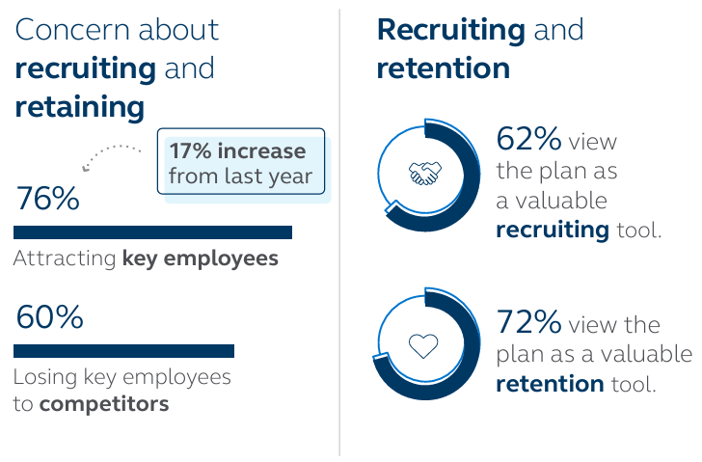
Findings in today’s market.
From plan sponsors with existing deferred comp plans
Source: 2023 Trends in Nonqualified Deferred Compensation, conducted by Principal®.
Notes:
Read slide

Slide 5
Helping you choose a plan to fit your needs.
Discover. Identify the issues your organization wants to resolve and what you want to achieve.
Solve. Learn how this plan can help solve your business challenges and achieve your objectives.
Design. Use the plan’s flexibility to tailor a plan to your organization’s and participants' needs.
Collaborate. Trust the service and experience we’ll provide to you and your key employees every step of the way, year after year.
Stay current. Make changes to your plan as your organization’s needs and goals change.
Notes:
Read slide

Slide 6
Discover
Identify issues your organization wants to resolve and what you want to achieve.
Notes:
Read slide

Slide 7
What are your organization’s goals?
Recruit
Attract the best employees as part of a competitive
benefits package.
Retain
Encourage key employees to remain loyal to
your organization.
Retire
Help your key employees save enough for
retirement above what 401(k) plans allow.
Notes:
Read slide

Slide 8
What are your key employees’ goals?
Retirement savings
Save beyond 401(k) plan limitations with employee deferrals or optional employer contributions.
Managing taxes
Help manage the impact of taxes using the plan's flexibility for when benefits are paid.
Notes:
Read slide

Slide 9
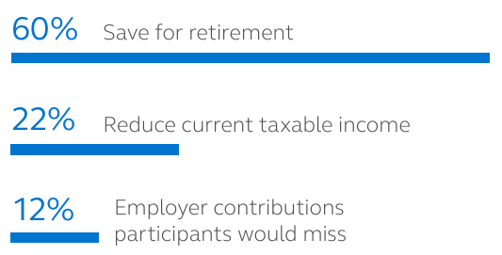
Main reasons for participating in the plan.
Source: 2023 Trends in Nonqualified Deferred Compensation, conducted by Principal®.
Notes:
Read slide

Slide 10
Solve
Learn how this plan can help solve your business challenges and achieve your objectives.
Notes:
Read slide

Slide 11
Is it right for your key employees?
Benefits for your key employees:
Receive an additional benefit paid entirely by the employer without any investment risk by the employee.
Participants receive benefits beyond 401(k) or 403(b) plan limits.
Design a personalized investment strategy.
Enjoy flexibility and take payouts from the plan without the same age restrictions as 401(k) plans.
Notes:
Once you’ve identified the most important goals, then consider the role that a deferred comp plan can play in helping achieve those goals. The plan offers benefits and considerations for both the organization and the key employees.
Read slide

Slide 12
Is it right for your key employees?
Considerations for your key employees:
Plan benefits aren't protected in the event of company bankruptcy.
If the company doesn't comply with IRS rules, participants could face taxes and penalties.
Notes:
Read slide

Slide 13
Is it right for you?
Benefits for you:
Increase morale with top employees by offering a benefit they value, which helps keep them loyal and motivated.
Leverage incentives to structure a benefit to recruit, retain, and reward your top employees.
Easier to administer with no discrimination testing, minimum participation, or Form 5500 filing, if set up properly.
Notes:
Read slide

Slide 14
Is it right for you?
Considerations for you:
The corporate tax deduction is deferred until benefits are paid, rather than a current deduction.
There are fees for plan administrative services and could be a potential charge to earnings on assets purchased to finance the plan.
The company takes an investment risk by promising to pay a defined benefit to the employee.
Notes:
Read slide

Slide 15
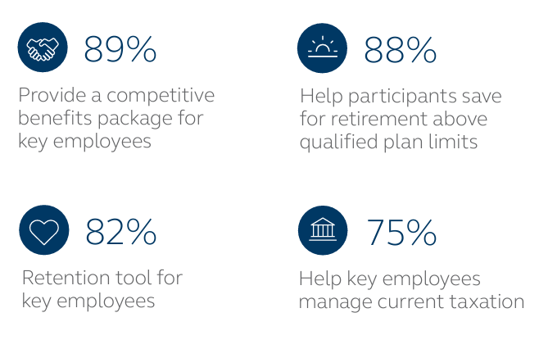
Top reasons why plan sponsors offer deferred comp plans.
Source: 2023 Trends in Nonqualified Deferred Compensation, conducted by Principal®.
Notes:
Read slide

Slide 16
Design
Use the plan’s flexibility to tailor a plan to help meet your organization’s and participants’ needs.
Notes:
Read slide

Slide 17
How’s the plan created?
Who participates
Select the groups of key employees to participate in this plan.
What can be offered
Choose how the benefit will grow with the flexibility to vary by employee.
What happens with the benefit
Decide how and when key employees may receive the benefits based on organizational needs.
How benefits are paid
Decide how payouts can be received from the plan. Benefits can be distributed as a lump sum or in annual installments.
Notes:
You're in control of making the plan yours – it’s based on the specific goals of your organization and unique needs of your key employees. Together with your financial professional, we’ll walk you through the decisions that need to be made to design a plan that makes sense for your organization:
Read the slide

Slide 18
Design
How it works
Notes:
This chart shows how money is contributed to the deferred comp plan and paid out at a later date. It also points out that when the benefit is distributed to the key employee, the employer receives an income-tax deduction and the key employee pays income tax on it.

Slide 19
How does an organization pay for it?
Company cash
Taxable investments
Corporate-owned life insurance
No specific plan assets are set aside. Instead, benefits are paid through company's cash flow.
The company invests in mutual funds and/or individual securities.
The company purchases a policy to pay future obligations.
Notes:
Keeping your promise to pay benefits to participants in the future is important. Any one of these three (or combination of) financing options can help you do that. Plus, we’ll provide a detailed financial model comparing the options to help you make this decision.
Read slide

Slide 20
Collaborate
Trust the service and experience we’ll provide to you and your key employees every step of the way, year after year.
Notes:
Read slide

Slide 21
How do we work with your organization.
Our team of experienced professionals will work closely with you and your financial professional to develop a strategy for implementing and servicing your plan.
And year after year, we’ll continue to work closely with you and your financial professional to fine-tune your plan to help ensure you’re working toward meeting your organization’s goals—and your plan is administered as efficiently as possible.
Notes:
Read slide

Slide 22
Keeping you in-the-know
To help you stay on top of your plan, a range of information is available on our website and corporate accounting reports. You also have easy access to plan reporting, investment resources, and other tools to assist with administering your plan. Plus, depending on plan type and design, you’ll receive:
Access to plan participants’ account information.
Daily valuation of assets.
Asset and benefit information and rebalancing services.
Financing reviews to assess plan performance.
Notes:
To help you stay on top of your plan, a range of information is available on our website and corporate accounting reports. You also have easy access to plan asset and liability reporting, investment resources, and other tools to assist with administering your plan. Plus, depending on your plan type and design, you’ll receive:
Read slide

Slide 23
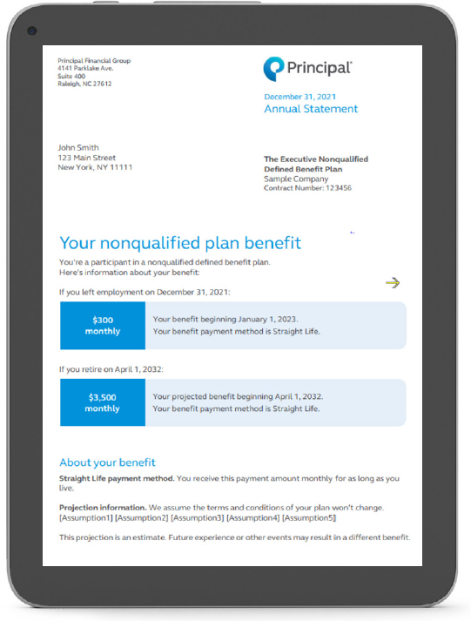
Turning key employees into participants.
We’re here to help every step of the way.
Whether this is a brand-new benefit or employees this are familiar with this type of plan, we offer custom education to introduce plan basics. We'll help you make sure your employees are aware they’re eligible, so they can make an informed decision to participate. Our deferred comp specialists are available to answer questions Monday-Friday.
Notes:
Read slide

Slide 24
Stay current
Make changes to your plan as your organization’s needs and goals change.
Notes:
Read slide

Slide 25
How does your plan keep up with your needs & goals?
Close attention to the plan over time, such as a participant’s benefit from the beginning of the plan until payout at retirement.
Experienced specialists who offer feedback on factors that can influence the plan, such as plan design changes and regulatory updates.
Resources are available for new and existing plans—all while watching out for your bottom line.
Financing Health Dashboard is a digital tool that helps ensure the plan’s financing continues to meet your goals.
Annual service reviews to discuss how the plan is doing.
Notes:
The deferred comp plan is your plan. Its long-term success depends on how well it keeps pace with your organization’s needs and goals -- today and tomorrow. So once your plan is in place, we’ll make sure to provide:
Read slide

Slide 26
Ready to start?
Once you decide that a deferred comp - defined benefit plan is right for your organization and key employees, we’ll bring our experience and resources to the table to help you put this plan in place within your desired timing. We’ll begin by: • Gathering information about your organization. • Tailoring the plan to your specific needs and goals. Thousands of employers value the solutions and services we provide. You can count on us, too. We’ll do our best to deliver a positive experience for everyone involved.
Notes:
Read slide

Slide 27
An industry leader in your corner.
Our history speaks for itself. We’ve been providing deferred comp plans for more than 34 years and are the No. 1 provider of deferred comp plans*. What sets us apart from others is our:
Commitment to and experience in the business and retirement plan markets.
Unique plan design and flexibility to tailor it to specific needs and goals.
Specialized team of legal, accounting, and financing resources with more than 200 years of experience to provide support.
Service and commitment to building long-lasting relationships.
* Based on number of plans (excluding 457 plans), PLANSPONSOR 2023 Defined Contribution Recordkeeping Survey, July 2023.
Notes:
Our history speaks for itself. We’ve been providing nonqualified deferred compensation plans for more than 34 years, and the No. 1 provider of deferred comp plans.
What sets us apart from others is our:
Commitment to and experience in the business and retirement plan markets.
Unique plan design and flexibility to tailor it to specific needs and goals.
Specialized team of legal, accounting and financing resources with more than 200 years of experience to provide support.
Service and commitment to building long-lasting relationships.
A member of the FORTUNE 500®, our employees are passionate about helping clients of all income and portfolio sizes achieve their goals. You can count on us to offer innovative ideas, investment expertise and real-life solutions to help make financial progress possible.
* Based on number of plans (excluding 457 plans), PLANSPONSOR 2023 Defined Contribution Recordkeeping Survey, July 2023.

Slide 28
Thank you
Notes:
Read slide

Slide 29
Before investing, carefully consider the investment option objectives, risks, charges, and expenses. Contact a financial professional or visit principal.com for a prospectus or, if available, a summary prospectus containing this and other information. Please read it carefully before investing.
The subject matter in this communication is educational only and provided with the understanding that Principal® is not rendering legal, accounting, investment, or tax advice. You should consult with appropriate counsel, financial professionals, and other advisors on all matters pertaining to legal, tax, investment, or accounting obligations and requirements.
Insurance products issued by Principal National Life Insurance Company (except in NY) and Principal Life Insurance Company®. Plan administrative services provided through Principal Life Insurance Company. Principal Funds, Inc. is distributed by Principal Funds Distributor, Inc. Securities offered through Principal Securities, Inc., member SIPC and/or independent broker/dealers. Referenced companies are members of the Principal Financial Group®, Des Moines, IA 50392.
No part of this presentation may be reproduced or used in any form or by any means, electronic or mechanical, including photocopying or recording, or by any information storage and retrieval system, without prior written permission from the Principal Financial Group.
Principal®, Principal Financial Group®, and Principal and the logomark design are registered trademarks of Principal Financial Services, Inc., a Principal Financial Group company, in the United States and are trademarks and service marks of Principal Financial Services, Inc., in various countries around the world.
BB11415-07 | 12/2023 | 3286708-122023 | © 2023 Principal Financial Services, Inc.
Notes:
Read slide

