Slide 1
3 tips for tackling debt
PRESENTER / SUBTITLE
Title, Date, etc.
Notes:
Financial professionals to add their approved disclosure block to the final page.

Slide 2
Fixed debt vs. revolving debt
A loan with pre-determined payments and time period (ex: car loan)
Fixed debt
A credit line, such as a credit card, that enables you to “borrow” varying amounts; payments vary based on how much you spend and how quickly you pay it back
Revolving debt
Notes:
I want to start by talking about the two main types of debt.
Many people take out loans to pay for large items such as a car or house. This is fixed debt. It’s typically paid back over a longer period of time, and each installment payment is generally a set amount. You incur no additional penalties or interest as long as you make a payment by the debt’s regular due date.
Some debt, however, may be incurred when you spend more “borrowed” money than you can pay back in a short amount of time. This is what’s known as revolving debt. For example, if you use a credit card for purchases, and you cannot or do not pay off the balance each month, that’s revolving debt.
Let’s talk about why too much debt of any kind may be concerning.

Slide 3
Do you have a high debt-to-income ratio?
Goal: Approximately 35%
Do you have high household debt?
American overall debt: $16.90 trillion¹
When is debt concerning?
Do you have savings for emergencies?
56% of Americans couldn’t cover an unexpected $1,000 bill with savings²
Are you saving enough for long-term goals such as retirement?
50% of women and 47% of men ages 55-66 have no retirement savings³
¹ Federal Reserve Bank of New York Quarterly Report on Household Debt and Credit, Q42022
² Bankrate
³ US Census Bureau
3
Notes:
Debt may be concerning when it limits the ability to maintain our lifestyle and plan for goals. One way to assess your debt level is to figure out your debt-to-income ratio.
This is simply your maximum fixed monthly debt payments divided by your monthly gross income. Some experts recommend a debt-to-income ratio of about 35%. (Principal backup: https://www.principal.com/individuals/build-your-knowledge/managing-debt-3-ways-find-right-balance)
If high debt becomes overwhelming, it can add stress to our lives and delay or interrupt our plans for financial security. According to research from the Federal Reserve, U.S. household debt continues to grow. As of the fourth quarter of 2022, Americans were in debt to the tune of $16.90 trillion¹. At the same time, the net savings rate has declined to 1%. 19% of workers have less than $1,000 in savings. ² It’s no wonder many of us are struggling to save a.
1 https://www.newyorkfed.org/microeconomics/hhdc, https://www.newyorkfed.org/medialibrary/interactives/householdcredit/data/pdf/HHDC_2022Q4
2 https://www.cnbc.com/2022/01/19/56percent-of-americans-cant-cover-a-1000-emergency-expense-with-savings.html
3 https://fred.stlouisfed.org/series/W207RC1Q156SBEA Does not include value of primary residence or defined benefit plans. EBRI/Greenwald Research Retirement Confidence Survey –March 2022 https://www.ebri.org/docs/default-source/rcs/2022-rcs/rcs_22-fs-3_prep.pdf?sfvrsn=e5c83b2f_4

Slide 4
3 tips for tackling debt
Recognize debt
Understand the cost of debt
Take control of debt
Notes:
So, what do we do if debt becomes concerning? For the rest of our time together today, I’m going to focus on 3 tips that can help you take action to manage debt. 1. Recognize if your debt may be a concern 2. Understand the cost of debt, and 3. Take control of your debt Let’s talk through each of these.

Slide 5
Worry about being able to pay bills
Have balances on several credit cards or installment loans
Recognize debt
Can only afford to pay the minimum amount due
Don’t have any emergency savings
Notes:
First – is your debt causing concern?
Before you answer, I want you to consider that debt is sneaky. Sometimes in life, as we try to meet the needs of ourselves and our families, debt can slowly build. Then one day you may feel stressed when it’s time to pay monthly bills. And thoughts about future plans, such as a vacation, aren’t exciting anymore. You may feel only worry about having enough money.
For example, how many of these situations apply to you?
Worry about being able to pay your bills
Have balances on several credit cards or other installment loans
Can only afford to pay the minimum amount due on your credit cards each month
Don’t have any emergency savings
These could be signs that your debt may be a concern.

Slide 6
Understand the cost of debt
To pay a $10,000 debt off | Interest rate | Minimum monthly payments | Cost of debt
1 year | 12.5% | $890 | $10,689
5 years | 12.5% | $224 | $13,498
10 years | 12.5% | $146 | $17,565
For illustration purposes only.
Notes:
It’s also important to understand the cost of debt.
As I’m sure you know, when we make purchases on credit, we’re using borrowed money. What we sometimes forget is that there’s a cost to using borrowed money — in the form of interest. And it’s in addition to the dollar amount we spend.
So let’s look at the true cost of paying off $10,000 in credit card debt. <talk through example…slide visual>
As you can see, the longer it takes to pay off debt, the greater the cost. And you’re not getting anything additional – no goods or services -- for that large amount spent on interest.

Slide 7
Take control of debt
Reframe your credit card use
Choose a debt payoff strategy
Consolidate your debt
Seek help from a credit counseling organization
Notes:
Thankfully, there are many ways to reduce your debt and avoid getting overwhelmed by debt in the future. We’ll take a look at a few options to consider, such as:
Reframe your credit card use
Choose a debt payoff strategy
Consolidate your debt
Seek help from a credit counseling organization

Slide 8
Reframe your credit card use
Use credit cards only in emergencies (as you build up emergency savings)
Only make credit card purchases if you know you can pay off the balance each month
Avoid paying for big-ticket items with a credit card
Notes:
Let’s first talk about reframing how you use credit cards.
If you’re trying to reduce credit card debt, consider using a credit card only when it’s absolutely necessary. For example, if you don’t yet have emergency savings and your car needs an unexpected repair, you may need to use a credit card. However, you can then make a plan for how quickly you’ll be able to pay off that balance.
If you do use a credit card, purchase only what you know you can absolutely pay off every month—for example, a piece of clothing you’ve already budgeted for.
Finally, if you’re using credit cards to pay for big ticket items, such as college tuition, consider another solution, such as a student loan, that may have a lower interest rate.

Slide 9
Choose a debt payoff strategy
Snowball method = lowest balance first
Avalanche method = highest interest rate first
Notes:
Next, consider how you can pay off the revolving debt you have. Most people use one of two methods to help.
With the snowball method, you tackle the smallest balance first and pay as much as you can as quickly as you can, while paying the minimum on other debts. Then, once that first small balance is paid off, you work on paying off the next debt with the next lowest balance.
This is great if you’re motivated by seeing small balances disappear.
The second method, the avalanche method, has you focus on the debt with the highest interest rate first, paying as much as you can as quickly as you can while paying the minimum on other debts. Similar to the snowball method, once that high-interest balance is paid off, you work on the next debt with the next highest interest rate.
This is great if you want to focus on paying less over the life of your loans.

Slide 10
Consolidate your debt
Lower interest rate may be possible
Set payment time may be possible
Fine print on any agreements is important
Notes:
You may also consider consolidating your debt. Consolidating debt is simply rolling all your revolving debt into one obligation, such as a balance transfer to a single credit card. This strategy has some pros and cons.
For example, if you decide to move all credit card debt to a single card with a low interest rate, read the fine print. You may be charged fees in order to transfer balances. An introductory low interest rate may also expire, or you may have to charge a certain dollar amount each month to maintain that low interest rate.
Some people may also consider a home equity loan or line of credit. This can have two pros: you will likely find a better interest rate than you’ll get on a credit card or other installment loan. And you may have an option to deduct the loan interest from your federal income tax bill.
However, consider this option very carefully. If you fall behind on your payments, or owe more on your home than you have equity, you may put yourself at risk for foreclosure.

Slide 11
Seek help from a credit counselor
Help you manage debt
Negotiate different repayment terms with creditors
Implement an affordable repayment schedule
Notes:
If you’ve considered the options we just discussed for taking control of your debt but your debt load is just too much to handle, you can always seek help from a professional credit counseling service.
These services are typically free—and they can help you manage your debt, negotiate with your creditors and implement an affordable repayment schedule.
Please also know that credit counseling organizations are usually non-profit organizations for free. These are different than debt settlement companies. The latter will charge you a fee, and sometimes creditors will not negotiate more flexible payment terms with debt settlement companies.

Slide 12
When your debt is under control
What’s next?
Boost retirement savings
Build an emergency savings fund
Notes:
Once you’ve gotten your debt to a manageable level, what’s next? ​
​
First—congratulate yourself. It takes effort to get debt under control.​
​
Next, make a budget that includes plans for both short- and long-term financial goals. ​
​
Those may include starting an emergency savings fund. Consider putting what you used to pay toward debt into those savings.​
​
If you can, start or increase your retirement savings. If you have a workplace plan such as a 401(k), you can typically increase your savings percentage at any time. If you don’t, an individual retirement account may be a good fit. ​
​
Let’s take a closer look at both of these.​

Slide 13
Build an emergency savings fund
3 to 6 months of regular net income
Notes:
How can an emergency fund help protect you from future debt?
It’s true that things happen in life that we don’t plan for and we don’t choose. Those include unexpected car and home repairs, medical costs, or a job loss, for example.
If you start and regularly add to an emergency savings fund, you may be able to avoid going into debt to pay unexpected bills. An emergency savings fund is typically held in something like an FDIC-insured bank savings account so that it’s easily accessible. As a general rule, try to build an emergency savings fund that’s equal to three to six months of your regular net income.

Slide 14
Boost your retirement savings
Additional contribution | Reduction in take home pay per week¹ | Projected savings at retirement²
1% | $5 | $39,883
2% | $10 | $79,767
3% | $15 | $119,650
5% | $25 | $199,417
The chart is for illustrative purposes only. This assumes a 6% annual rate of return on savings for an individual with $35,000 annual income and 30 years to retirement of accumulation.
Notes:
Now let’s talk about boosting your retirement savings.
We all have hopes and dreams for our post-work years. Saving as much as you can for as long as you can can help you get closer to making those hopes and dreams come true.
In fact, increasing your retirement contribution—by even a small amount each month—may make a big difference over time. Let’s take a quick look at this example to illustrate the potential “big difference.” It’s based on an individual who has a $35,000 annual income, 30 years to retirement, and an annual 6% rate of return.
<talk through example>
By increasing their contribution just $25 each month, they increased their retirement savings to nearly $200,000 ($199,417 to be exact). Pretty impressive, isn’t it?

Slide 15
Recognize debt
Remember the 3 tips
Understand the cost of debt
Take control of debt
15
Notes:
That’s it for our debt discussion today. As we wrap up our time together, here’s a quick reminder of three tips to tackling debt:
1. Recognize if your debt may be a concern
2. Understand the cost of debt
3. Take control of your debt

Slide 16
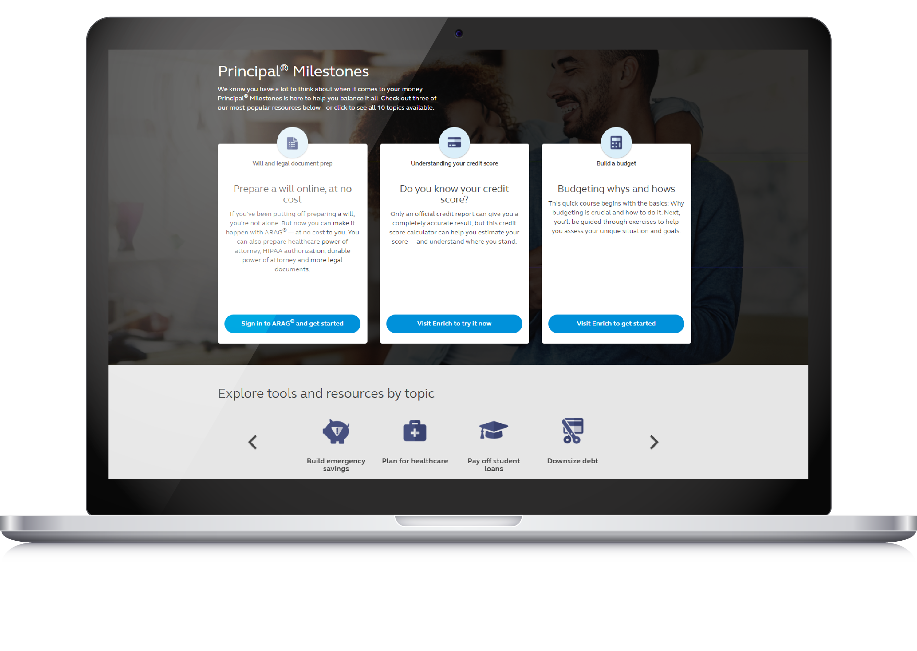
Principal® Milestones
Get started at principal.com/Milestones
Notes:
We understand it can be difficult to save for retirement with daily bills to pay, emergency repairs to make, and more. It can be easy to focus on the short term and lose sight of long-term goals. Principal® Milestones can help you prioritize your goals with your expenses so you can work toward financial security now and in the future.
Principal has teamed with experts at Enrich and ARAG to bring holistic financial wellness resources to you at no cost. Through Principal.com/Milestones you can prepare a will or other legal documents, create a household budget, compare student loan repayment options, take a course about health care benefits, learn how to pay down debt, and more.
Milestones is a helpful resource for everyone, no matter your life stage or your financial situation.

Slide 17
Thank you
17

Slide 18
Important information
The subject matter in this communication is educational only and provided with the understanding that Principal® is not rendering legal, accounting, investment or tax advice. You should consult with appropriate counsel, financial professionals, and other advisors on all matters pertaining to legal, tax, investment or accounting obligations and requirements. The value-added resources provided through ARAG Services, LLC (ARAG®) and iGrad, Inc. (Enrich®) are not a part of any insurance products and plan administrative services provided through Principal Life Insurance Co or affiliated with any company of the Principal Financial Group®. All resources may be changed or canceled at any time. The use of resources provided by ARAG Services, LLC or Enrich should not be considered a substitute for consultation with an attorney or advisor. Principal® is not responsible for any loss, injury, claim, liability, or damages related to the use of the ARAG Will & Legal Document Center or Enrich resources.
Please remember that the ARAG legal documents, DIY Docs® are accurate and useful in many situations. Due to possible changes by state, it is a good idea to periodically review a template used to be sure it is the most current template. Whether or not the document is right for you and your situation depends on your circumstances. If you want specific advice regarding your situation, consult an attorney.
Information is intended to be educational in nature and is not intended to be taken as a recommendation.
Insurance products and plan administrative services provided through Principal Life Insurance Company®., a member of the Principal Financial Group®, Des Moines, Iowa 50392.
Principal®, Principal Financial Group®, and Principal and the logomark design are registered trademarks of Principal Financial Services, Inc., a Principal Financial Group company, in the United States and are trademarks and service marks of Principal Financial Services, Inc., in various countries around the world.
© 2023 Principal Financial Services, Inc.
PD439-12 | 2860620-042023

