Slide 1
Principal® Deferred Compensation - Defined Contribution
Keeping your business strong and key employees motivated
PRESENTER NAME (ALL CAPS)
The presenter’s title goes on this line
Notes:
[ Welcome attendees and introduce yourself. ]

Slide 2
What’s a deferred comp plan?
It’s much simpler than you may think. A deferred compensation - defined contribution plan is an employer-sponsored benefit for the key employees you choose. It’s basically an agreement between you and your key employees.
Those who participate defer a portion of their annual compensation into the plan before taxes. And you promise to distribute that money, plus any earnings and additional employer contributions, to them at a future time.
Notes:
Read slide

Slide 3
Keep your key employees satisfied
What can you do now to help ensure your top talent remains committed to you—and not the competition? Enhance your benefits package with a deferred comp plan. It can give you a competitive advantage by:
Encouraging the best employees to join your organization as it grows.
Keeping your key employees satisfied and motivated for the long term.
Rewarding them for reaching goals.
Helping employees bridge the retirement gap resulting from 401(k) plan testing and limitations.
Notes:
Read slide

Slide 4
Helping you choose a plan to fit your needs
Discover. Identify the issues your organization wants to resolve and what you want to achieve.
Solve. Learn how this plan can help solve your business challenges and achieve your objectives.
Design. Use the plan’s flexibility to tailor a plan to your organization’s and participants' needs.
Collaborate. Trust the service and expertise we’ll provide to you and your key employees every step of the way, year after year.
Stay current. Make changes to your plan as your organization’s needs and goals change.
Notes:
Read slide

Slide 5
Findings in today’s market* From plan sponsors with existing deferred comp plans
77% concerned about losing key employees
94% concerned about attracting key employees
Primary reason for employer contributions: Retention
Use of plan:
59% recruiting
66% retention
*2022 Trends in Nonqualified Deferred Compensation, conducted by Principal.
Notes:
Read slide

Slide 6
Discover
Identify issues your organization wants to resolve and what you want to achieve
Notes:
Read slide

Slide 7
What are your organization’s goals?
Recruit
Attract the best employees as part of a competitive benefits package.
Retain
Encourage key employees to remain loyal to your organization.
Reward
Provide performance-based contributions to achieve organizational goals.
Ownership experience
Create phantom shares to provide an ownership experience without the dilution that comes from actual equity grants.
Retire
Help your key employees save enough for retirement above what 401(k) plans allow.
Notes:
Read slide

Slide 8
What are your key employees’ goals?
Retirement savings
Save beyond 401(k) plan limitations with employee deferrals or optional employer contributions.
Other savings goals
Control timing of payouts to meet other savings goals before or after retirement, such as college education or second home.
Managing taxes
Help manage the impact of taxes using the plan's flexibility for when benefits are paid.
401(k) restoration
Use employee deferrals or employer contributions from deferred comp to restore benefits limited under a 401(k) plan.
Notes:
Read slide

Slide 9
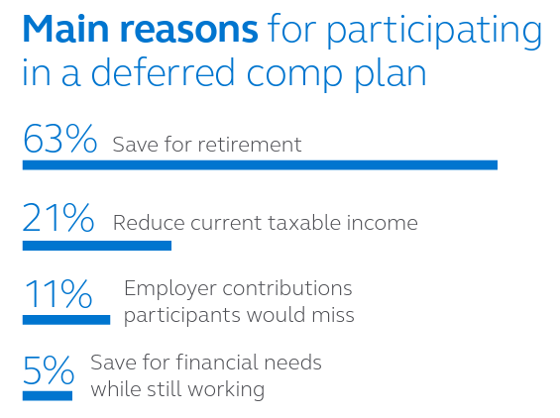
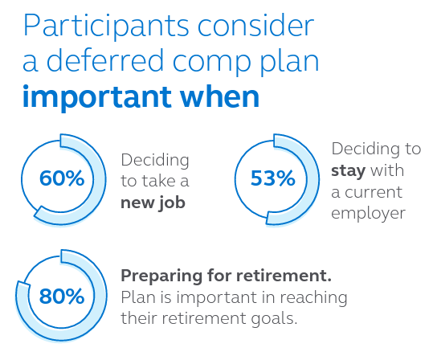
Why participants consider deferred comp important
* 2022 Trends in Nonqualified Deferred Compensation, conducted by Principal.
Notes:
Read slide

Slide 10
Solve
Learn how this plan can help solve your business challenges and achieve your objectives
Notes:
Read slide

Slide 11
Is it right for your key employees?
Benefits for your key employees:
Pre-tax deferrals, tax-deferred growth, and compounded earnings.
Defer up to 100% of compensation to meet savings goals.*
Design a personalized investment strategy.
Enjoy flexibility and take payouts from the plan without the same age restrictions as 401(k) plans.
* Employees can defer up to 100% of compensation, but plan sponsors typically permit deferrals of less than 100% due to other payroll deductions, such as FICA taxes and health insurance.
Notes:
Once you’ve identified the most important goals, then consider the role that a deferred comp plan can play in helping achieve those goals. The plan offers benefits and considerations for both the organization and the key employees.
Read slide

Slide 12
Is it right for your key employees?
Considerations for your key employees:
No rollovers or loans like qualified retirement plans.
Compensation deferred into the plan isn’t protected in the event of company bankruptcy.
The decision to defer compensation must be made the year ahead of earning the income.
Notes:
Read slide

Slide 13
Is it right for you?
Benefits for you:
Make optional company contributions.
Restore 401(k) plan contributions limited by IRS testing.
Easier to administer with no discrimination testing, minimum participation or Form 5500 filing, if set up properly.
Notes:
Read slide

Slide 14
Is it right for you?
Considerations for you:
The corporate tax deduction is deferred until benefits are paid, rather than a current deduction.
There’s a potential charge to earnings on assets purchased to finance the plan.
Notes:
Read slide

Slide 15
Design
Use the plan’s flexibility to tailor a plan to help meet your organization’s and participants’ needs
Notes:
Read slide

Slide 16
How’s the plan created?
Who participates
Select the groups of key employees to participate in this plan.
What can be contributed
You can allow key employee deferrals (up to 100% of comp*) and/or provide employer contributions with the flexibility to vary benefits by employees.
What happens with the contributions
You can select an investment line-up for participants from a broad range of options. In addition, you can decide how and when key employees may receive the benefits based on organizational needs.
How benefits are paid
Decide how payouts can be received from the plan. Benefits can be distributed as a lump sum or in annual installments.
* Employees can defer up to 100% of compensation, but plan sponsors typically permit deferrals of less than 100% due to other payroll deductions, such as FICA taxes and health insurance.
Notes:
You're in control of making the plan yours – it’s based on the specific goals of your organization and unique needs of your key employees. Together with your financial professional, we’ll walk you through the decisions that need to be made to design a plan that makes sense for your organization:
Read the slide

Slide 17
Design
How it works
Contributes to deferred comp plan (pre-tax)
Reach savings goals
Makes optional contribution for the employee
Deferred comp plan
Notes:
This chart shows how money is contributed to the deferred comp plan and paid out at a later date. It also points out that when the benefit is distributed to the key employee, the employer receives an income-tax deduction and the key employee pays income tax on it.

Slide 18
How does an organization pay for it?
Company cash
Taxable investments
Corporate-owned life insurance
No specific plan assets are set aside. Instead, benefits are paid through company's cash flow.
The company invests in mutual funds and/or individual securities.
The company purchases a policy to pay future obligations.
Notes:
Keeping your promise to pay benefits to participants in the future is important. Any one of these three (or combination of) financing options can help you do that. Plus, we’ll provide a detailed financial model comparing the options to help you make this decision.
Read slide

Slide 19
Collaborate
Trust the service and expertise we’ll provide to you and your key employees every step of the way, year after year
Notes:
Read slide

Slide 20
How do we work with your organization?
Our team of professionals will work closely with you and your financial professional to develop a strategy for implementing and servicing your deferred comp plan.
But we don’t stop there. Year after year, we’ll continue to work closely with you and your financial professional to fine-tune your plan to ensure your organization's goals are met—and your plan is administered as efficiently as possible.
Notes:
Read slide

Slide 21
Keeping you in-the-know
To help you stay on top of your plan, a range of information is available on our website and corporate accounting reports. You also have easy access to plan reporting, investment resources, and other tools to assist with administering your plan. Plus, depending on plan type and design, you’ll receive:
Access to plan participants’ account information.
Daily valuation of assets/liabilities.
Asset/liability information and rebalancing services.
Financing reviews to assess plan performance.
Updates on enrollment progress.
Quarterly newsletter featuring legislative news, service updates, and more.
Notes:
To help you stay on top of your plan, a range of information is available on our website and corporate accounting reports. You also have easy access to plan asset and liability reporting, investment resources and other tools to assist with administering your plan. Plus, depending on your plan type and design, you’ll receive:
Read slide

Slide 22
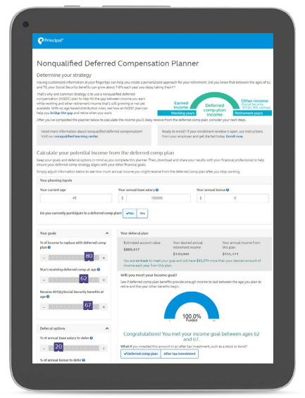
Turning key employees into participants
We’re here to help every step of the way:
Step 1: Introduce the plan. We provide custom education to introduce the plan.
Step 2: Enrollment. Participants can enroll online and our deferred comp professionals are available to answer questions Monday-Friday.
Step 3: Ongoing education and planning. We help your participants stay on track through communication and education, plus plan information online.
Notes:
Understanding the benefits of this exclusive plan is the first step – it’s what will encourage your key employees to participate. We're here to help every step of the way:
Step 1: Introduce the plan
Whether this is a brand-new benefit or employees are familiar with this type of plan, we offer award-winning* custom education to introduce plan basics. We'll help
you make sure your employees are aware they are eligible so they can make an informed decision to participate.
Step 2: Enrollment
Participants can conveniently enroll online at principal.com. Our deferred compensation plan specialists are available to answer questions Monday-Friday.
Step 3: Ongoing education and planning
Your participants need support to stay on track. We can also provide you with additional communication and education to promote greater understanding and appreciation of the benefit. Participants can find information about their accounts, investment strategy, contributions and scheduled distributions at principal.com.

Slide 23
Stay Current
Make changes to your plan as your organization’s needs and goals change
Notes:
Read slide

Slide 24
How does your plan keep up with your needs & goals?
Close attention to the plan over time, such as a participant’s account balance from the beginning of the plan until payout.
Experienced specialists who offer feedback on factors that can influence the plan, such as plan design changes and regulatory updates.
Analytical tools and resources are available for new and existing plans—all while watching out for your bottom line.
Financial health dashboard helps ensure the plan’s financing continues to meet your goals.
Annual service reviews to discuss how the plan is doing.
Experience reviews provide information about the plan’s benefit experience, as well as the experience of the assets supporting those benefits.
Notes:
The deferred comp plan is your plan. Its long-term success depends on how well it keeps pace with your organization’s needs and goals -- today and tomorrow. So once your plan is in place, we’ll make sure to provide:
Read slide

Slide 25
Ready to get started?
Once you decide that a deferred comp plan is right for your organization and key employees, we’ll bring our expertise and resources to the table to help you put this plan in place within your desired timing.
We’ll begin by:
Gathering information about your organization.
Tailoring the plan to your specific needs and goals.
Thousands of employers value the solutions and services we provide. You can count on us, too. We’ll do our best to deliver a positive experience for everyone involved.
Notes:
Read slide

Slide 26
An industry leader in your corner
Our history speaks for itself. We’ve been providing deferred comp plans for more than 34 years and are the No. 1 provider of deferred comp plans*. What sets us apart from others is our:
Commitment to and experience in the business and retirement plan markets.
Unique plan design and flexibility to tailor it to specific needs and goals.
Specialized team of legal, accounting, and financing resources with more than 200 years of experience to provide support.
Service and commitment to building long-lasting relationships.
* Based on number of NQDC plans (excluding 457 plans), PLANSPONSOR Recordkeeping Survey, July 2022.
Notes:
Our history speaks for itself. We’ve been providing nonqualified deferred compensation plans for more than 34 years, and the No. 1 provider of deferred comp plans.
What sets us apart from others is our:
Commitment to and experience in the business and retirement plan markets.
Unique plan design and flexibility to tailor it to specific needs and goals.
Specialized team of legal, accounting and financing resources with more than 200 years of experience to provide support.
Service and commitment to building long-lasting relationships.
A member of the FORTUNE 500®, our employees are passionate about helping clients of all income and portfolio sizes achieve their goals. You can count on us to offer innovative ideas, investment expertise and real-life solutions to help make financial progress possible.
* Based on number of NQDC plans (excluding 457 plans), PLANSPONSOR Recordkeeping Survey, July 2022.

Slide 27
Thank you
Notes:
Read slide

Slide 28
Before investing, carefully consider the investment option objectives, risks, charges, and expenses. Contact a financial professional or visit principal.com for a prospectus or, if available, a summary prospectus containing this and other information. Please read it carefully before investing.
The subject matter in this communication is educational only and provided with the understanding that Principal® is not rendering legal, accounting, investment, or tax advice. You should consult with appropriate counsel, financial professionals, and other advisors on all matters pertaining to legal, tax, investment, or accounting obligations and requirements.
Insurance products issued by Principal National Life Insurance Company (except in NY) and Principal Life Insurance Company®. Plan administrative services provided through Principal Life Insurance Company®. Principal Funds, Inc. is distributed by Principal Funds Distributor, Inc. Securities offered through Principal Securities, Inc., member SIPC and/or independent broker/dealers. Referenced companies are members of the Principal Financial Group®, Des Moines, IA 50392.
No part of this presentation may be reproduced or used in any form or by any means, electronic or mechanical, including photocopying or recording, or by any information storage and retrieval system, without prior written permission from the Principal Financial Group.
Principal®, Principal Financial Group®, and Principal and the logomark design are registered trademarks of Principal Financial Services, Inc., a Principal Financial Group company, in the United States and are trademarks and service marks of Principal Financial Services, Inc., in various countries around the world.
For Registered Representative Information only. Not for use with the general public.
BB11548-05 | 07/2023 | 2996020-072023 | Copyright © 2023 Principal Financial Services, Inc.
Notes:
Read the slide

